Slide 1
IE 563 Experimental Design in Engineering
Dr. Erin Gerber, P.E.
Department of Industrial Engineering
University of Louisville

Slide 2
Chapter 4 Randomized Block Designs

Slide 3
The Blocking Principle
Blocking is a technique for dealing with nuisance factors
A nuisance factor is a factor that probably has some effect on the response, but it’s of no interest to the experimenter…however, the variability it transmits to the response needs to be minimized
Typical nuisance factors include batches of raw material, operators, pieces of test equipment, time (shifts, days, etc.), different experimental units
Many industrial experiments involve blocking (or should)
Block out known source of variation (e.g. boy’s shoe example)

Slide 4
The Blocking Principle
Most common design: randomized complete block design (RCBD)
Complete means each block contains all factor levels
Randomized within each block, not between blocks
Variability between blocks can be large, variability within a block is usually relatively small
In general, a block is a specific level of the nuisance factor
A complete replicate of the basic experiment is conducted in each block
A block represents a restriction on randomization
All runs within a block are randomized

Slide 5
Heart Rate Reduction Example
Evaluate the effect of a drug dosage for inducing a temporary reduction in a patient’s heart rate
Administer 3 dosages of the drug (low, medium, high) to 8 patients
Response? Factor? # Factor Levels? # Replicates?

Slide 6
Heart Rate Reduction Example
The patients are a source of nuisance variability
The need for blocking – block out variation among patients – concentrate on variance among drug dosages
To conduct this experiment as a RCBD, assign all 3 drug dosages to each patient
Each patient is called a “block”; that is, it’s a more homogenous experimental unit on which to test the drug dosage
All runs within a block are randomized

Slide 7
Wheat Example
Evaluate the effect of wheat type on crop yield (in bushels)
Plant all 4 wheat types on each of 5 fields available for use
Response? Factor? # Factor Levels? # Replicates?

Slide 8
Wheat Example
The fields are a source of nuisance variability
The need for blocking – block out variation among fields – concentrate on variance among wheat types
To conduct this experiment as a RCBD, assign all 4 wheat types to each field
Each field is called a “block”
All runs within a block are randomized

Slide 9
Randomized Block Designs
If we used the single factor ANOVA technique discussed in Chpt.3, the error term would reflect both the random error and the known source of variability (variability between patients or fields)
We want the error term to include only the random error – we want to remove/separate the known source of variability from the random error
Use randomized complete block design (RCBD)
Complete means each block contains all factor levels
RCBD improves the accuracy of the comparison between factor levels (drug dosage or wheat types) by eliminating known source of variability (patients or fields)

Slide 10
Randomized Complete Block Design
a factor levels b blocks

Slide 11
Randomized Complete Block Design
The RCBD statistical model is
y_{ij} = ij^{th} observation (factor level i, block j). A random variable.
μ = the overall mean common to all factor levels.
τ_{i} = the i^{th} factor level effect.
β_{j} = the j^{th} block effect.
ε_{ij} = random error. A random variable. ε_{ij}~ NID(0, σ²)

Slide 12
Randomized Complete Block Design
Total variability can be partitioned into its components
SS_{Total} = SS_{Factor} + SS_{block} + SS_{Error}

Slide 13
Randomized Complete Block Design
Source of Variation | SS | df | MS | F
Factor | SS_{Factor} | a-1 | MS_{Factor}
Block | SS_{block} | b-1 | MS_{block}
Error | SS_{Error} | (a-1)(b-1) | MS_{Error}
Total | SS_{Total} | N-1
H₀: μ₁ = μ₂ = … = μ_{a}
H₁: μ_{i} ≠ μ_{j} for at least one pair of factor levels (i,j)
Reject H₀ when

Slide 14
Randomized Complete Block Design
Factor has significant effect on response if
Although not a true F test, we often conclude blocking was necessary (i.e. significant variation between blocks) if

Slide 15
Heart Rate Reduction Example
a = 3 b = 8
Totals for each Factor level (dosage)
Totals for each block (patient)
Grand Total

Slide 16
The Heart Rate Reduction Example

Slide 17
Heart Rate Reduction Example
Source of Variation | SS | df | MS | F
Dosage | 511.41 | 2 | 255.71 | 10.98
Patient | 724.68 | 7 | 103.53
Error | 325.96 | 14 | 23.28
Total | 1562.05 | 23
H₀: μ_{low} = μ_{medium} = μ_{high}
Does drug dosage affect heart rate? F_{0.01,2,14} = 6.51
Was blocking necessary?
MS_{block}/MS_{E} = 4.45 F_{0.01,7,14} = 4.28
P-value for block?

Slide 18
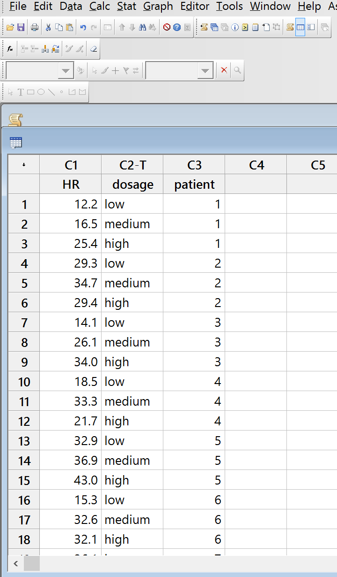
Randomized Complete Block Design
In Minitab
Enter data in 3 columns
response
factor levels
blocks

Slide 19
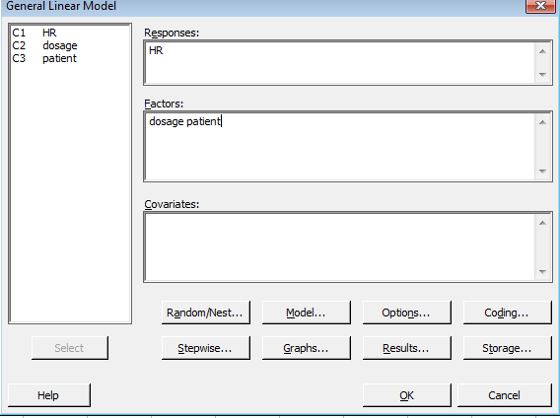
Randomized Complete Block Design
Stat
ANOVA
GLM
Model: factor and block

Slide 20
Heart Rate Reduction Example
General Linear Model: HR versus dosage, patient
Method
Factor coding (-1, 0, +1)
Factor Information
Factor Type Levels Values
dosage Fixed 3 high, low, medium
patient Fixed 8 1, 2, 3, 4, 5, 6, 7, 8
Analysis of Variance
Source DF Adj SS Adj MS F-Value P-Value
dosage 2 511.4 255.71 10.98 0.001
patient 7 724.7 103.53 4.45 0.009
Error 14 326.0 23.28
Total 23 1562.1
H₀: μ_{low} = μ_{medium} = μ_{high}
Does drug affect heart rate?
Was blocking necessary?

Slide 21
Wheat Example
General Linear Model: Crop Yield versus Wheat Type, Field
Method
Factor coding (-1, 0, +1)
Factor Information
Factor Type Levels Values
Wheat Type Fixed 4 1, 2, 3, 4
Field Fixed 5 1, 2, 3, 4, 5
Analysis of Variance
Source DF Adj SS Adj MS F-Value P-Value
Wheat Type 3 178.9 59.62 0.52 0.677
Field 4 5274.2 1318.55 11.50 0.000
Error 12 1376.4 114.70
Total 19 6829.5
H₀: μ₁ = μ₂ = μ₃ = μ₄
Does wheat type affect crop yield?
Was blocking necessary?

Slide 22
RCBD: Residual Analysis
Remember:
Residual is difference between actual observation and estimated observation
Calculation of estimated observation depends on model
Remember Linear Statistical Model for RCBD

Slide 23
RCBD: Residual Analysis
Estimate the RCBD Linear Statistical Model parameters
Estimated observation for RCBD (used to find residuals)

Slide 24
Heart Rate Reduction Example

Slide 25
Wheat Example

Slide 26
RCBD: Comparison Among Factor Level Means
Do Tukey test in Minitab for comparison among factor levels (not blocks)
Do Tukey test (comparison among factor level means) for wheat example?
Do Tukey test (comparison among factor level means) for heart rate example?

Slide 27
Heart Rate Reduction Example
Dosage | Average HR
High | 32.20
Medium | 29.70
Low | 21.40
What dosage to use to
maximize heart rate
reduction?
Tukey Pairwise Comparisons: Response = HR, Term = dosage
Grouping Information Using the Tukey Method and 95% Confidence
dosage N Mean Grouping
high 8 32.2 A
medium 8 29.7 A
low 8 21.4 B
Means that do not share a letter are significantly different.
Tukey Simultaneous Tests for Differences of Means
Difference of Difference SE of Simultaneous Adjusted
dosage Levels of Means Difference 95% CI T-Value P-Value
low - high -10.80 2.41 (-17.11, -4.49) -4.48 0.001
medium - high -2.50 2.41 ( -8.81, 3.81) -1.04 0.567
medium - low 8.30 2.41 ( 1.99, 14.61) 3.44 0.010
Individual confidence level = 97.97%

Slide 28
Heart Rate Reduction Example
Avg. HR reduction for High and Medium dosages not significantly different
Choose either medium or high dosage to maximize % reduction in HR

Slide 29
Wheat Example
From ANOVA – wheat type not significant
No difference among wheat types in terms of mean crop yield
To choose a preferred wheat type (factor level) when factor not significant: plot residual vs wheat type (factor) to compare residual variability among treatments – choose factor level with minimum residual variability

Slide 30
Wheat Example

Slide 31
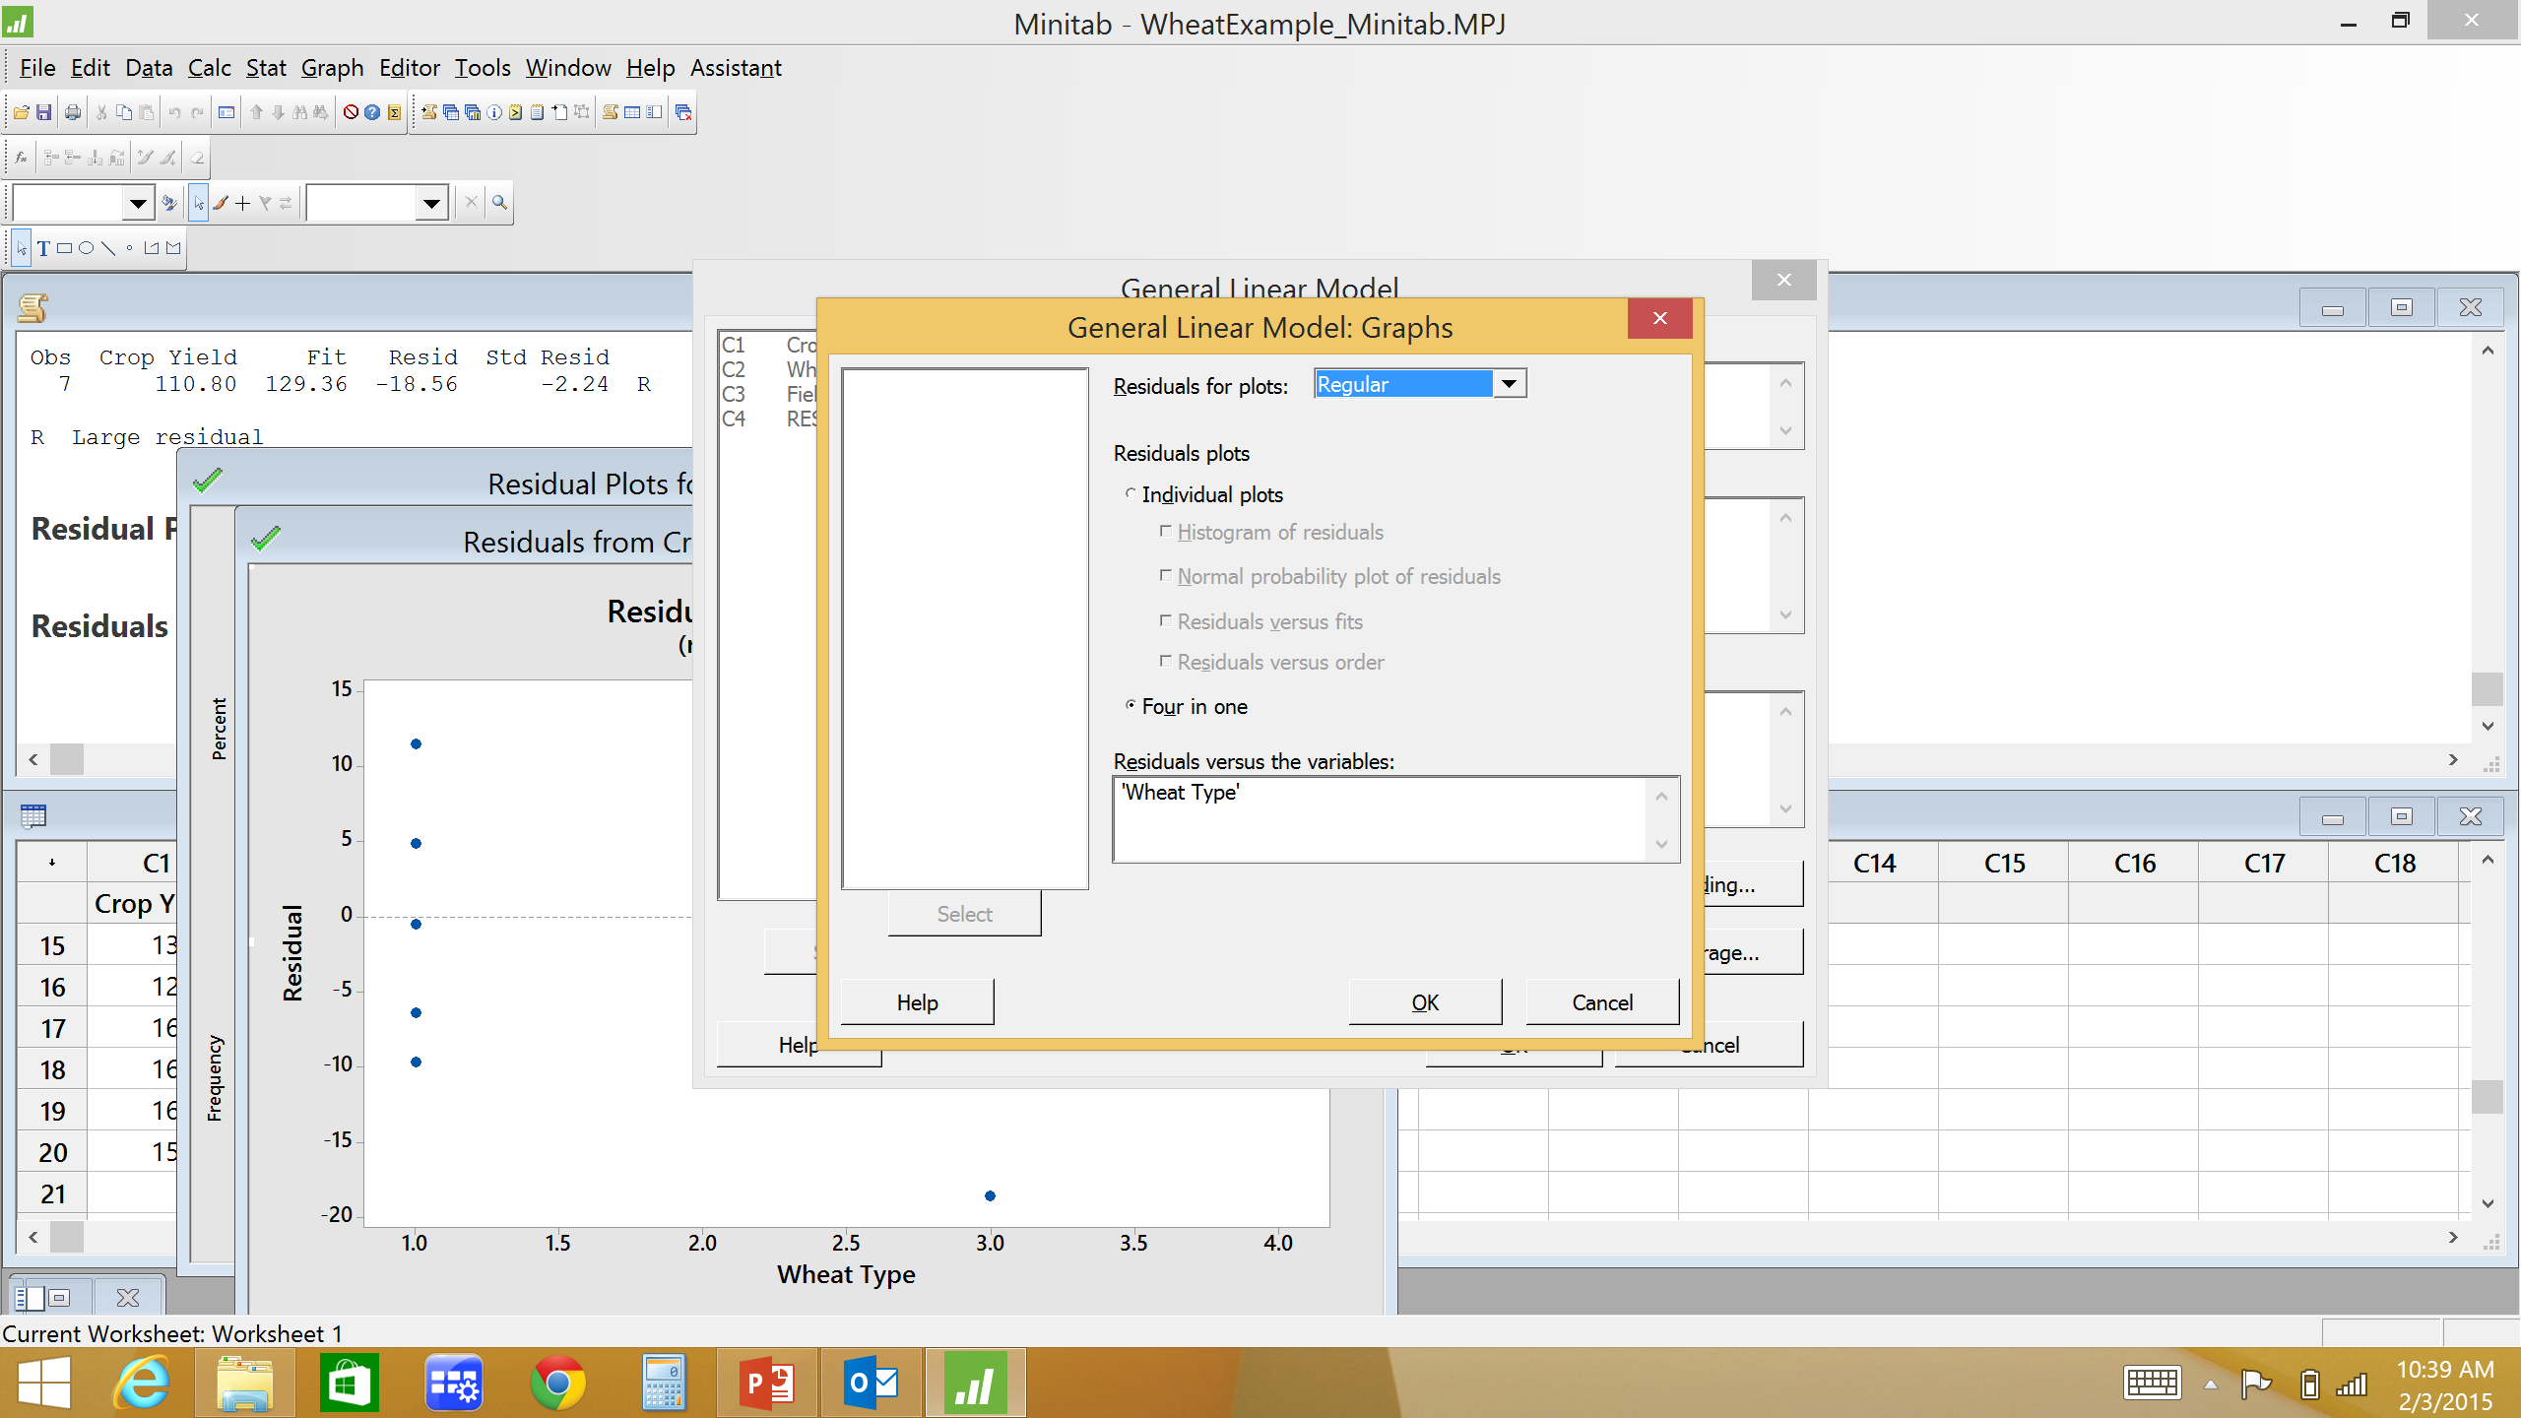
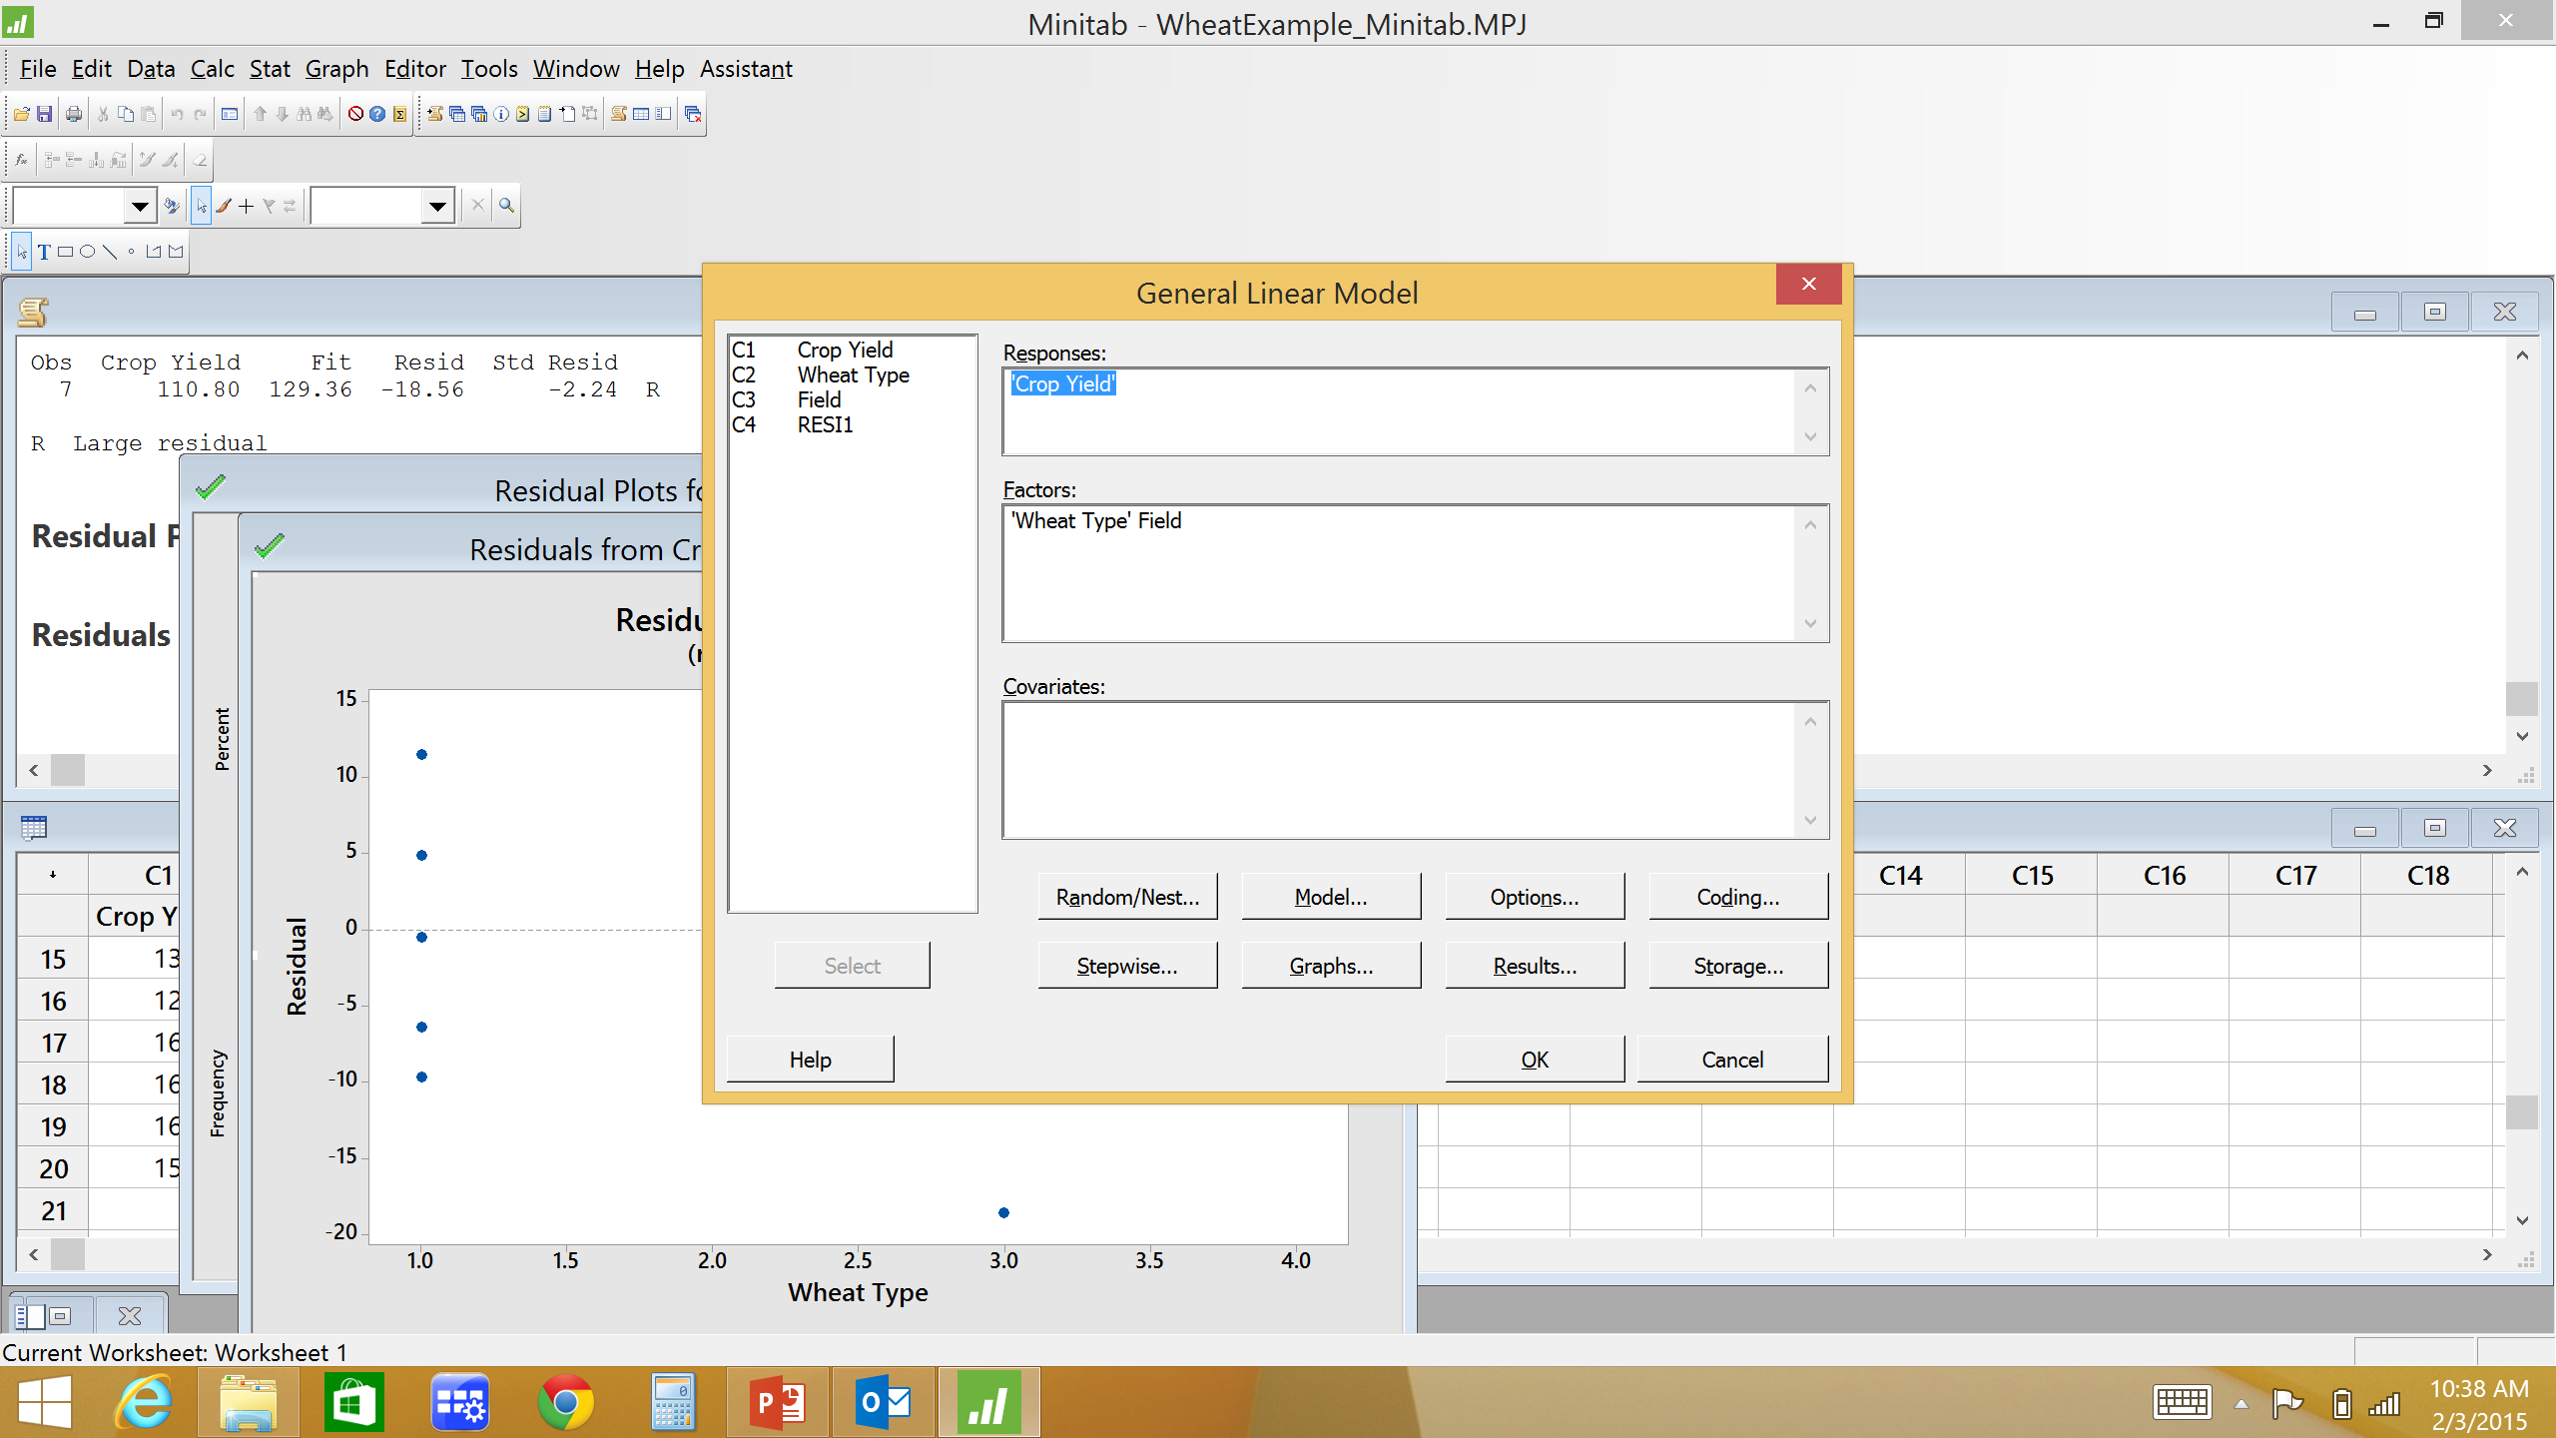
Residual vs Factor Plot in Minitab
In ANOVA GLM menu
Graphs
Residuals versus the variables

Slide 32
RCB Design
One factor of interest and one nuisance factor (not of interest, but we need to separate from random error)
A significant assumption is that the two terms(factor & block) do not interact
If this assumption is violated, the RCB design will not produce valid results (use factorial design – chpt 5)

Slide 33
Chapter 5 Factorial Designs

Slide 34
Factorial Designs
Until now we have only considered 1 factor
Now we will consider multiple factors and their interactions
Factorial Design: each complete replicate of the experiment contains responses at all possible combinations of factor levels
Factor A has a levels; Factor B has b levels; ab combinations
Example: study effect of speed and feed rates on tool life.
Consider 2 speed rates and 4 feed rates. Therefore each replicate of the experiment contains responses at the 8 different combinations of speed and feed

Slide 35
Factorial Designs
Consider the effect of 2 or more factors
Main Effects – primary factors of interest
Interactions – difference in response between levels of one factor is not same at all levels of other factor. Effect of a factor depends on level of another factor.
Effect of a factor is the change in response produced by a change in the factor level.
Example: consider a 2 factor experiment (Factors A and B) each with 2 levels (low(-) and high(+)). Consider the following responses for 1 replicate.

Slide 36
Factorial Designs
Factor effect: The change in the mean response when the factor is changed from low to high level
Changing from A- to A+ increases average response by 21 units
Magnitude of the effect indicates significance of factor

Slide 37
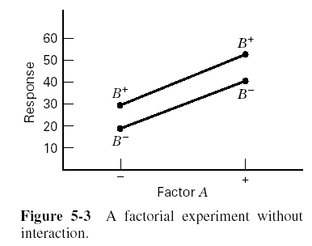
Factorial Designs
Significant Interaction: difference in response between levels of one factor is not same at all levels of other factor. Effect of a factor depends on level of another factor.
At A-: Changing from B- to B+ increases average response by 10 units
At A+: Changing from B- to B+ increases average response by 12 units
Therefore, NO significant interaction

Slide 38
Factorial Designs
Consider the effect of 2 or more factors
Main Effects – primary factors of interest
Interactions – difference in response between levels of one factor is not same at all levels of other factor. Effect of a factor depends on level of another factor.
Another Example: consider a 2 factor experiment (Factors A and B) each with 2 levels (low(-) and high(+)). Consider the following responses for 1 replicate.

Slide 39
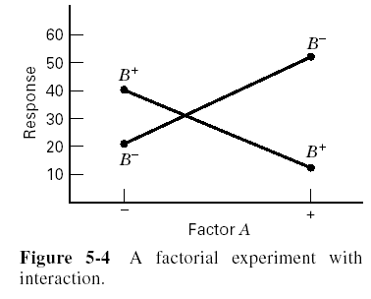
Factorial Designs
Significant Interaction: Effect of a factor depends on level of another factor.
At A-: Changing from B- to B+ increases average response by 20 units
At A+: Changing from B- to B+ decreases average response by 38 units
Therefore, significant interaction

Slide 40
Interactions
Interactions
Interaction Plot: non-parallel lines indicate significant interaction
Indicate effect of one factor is different at different levels of other factor
How does going from B- to B+ affect the response? If significant interaction then it depends on which level of A is being used.
When a significant interaction is present the corresponding main effects have little practical meaning since effect of one factor depends on level of other factor
Evaluate interactions first!

Slide 41
Factorial Designs
Before we discuss how to analyze factorial designs let’s discuss why use factorial designs
Why not use series of OFAT experiments?
One-Factor-At-A-Time (OFAT)
Adjust one variable, hold all others constant
Extremely inefficient method (more trials)
Inefficiency gets worse as number of variables increases
May not properly consider interactions between factors

Slide 42
OFAT Experiments
Simple example: determine effect of factors A and B on response
Each factor has 2 levels
Factor levels coded as + and – to denoted high and low factor levels
A+, A-, B+, B-

Slide 43
OFAT Experiments
Conduct 2 experiments
Experiment 1 to determine the effect of A (hold B constant)
Experiment 2 to determine the effect of B (hold A constant)
Get 2 estimates of each factor effect
Experiment 1
2 estimates of effect of A
Experiment 2
2 estimates of effect of B

Slide 44
OFAT Experiments (cont.)
Disadvantages of OFAT:
Does not properly consider AB interaction
No data collected at A+ B+
Requires more trials than DOE
6 trials used in OFAT
Could get better info in 4 trials using Factorial Design

Slide 45
Factorial Design
Use only 4 trials
Still get 2 estimates of each factor (as with OFAT)
Consider AB interaction

Slide 46
OFAT COSTS YOU $$
“There aren’t any interactions.”
“I’ll investigate that factor next.”
“It’s too early to use statistical methods.”
“A good statistical experiment would be too large.”
“My data are too variable to use statistics.”
“We’ll worry about the statistics after we run the experiment.”
“Let’s just vary one thing at a time so we won’t get confused.”
Haaland, Biotechnology Experiment Design,

Slide 47
Factorial Design
General Two-Factor Factorial Design
Two Factors: A and B
Factor A has a levels
Factor B has b levels
n_{ij} replicates at combination A_{i}B_{j}
For balanced design:
n replicates at each combination of factor levels, A_{i}B_{j}
i.e. n = n_{ij} for all combination of factor levels, A_{i}B_{j}
N = abn total observations (for balanced design)
Y_{ijk} = ijk^{th} observation. Factor A level i, Factor B level j,
replicate k.

Slide 48
General Two-Factor Factorial Design
Linear Statistical Model
Where
Y_{ijk} = ijk^{th} observation. Factor A level i, Factor B level j, replicate k
μ = overall mean
τ_{i} = effect of the i^{th} level of factor A
β_{j} = effect of the j^{th} level of factor B
(τβ)_{ij} = effect of the interaction of τ_{i} and β_{j} (i.e. AB interaction)
ε_{ijk} = random error. Assumed to be NID (0, σ²)

Slide 49
General Two-Factor Factorial Design
Total variability partitioned into components
SS_{Total} = SS_{A} + SS_{B} + SS_{AB} + SS_{Error}

Slide 50
General Two-Factor Factorial Design
Source of Variation | SS | df | MS | F
A | SS_{A} | a-1 | MS_{A}
B | SS_{B} | b-1 | MS_{B}
AB | SS_{AB} | (a-1)(b-1) | MS_{AB}
Error | SS_{Error} | N-ab | MS_{Error}
Total | SS_{Total} | N-1
Main effect of factor A significant if MS_{A}/MS_{Error} > F_{α,a-1,N-ab}
Main effect of factor B significant if MS_{B}/MS_{Error} > F_{α,b-1,N-ab}
AB interaction significant if MS_{AB}/MS_{Error} > F_{α,(a-1)(b-1),N-ab}

Slide 51
General Two-Factor Factorial Design
Through the ANOVA we are conducting 3 hypotheses test:
Hypothesis test for Factor A
H₀: µ_{A1} = µ_{A2} = … = µ_{Aa}
Hypothesis test for Factor B
H₀: µ_{B1} = µ_{B2} = … = µ_{Bb}
Hypothesis test for AB Interaction
H₀: µ_{AB1} = µ_{AB2} = … = µ_{ABab}

Slide 52
General Two-Factor Factorial Design
Cake Baking Example
Do number of eggs and/or brand of cake mix affect cake moisture (ml of H₂0/1000mg cake)?
Response? Factors? # Factor levels? # replicates?
 |  | # eggs
Cake mix | 1 | 1.5 | 2 | Totals
Betty Crocker | 37 16 44 | 55 69 41 | 94 87 75 | 518
Duncan Hines | 11 36 17 | 67 40 25 | 16 21 31 | 264
Pillsbury | 22 43 15 | 28 15 55 | 47 34 62 | 321
Totals | 241 | 395 | 467 | 1103
Balanced design

Slide 53
Two Factor Cake Baking Example
SS_{Error} = 13877 – 3947 - 2962 - 2953 = 4015

Slide 54
Two Factor Cake Baking Example
Source of Variation | SS | df | MS | F
cake mix | 3947 | 2 | 1974 | 8.85
# eggs | 2962 | 2 | 1481 | 6.64
cake mix*# eggs | 2953 | 4 | 738 | 3.31
Error | 4015 | 18 | 223
Total | 13877 | 26
Do brand of cake mix and/or # eggs affect cake moisture?
First check interaction – cake mix * #eggs significant?
F _{0.05,4,18} = 2.93
Then check main effects – cake mix significant? # eggs significant?
F _{0.05,2,18} = 3.55

Slide 55
Factorial Design in Minitab
2 ways to enter data in Minitab
You enter factor levels and responses
Separate columns for each factor
Response in a column
Use Minitab to generate many factorial experimental design/data collection worksheet (random or standard order), you fill in responses

Slide 56
General Two-Factor Factorial Design
Enter data in Minitab worksheet
Separate column for each factor
One column for Response
Enter data in actual run order
Data entered in 3 columns: Response, Factor A levels, Factor B levels

Slide 57
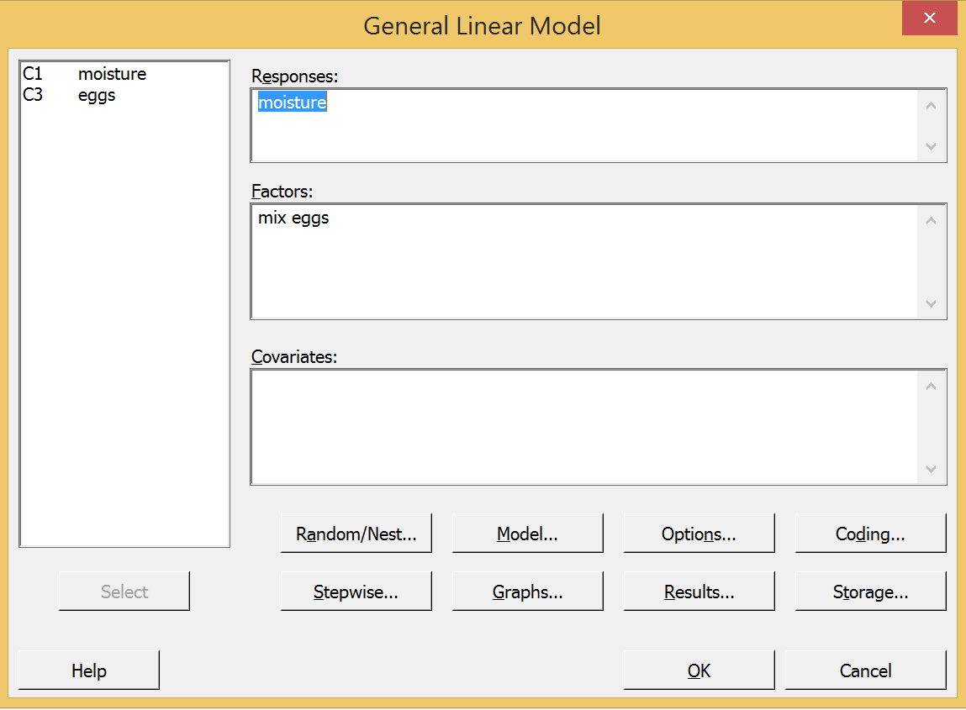
General Two-Factor Factorial Design
Stat
ANOVA
GLM
Fit General Linear Model

Slide 58
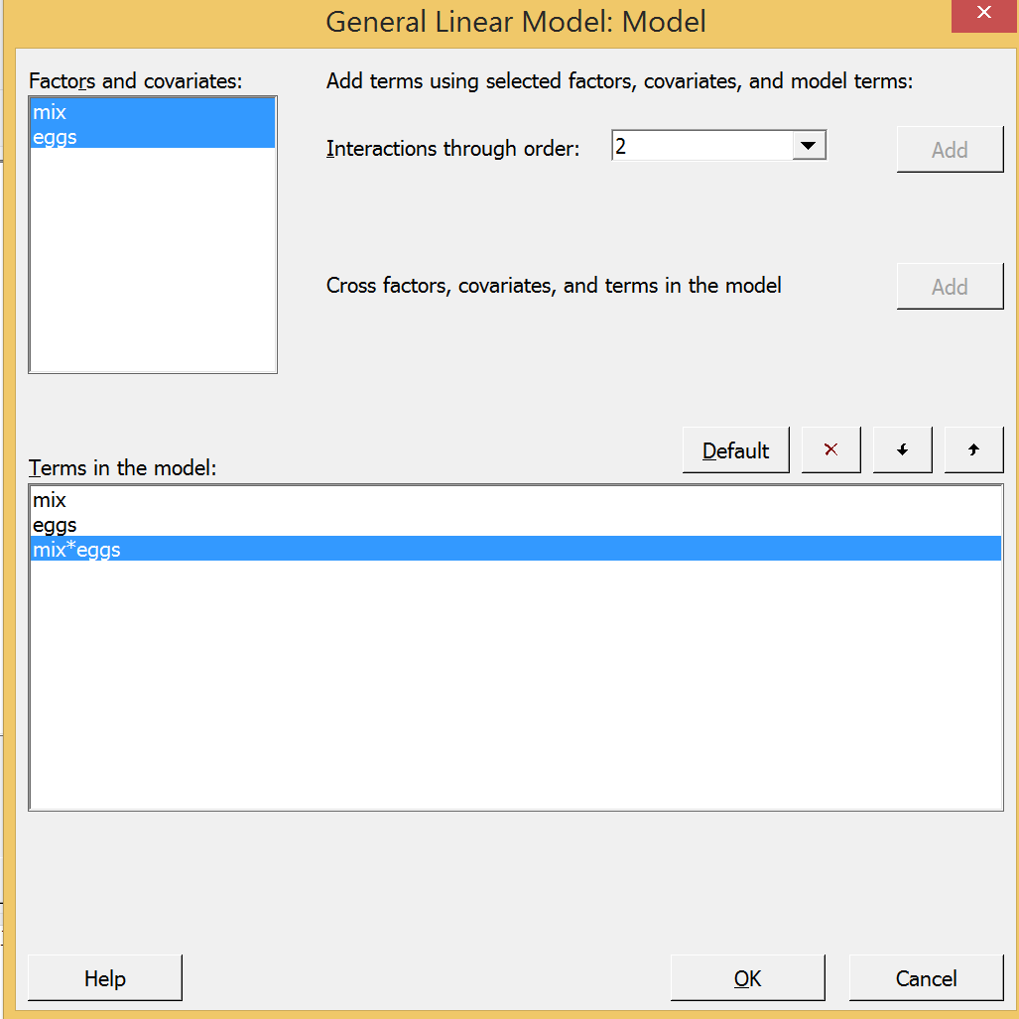
General Two-Factor Factorial Design
Highlight both terms
Select interactions through order 2, (or greater for more terms)
Click “Add”
Mix*eggs term now shows in “Terms in model”

Slide 59
Two Factor Cake Baking Example
General Linear Model: moisture versus mix, eggs
Method
Factor coding (-1, 0, +1)
Factor Information
Factor Type Levels Values
mix Fixed 3 Betty, Duncan, Pilsbury
eggs Fixed 3 1.0, 1.5, 2.0
Analysis of Variance
Source DF Seq SS Contribution Adj SS Adj MS F-Value P-Value
mix 2 3947 28.44% 3947 1973.6 8.85 0.002
eggs 2 2962 21.34% 2962 1481.0 6.64 0.007
mix*eggs 4 2953 21.28% 2953 738.4 3.31 0.034
Error 18 4015 28.93% 4015 223.0
Total 26 13877 100.00%
Do number of eggs and/or brand of cake mix affect cake moisture?

Slide 60
Factorial Designs in Minitab
Minitab can generate many factorial designs which can be used as a data collection sheet and for analysis
Stat
DOE
Factorial
Create Factorial Design
General Full Factorial Design
Enter # of factors
Designs…
Enter # of levels of each factor
Enter # of replicates

Slide 61
Factorial Designs in Minitab
Design shown in randomized order
Enter response in new column (C7) and analyze as before:
Stat
ANOVA
GLM
Enter model

Slide 62
Factorial Designs in Minitab
To generate design in standard order:
After entering the design (# factor levels, # replicates), choose ‘Options…’ in the ‘Create Factorial Design’ menu
Un-check ‘Randomize runs’

Slide 63
Factorial Designs in Minitab
Now design in standard order
Enter response in new column (C7) and analyze as before:
Stat
ANOVA
GLM
Enter model

Slide 64
Two-Factor Factorial Design: Residual Analysis
Need to check ANOVA assumptions
Remember: Residual is difference between actual observation and estimated observation
Calculation of estimated observation depends on model
For Two-Factor Factorial Design

Slide 65
Two Factor Cake Baking Example

Slide 66
Interaction Interpretation
Cake mix * # eggs interaction is significant
What does this mean?
Cake mix and # eggs are significant in specific combinations
Some combinations of cake mix and # eggs lead to significantly different cake moistures than other cake mix and # eggs combinations
The effect of cake mix is not the same for all # eggs
Either:
different cake mixes are moister with different # eggs
OR
All cake mixes are moister with a particular # eggs, but one cake mix has a larger differential in moisture between # eggs
BC
DH cake mix
Pills
moisture
1.5 2
#eggs
BC
DH cake mix
Pills
moisture
1.5 2
#eggs

Slide 67
Interaction and Main Effects Plots
To help interpret results, construct graphs for significant interactions and significant main effects not included in a significant interaction
Average response at each combination of factor levels (interaction plot) or at each factor level (main effects plot)
Which cake mix brand and # eggs to maximize moisture?
Not a statistical comparison

Slide 68
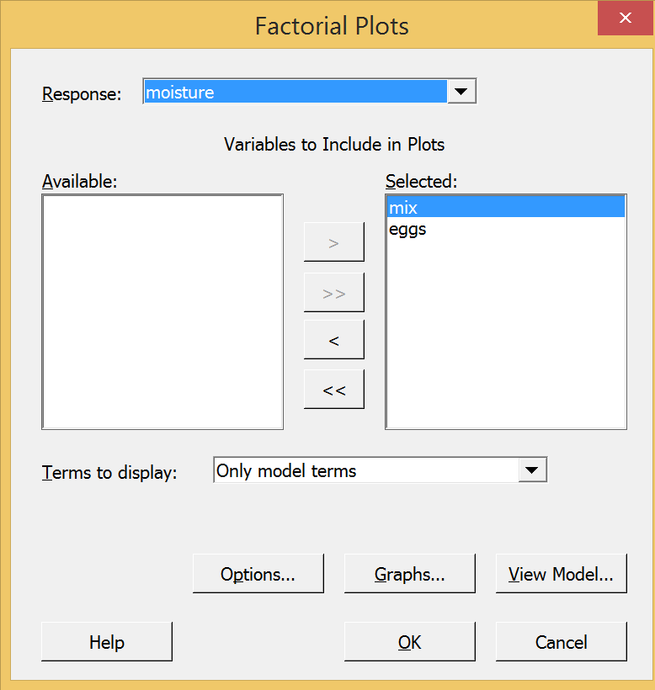
Interaction and Main Effects Plots
In Minitab: Under ANOVA - GLM
Factorial Plots
Only evaluate factor plots of significant interactions and significant main effects not in a significant interaction

Slide 69
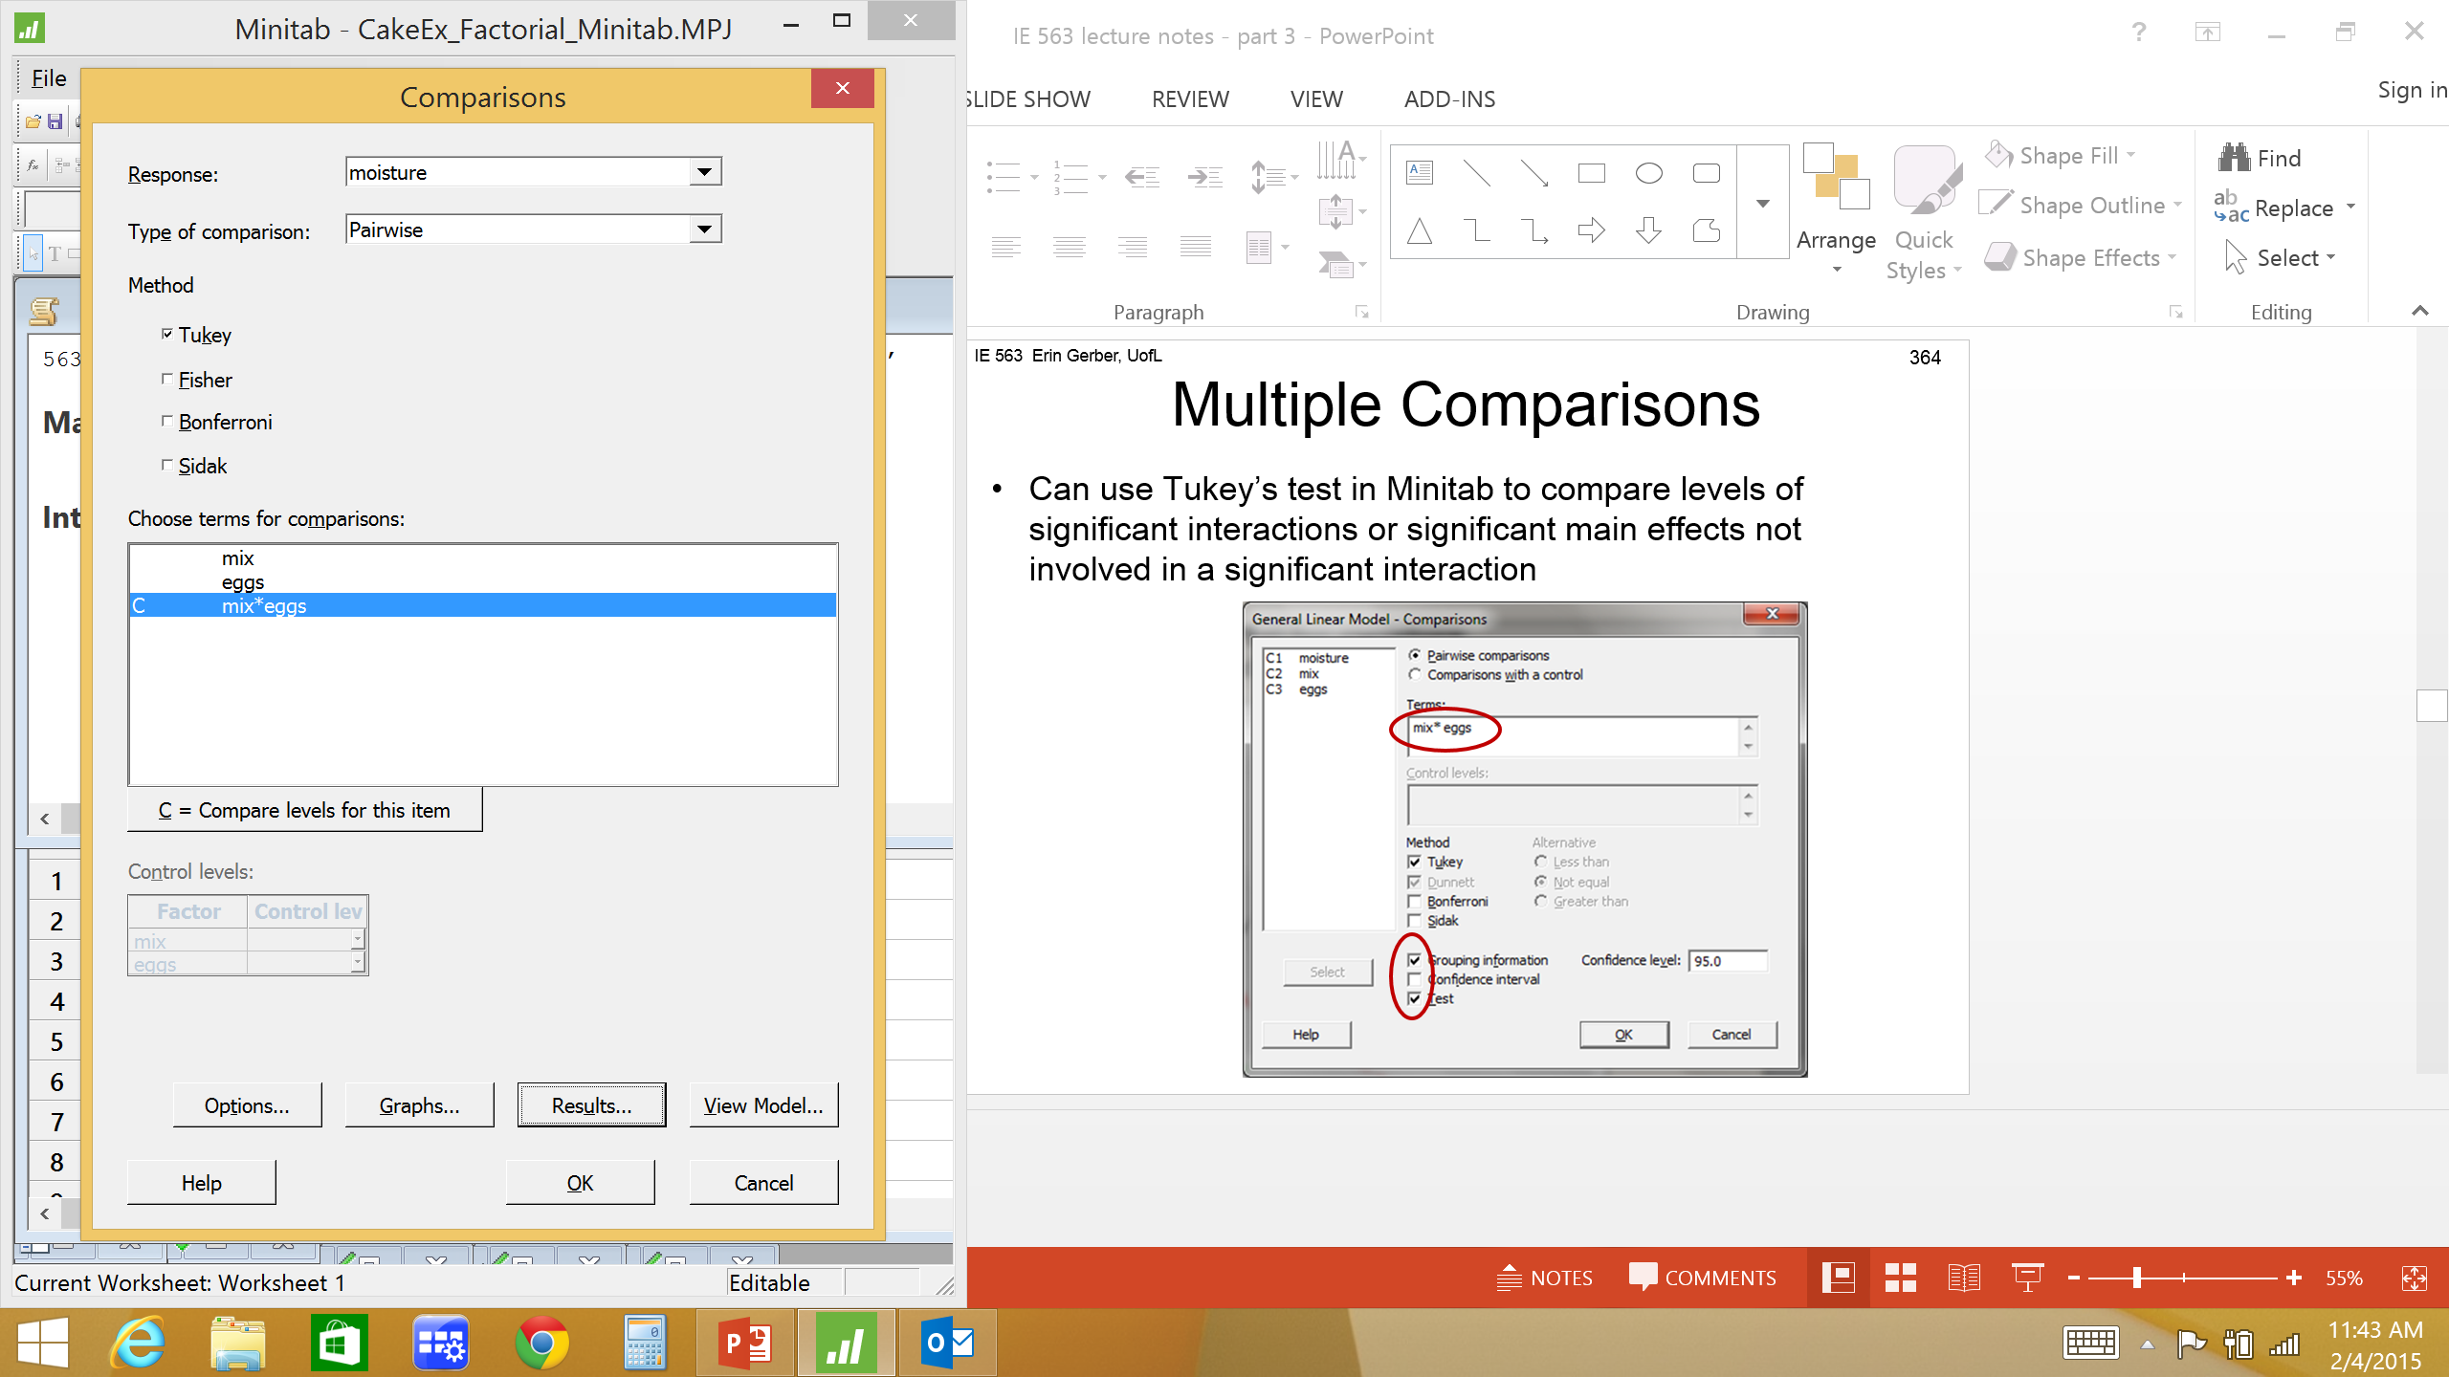
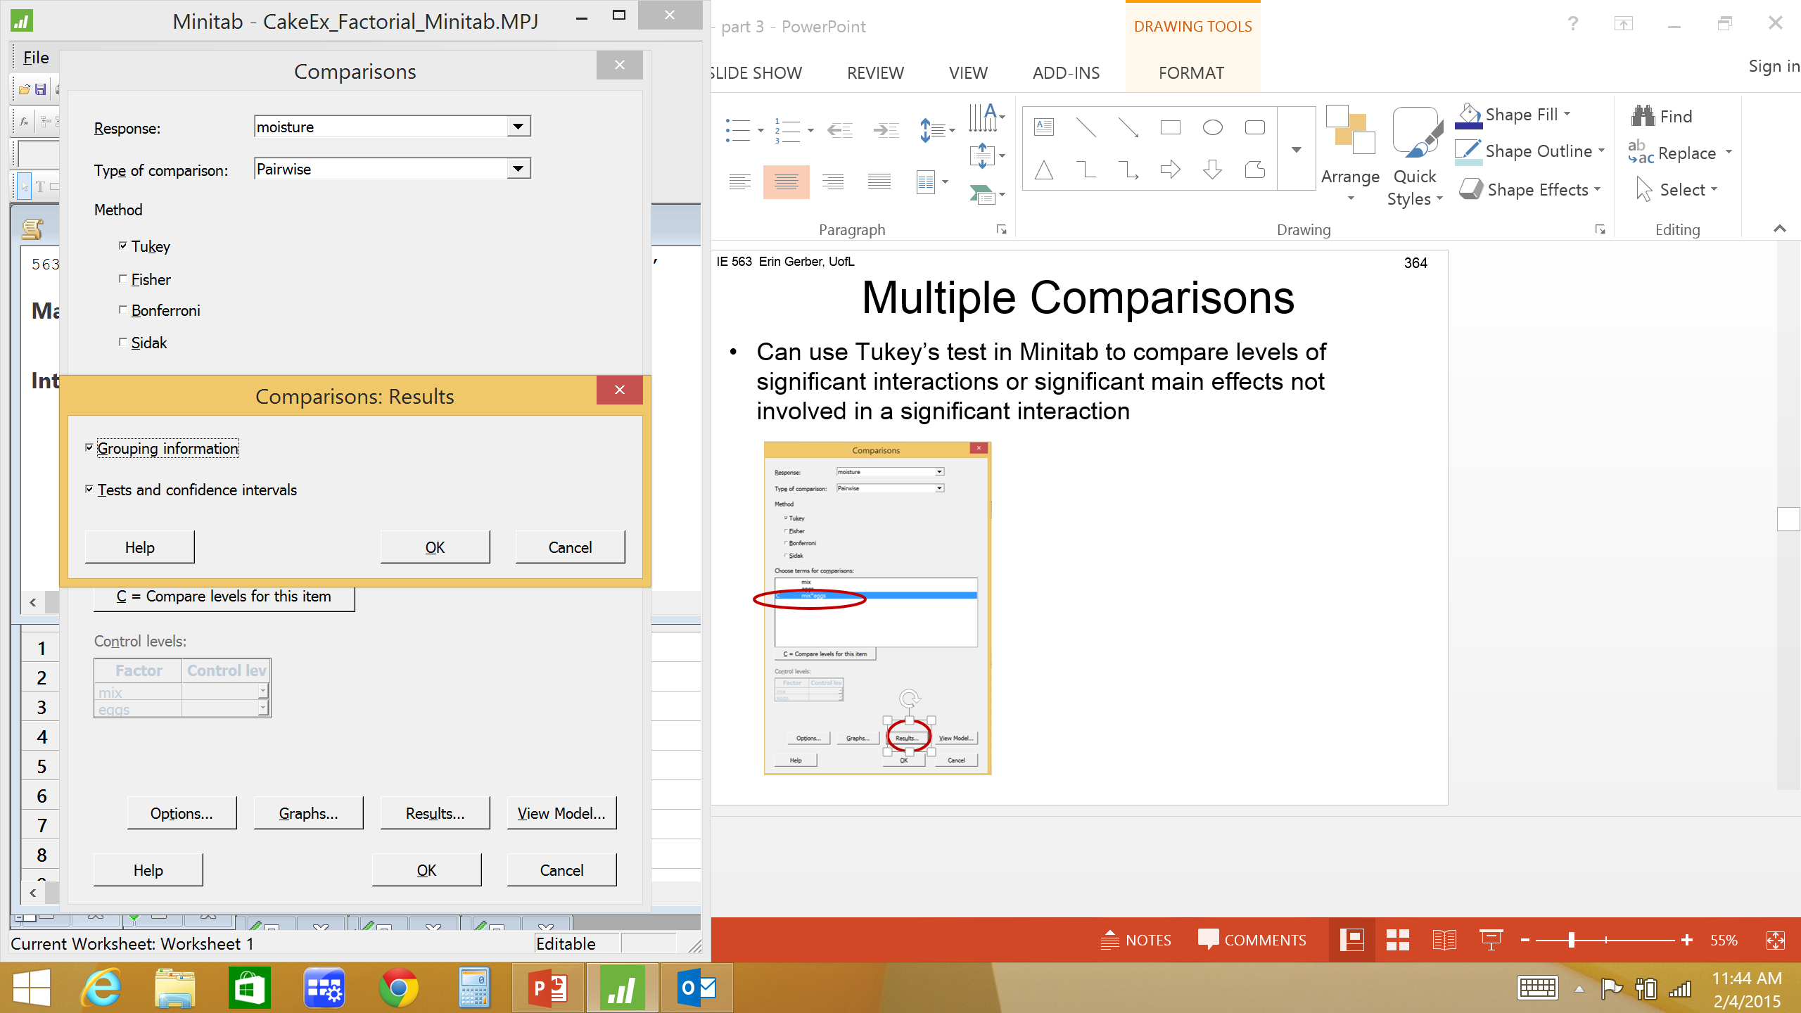
Multiple Comparisons
Can use Tukey’s test in Minitab to compare levels of significant interactions or significant main effects not involved in a significant interaction

Slide 70
Multiple Comparisons
Tukey Test
Often helpful to analyze Minitab Tukey Test output in an order suggested by the interaction plot
Start with combo with maximum (minimum) avg. response; compare to combos in decreasing (increasing) order; stop when first significant difference found
etc
•••
3
2
1
Tukey test output shows comparisons of all 36 pairs of combinations of cake mix brand and # eggs

Slide 71
Multiple Comparisons
Tukey Pairwise Comparisons: Response = moisture, Term = mix*eggs
Grouping Information Using the Tukey Method and 95% Confidence
mix*eggs N Mean Grouping
Betty 2.0 3 85.3333 A
Betty 1.5 3 55.0000 A B
Pilsbury 2.0 3 47.6667 A B
Duncan 1.5 3 44.0000 A B
Pilsbury 1.5 3 32.6667 B
Betty 1.0 3 32.3333 B
Pilsbury 1.0 3 26.6667 B
Duncan 2.0 3 22.6667 B
Duncan 1.0 3 21.3333 B
Means that do not share a letter are significantly different.

Slide 72
Multiple Comparisons
Tukey Simultaneous Tests for Differences of Means
Difference SE of Simultaneous Adjusted
Difference of mix*eggs Levels of Means Difference 95% CI T-Value P-Value
(Betty 1.5) - (Betty 1.0) 22.7 12.2 ( -20.1, 65.4) 1.86 0.647
(Betty 2.0) - (Betty 1.0) 53.0 12.2 ( 10.2, 95.8) 4.35 0.009
(Duncan 1.0) - (Betty 1.0) -11.0 12.2 ( -53.8, 31.8) -0.90 0.990
(Duncan 1.5) - (Betty 1.0) 11.7 12.2 ( -31.1, 54.4) 0.96 0.985
(Duncan 2.0) - (Betty 1.0) -9.7 12.2 ( -52.4, 33.1) -0.79 0.996
(Pilsbury 1.0) - (Betty 1.0) -5.7 12.2 ( -48.4, 37.1) -0.46 1.000
(Pilsbury 1.5) - (Betty 1.0) 0.3 12.2 ( -42.4, 43.1) 0.03 1.000
(Pilsbury 2.0) - (Betty 1.0) 15.3 12.2 ( -27.4, 58.1) 1.26 0.931
(Betty 2.0) - (Betty 1.5) 30.3 12.2 ( -12.4, 73.1) 2.49 0.299
(Duncan 1.0) - (Betty 1.5) -33.7 12.2 ( -76.4, 9.1) -2.76 0.194
(Duncan 1.5) - (Betty 1.5) -11.0 12.2 ( -53.8, 31.8) -0.90 0.990
(Duncan 2.0) - (Betty 1.5) -32.3 12.2 ( -75.1, 10.4) -2.65 0.232
(Pilsbury 1.0) - (Betty 1.5) -28.3 12.2 ( -71.1, 14.4) -2.32 0.378
(Pilsbury 1.5) - (Betty 1.5) -22.3 12.2 ( -65.1, 20.4) -1.83 0.663
(Pilsbury 2.0) - (Betty 1.5) -7.3 12.2 ( -50.1, 35.4) -0.60 0.999
(Duncan 1.0) - (Betty 2.0) -64.0 12.2 (-106.8, -21.2) -5.25 0.001

Slide 73
Multiple Comparisons (cont)
Tukey Simultaneous Tests for Differences of Means
Difference SE of Simultaneous Adjusted
Difference of mix*eggs Levels of Means Difference 95% CI T-Value P-Value
(Duncan 1.5) - (Betty 2.0) -41.3 12.2 ( -84.1, 1.4) -3.39 0.062
(Duncan 2.0) - (Betty 2.0) -62.7 12.2 (-105.4, -19.9) -5.14 0.002
(Pilsbury 1.0) - (Betty 2.0) -58.7 12.2 (-101.4, -15.9) -4.81 0.003
(Pilsbury 1.5) - (Betty 2.0) -52.7 12.2 ( -95.4, -9.9) -4.32 0.010
(Pilsbury 2.0) - (Betty 2.0) -37.7 12.2 ( -80.4, 5.1) -3.09 0.110
(Duncan 1.5) - (Duncan 1.0) 22.7 12.2 ( -20.1, 65.4) 1.86 0.647
(Duncan 2.0) - (Duncan 1.0) 1.3 12.2 ( -41.4, 44.1) 0.11 1.000
(Pilsbury 1.0) - (Duncan 1.0) 5.3 12.2 ( -37.4, 48.1) 0.44 1.000
(Pilsbury 1.5) - (Duncan 1.0) 11.3 12.2 ( -31.4, 54.1) 0.93 0.988
(Pilsbury 2.0) - (Duncan 1.0) 26.3 12.2 ( -16.4, 69.1) 2.16 0.468
(Duncan 2.0) - (Duncan 1.5) -21.3 12.2 ( -64.1, 21.4) -1.75 0.711
(Pilsbury 1.0) - (Duncan 1.5) -17.3 12.2 ( -60.1, 25.4) -1.42 0.875
(Pilsbury 1.5) - (Duncan 1.5) -11.3 12.2 ( -54.1, 31.4) -0.93 0.988
(Pilsbury 2.0) - (Duncan 1.5) 3.7 12.2 ( -39.1, 46.4) 0.30 1.000
(Pilsbury 1.0) - (Duncan 2.0) 4.0 12.2 ( -38.8, 46.8) 0.33 1.000
(Pilsbury 1.5) - (Duncan 2.0) 10.0 12.2 ( -32.8, 52.8) 0.82 0.995
(Pilsbury 2.0) - (Duncan 2.0) 25.0 12.2 ( -17.8, 67.8) 2.05 0.532
(Pilsbury 1.5) - (Pilsbury 1.0) 6.0 12.2 ( -36.8, 48.8) 0.49 1.000
(Pilsbury 2.0) - (Pilsbury 1.0) 21.0 12.2 ( -21.8, 63.8) 1.72 0.727
(Pilsbury 2.0) - (Pilsbury 1.5) 15.0 12.2 ( -27.8, 57.8) 1.23 0.939
Individual confidence level = 99.75%

Slide 74
Tukey Test (continued)
Difference SE of Adjusted
mix of Means Difference 95% CI T-Value P-Value
(Betty 2.0) 30.3 12.2 ( -12.4, 73.1) 2.49 0.299
- (Betty 1.5)
1

Slide 75
Tukey Test (continued)
Diff SE of Adjusted
mix of Means Diff 95% CI T-Value P-Value
(Pilsbury 2.0) -37.7 12.2 ( -80.4, 5.1) -3.09 0.110
-(Betty 2.0)
(Duncan 1.5) -41.3 12.2 ( -84.1, 1.4) -3.39 0.062
- (Betty 2.0)
(Pilsbury 1.5) -52.7 12.2 ( -95.4, -9.9) -4.32 0.010
- (Betty 2.0)
2
3
4

Slide 76
Tukey Test (continued)
For cake baking example
The combination (cake mix =Betty, # eggs =2) produces cakes that are significantly moister than all other combinations of cake mix and # eggs EXCEPT (cake mix=Betty, #eggs=1.5), (cake mix=Pillsbury, #eggs=2), (cake mix=Duncan, #eggs=1.5)
To maximize cake moisture use any one of the following combinations:
Cake mix | # eggs
Betty | 2
Betty | 1.5
Pillsbury | 2
Duncan | 1.5

Slide 77
Tukey Test
Minitab Tukey Grouping Information
Grouping Information Using the Tukey Method and 95% Confidence
mix*eggs N Mean Grouping
Betty 2.0 3 85.3333 A
Betty 1.5 3 55.0000 A B
Pilsbury 2.0 3 47.6667 A B
Duncan 1.5 3 44.0000 A B
Pilsbury 1.5 3 32.6667 B
Betty 1.0 3 32.3333 B
Pilsbury 1.0 3 26.6667 B
Duncan 2.0 3 22.6667 B
Duncan 1.0 3 21.3333 B
Means that do not share a letter are significantly different.
To maximize cake moisture use any one of the following combinations:
Cake mix | # eggs
Betty | 2
Betty | 1.5
Pillsbury | 2
Duncan | 1.5

Slide 78
Multiple Comparisons

Slide 79
Pairwise Comparisons
Remember: Possible to get seemingly paradoxical results. Especially as number of pairs increases
1 and 2 not significantly different
1 and 3 not significantly different
Does this imply 2 and 3 not significantly different? NO!
2 and 3 are significantly different
Saying a pair is not significantly different is not the same as saying they are equal.
The transitive property (A=B and B=C therefore A=C) is not in effect
We know 2 and 3 are significantly different and 1 is somewhere between 2 and 3
Choose either 2 or1 to maximize response

Slide 80
Another Example
Automated car body assembly line example.
Multispot welding machines are used to weld 2 metal body parts together. In one assembly line there are 3 supposedly similar machines. The manager of the line wishes to investigate whether their performance is actually identical. Also the manager wants to investigate the effect of various types of welding material.
Does weld material and/or welding machine affect weld strength (measured in Newtons)?

Slide 81
Car Body Weld Example
 |  | Machine
Weld Material | 1 | 2 | 3
1 | 4.12 4.21 6.11 | 3.74 6.40 5.27 | 6.17 3.79 4.47
2 | 3.44 3.32 3.75 | 3.93 4.41 4.98 | 3.05 4.03 3.32
3 | 6.09 4.46 3.38 | 5.00 5.15 6.75 | 4.88 4.49 3.49
4 | 7.88 6.75 7.22 | 6.43 5.87 8.50 | 8.31 7.10 7.60
Response? Factors? # Factor levels? # Replicates?
Balanced design

Slide 82
Car Body Weld Example
General Linear Model: Weld Strength versus Material, Machine
Method
Factor coding (-1, 0, +1)
Factor Information
Factor Type Levels Values
Material Fixed 4 1, 2, 3, 4
Machine Fixed 3 1, 2, 3
Analysis of Variance
Source DF Adj SS Adj MS F-Value P-Value
Material 3 58.846 19.6155 21.29 0.000
Machine 2 1.815 0.9073 0.98 0.388
Material*Machine 6 3.958 0.6597 0.72 0.640
Error 24 22.114 0.9214
Total 35 86.733
Does weld material and/or welding machine affect weld strength?

Slide 83
Car Body Weld Example

Slide 84
Car Body Weld Example
Interpret results
Interaction significant?
No
Weld material main effect significant?
Yes, Look at main effects plot to get general idea of which weld material to use. Use Tukey test to choose weld material.
Weld machine main effect significant?
No, therefore weld machines are similar in terms of average weld strength

Slide 85
Car Body Weld Example
Which weld material to use to maximize weld strength?
Can look at main effects plot to get general idea.

Slide 86
Car Body Weld Example
Which weld material to use to maximize weld strength?
Tukey Pairwise Comparisons: Response = Weld Strength, Term = Material
Grouping Information Using the Tukey Method and 95% Confidence
Material N Mean Grouping
4 9 7.29556 A
1 9 4.92000 B
3 9 4.85444 B
2 9 3.80333 B
Means that do not share a letter are significantly different.
Material 4 produces weld strengths that are statistically significantly stronger than the other 3 materials.

Slide 87
RCB Design vs 2 Factor Factorial Design
Randomized Complete Block (RCB) Design
One factor of interest and one nuisance factor
nuisance factor not of interest, but needs to be separated from random error
The two terms(factor & block) do not interact
2 Factor Factorial Design
Two factors of interest
Consider interaction of 2 factors

Slide 88
Factorial Design
Analysis techniques we used for two-factor factorial design can be extended for more than 2 factors
For K factors, model will include:
K main effects
C^{K}₂ 2-way interactions
C^{K}₃ 3-way interactions
•••
K (K-1)-way interactions
1 K-way interaction
Example: 6 factor factorial design
6 main effects
15 2-way interactions
20 3-way interactions
15 4-way interactions
6 5-way interactions
1 6-way interaction

Slide 89
Factorial Design
General Three-Factor Factorial Design
Three Factors: A and B and C
Factor A has a levels
Factor B has b levels
Factor C has c levels
n_{ijk} replicates at combination A_{i}B_{j}C_{k}
For balanced design:
n replicates at each combination of factor levels, A_{i}B_{j}C_{k}
i.e. n = n_{ijk} for all combination of factor levels, A_{i}B_{j}C_{k}
N = abcn total observations (for balanced design)
Y_{ijkl} = ijkl^{th} observation. Factor A level i, Factor B level j,
Factor C level k, replicate l.

Slide 90
General Three-Factor Factorial Design
Linear Statistical Model
Where
Y_{ijk} = ijk^{th} observation. Factor A level i, Factor B level j, replicate k
μ = overall mean
τ_{i} = effect of the i^{th} level of factor A
β_{j} = effect of the j^{th} level of factor B
γ_{k} = effect of the k^{th} level of factor C
(τβ)_{ij} = effect of the interaction of τ_{i} and β_{j} (i.e. AB interaction)
(τγ)_{ik} = effect of the interaction of τ_{i} and γ_{k} (i.e. AC interaction)
(βγ)_{jk} = effect of the interaction of β_{j} and γ_{k} (i.e. BC interaction)
(τβγ)_{ijk} = effect of the interaction of τ_{i} and β_{j} and γ_{k} (i.e. ABC interaction)
ε_{ijkl} = random error. Assumed to be NID (0, σ²)

Slide 91
General Three-Factor Factorial Design
Total variability partitioned into components
SS_{Total} = SS_{A} +SS_{B} +SS_{c} +SS_{AB} +SS_{AC} +SS_{BC} +SS_{ABC} + SS_{Error}

Slide 92
General Three-Factor Factorial Design

Slide 93
General Three-Factor Factorial Design
Source of Variation | SS | df | MS | F
A | SS_{A} | a-1 | MS_{A}
B | SS_{B} | b-1 | MS_{B}
C | SS_{C} | c-1 | MS_{C}
AB | SS_{AB} | (a-1)(b-1) | MS_{AB}
AC | SS_{AC} | (a-1)(c-1) | MS_{AC}
BC | SS_{BC} | (b-1)(c-1) | MS_{BC}
ABC | SS_{ABC} | (a-1)(b-1)(c-1) | MS_{ABC}
Error | SS_{Error} | N-abc | MS_{Error}
Total | SS_{Total} | N-1

Slide 94
3-Factor Factorial Design
Example: Is car gas mileage affected by gas additive A, gas additive B and/or driving conditions?
3 levels of gas additive A (low, medium, high)
3 levels of gas additive B (low, medium, high)
2 levels of driving conditions (city, highway)
A car has 2 measurements of mpg for each combination of additive A, additive B, and driving condition

Slide 95
Gas Mileage Example
City Driving Conditions
Highway Driving Conditions
Additive A
Additive B
Additive A
Additive B

Slide 96
Gas Mileage Example

Slide 97
Gas Mileage Example

Slide 98
Gas Mileage Example
F _{0.05,1,18} = 4.41
F _{0.05,2,18} = 3.55
F _{0.05,4,18} = 2.93
Is car gas mileage affected by gas additive A, gas additive B and/or driving conditions?

Slide 99
Gas Mileage Example

Slide 100
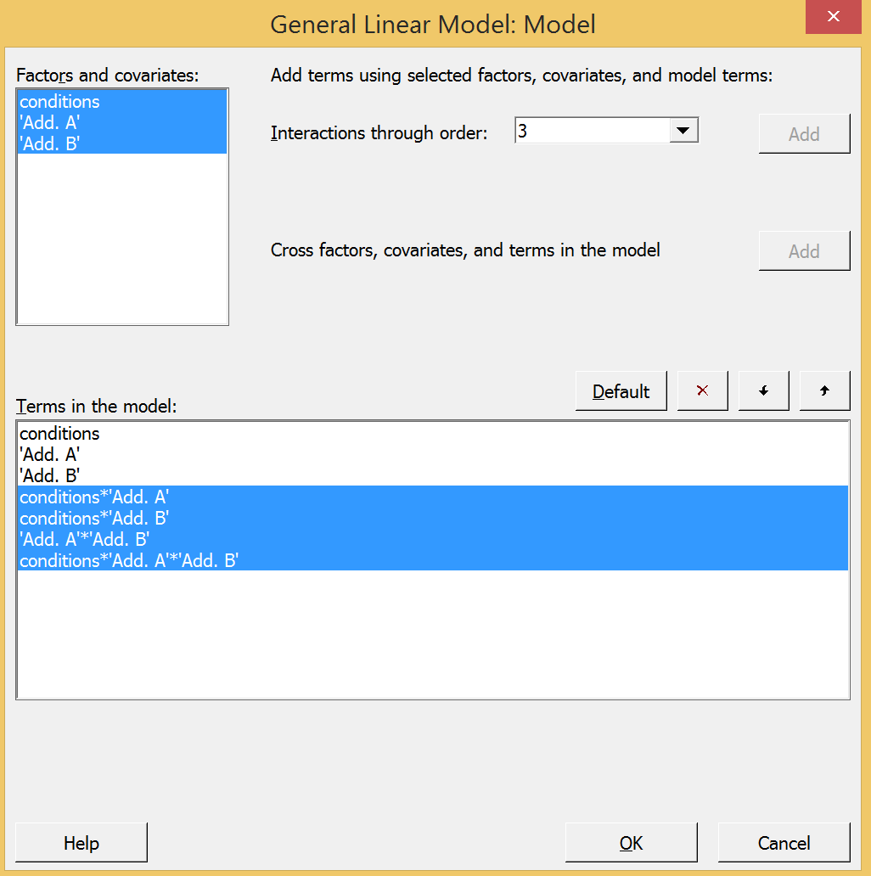
Gas Mileage Example

Slide 101
Gas Mileage Example
Minitab output
Analysis of Variance
Source DF Adj SS Adj MS F-Value P-Value
conditions 1 180.90 180.903 19.85 0.000
Add. A 2 308.81 154.406 16.94 0.000
Add. B 2 19.57 9.783 1.07 0.363
conditions*Add. A 2 88.83 44.416 4.87 0.020
conditions*Add. B 2 15.13 7.566 0.83 0.452
Add. A*Add. B 4 98.95 24.737 2.71 0.063
conditions*Add. A*Add. B 4 62.95 15.738 1.73 0.188
Error 18 164.04 9.114
Total 35 939.19

Slide 102
Gas Mileage Example

Slide 103
Gas Mileage Example
Interpret results
Significant terms (at α = 0.05)
Interaction: Driving condition * additive A
Main Effect: Driving condition
Main Effect: additive A
How to choose factor levels?
Look at Driving condition * additive A interaction plot and Tukey test
How to choose a preferred factor level when factor not significant:
plot residual vs factor to compare residual variability among factor levels
choose factor level with minimum residual variability
Look at residual variance for additive B

Slide 104
Gas Mileage Example
Evaluate significant interaction(s)
Evaluate significant condition*additive A interaction
Which level(s) of additive A and driving condition to maximize gas mileage?

Slide 105
Gas Mileage Example
Minitab Tukey Test for condition*additive A
Grouping Information Using the Tukey Method and 95% Confidence
Add.
A*conditions N Mean Grouping
3 2 6 36.1833 A
2 2 6 31.7500 A B
3 1 6 31.4500 A B
1 2 6 27.8167 B C
1 1 6 27.3000 B C
2 1 6 23.5500 C
Means that do not share a letter are significantly different.
To maximize gas mileage use any one of the following combinations:
Condition | Additive A
2 | 3
2 | 2
1 | 3

Slide 106
Gas Mileage Example
What level of additive B to use?
Look at residual variance for additive B
What about not using additive B at all? It is not a significant factor.

Slide 107
Review: Analysis Procedure for Factorial Design with 2+ Replicates
Do ANOVA (include all main effects and interactions)
Do Residual Analysis to check ANOVA assumptions
Interpret results
3a. Interpret significant interactions
use interaction plot and Tukey Test
3b. Interpret significant main effects NOT involved in a significant interaction
use main effects plot and Tukey Test
3c. Interpret all completely non-significant factors
use residual variance plot

Slide 108
Sample Size for Factorial Design
In Minitab
Stat
Power and Sample Size
General Full Factorial Design
Number of levels of each factor
3 factors:
Factor A has 3 levels
Factor B has 2 levels
Factor C has 2 levels
St. Dev. = √MS_{E} from pre-experiment

Slide 109
Sample Size for Factorial Design
Power and Sample Size
General Full Factorial Design
α = 0.05 Assumed standard deviation = 1.82
Factors: 3 Number of levels: 3, 2, 2
Include terms in the model up through order: 3
Not including blocks in model.
Maximum Total Target
Difference Reps Runs Power Actual Power
2.45 4 48 0.9 0.914825
# replicates at each combination of the factor levels
N = (3)(2)(2)(4) = 48 obs

Slide 110
Multiple Linear Regression
Can be used for factorial designs
Remember: use R²_{adj} to evaluate and compare multiple linear regression models
Consider main effects and interactions as terms in regression model as well as higher-order terms

Slide 111
Multiple Linear Regression
Which terms to include in model?
Example: 4 factors (A,B,C,D) then many terms that could be included in model
Main Effects: A, B, C, D
2-way interactions: AB, AC, AD, BC, BD, CD
3-way interactions: ABC, ABD, ACD, BCD
4-way interaction: ABCD
15 possible terms
How to know which combination of these to include in model? Not all will be significant.

Slide 112
Multiple Linear Regression
If a factorial design, then ANOVA results can suggest terms to include in regression model (i.e. significant ANOVA terms)
If ANOVA cannot be performed, then can use stepwise regression to choose subset of terms to include in regression model
Forward selection
Backward elimination
Stepwise regression
Stepwise regression will result in a single model (i.e. subset of terms) – not necessarily the “optimal” model - there may be other good models.

Slide 113
Regression: Forward Selection
Start with NO terms in model other than intercept
Add terms to model one at a time in order of their correlation with response Y. Term most correlated with Y added first.
Find partial F statistic for each term not in model.
Term with largest partial F statistic added to model first.
Iteratively add terms to model while their partial F statistics are larger than an entry F value, F_{IN}
Once a term is added to the model it cannot be removed.
Partial F statistic for X_{i} with X_{j} and X_{k} currently in model =

Slide 114
Regression: Backward Elimination
Start with ALL terms in model
Remove terms from model one at a time in order of their correlation with response Y. Term least correlated with Y removed first.
Find partial F statistic for each term in model.
Term with smallest partial F statistic removed first.
Iteratively remove terms from model while their partial F statistics are smaller than an exit F value, F_{OUT}
Keep removing terms until no term in model has a partial F statistic is less than F_{OUT}
Once a term is removed from the model it cannot reenter.

Slide 115
Regression: Stepwise Regression
Combination of forward selection and backward elimination
At each iteration, all terms both in and out of the model are reassessed using their partial F statistics
The term not in the model with the largest partial F statistic larger than F_{IN} is added to the model.
The term in the model with the smallest partial F statistic smaller than F_{OUT} is removed from the model.
Terms can enter the model and/or be removed from the model more than once
A single model (i.e. subset of terms) will result – not necessarily the “optimal” model - there may be other good models.

Slide 116
Regression: Stepwise Regression
In Minitab
Make columns for all main effects and interactions
Calc
Calculator
Then do stepwise regression
Stat
Regression
Stepwise

Slide 117
Stepwise Regression in Minitab
Example: 3 factors (A,B,C)
Determine the combination of factors/interactions to include in regression model
Make worksheet with columns for all main effects and interactions

Slide 118
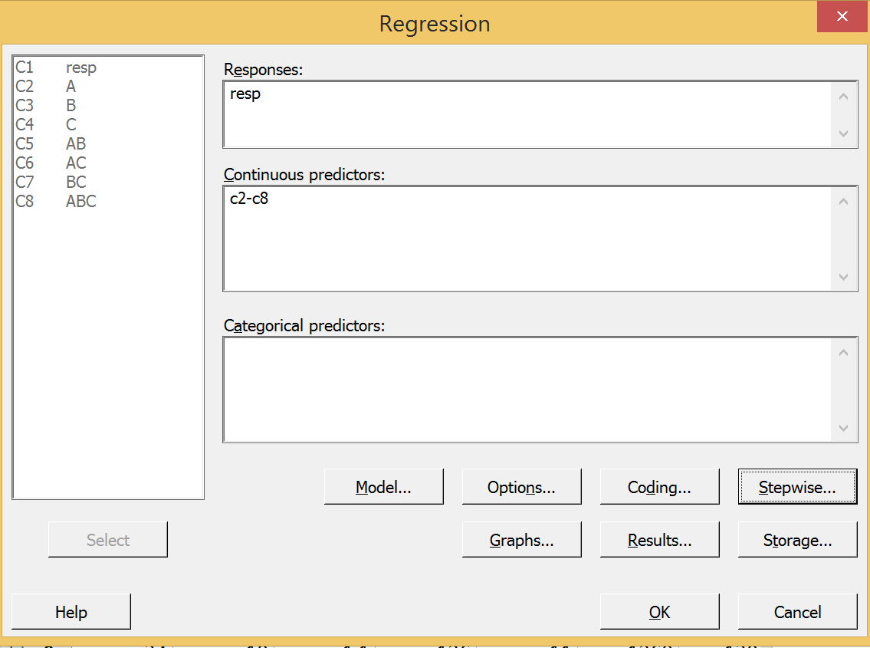
Stepwise Regression in Minitab
Stat
Regression
Regression

Slide 119
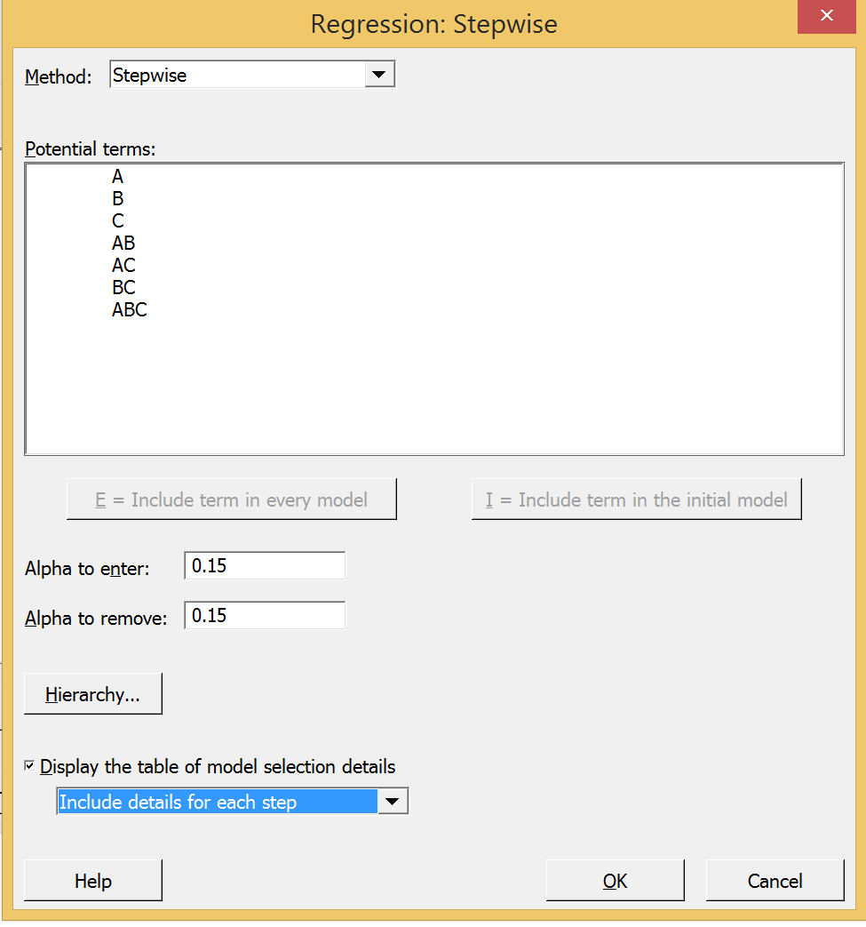
Stepwise Regression in Minitab
This can do:
Stepwise
Forward Selection
Backward Elimination
Default alpha values = 0.15

Slide 120
Stepwise Regression in Minitab
Regression Analysis: resp versus A, B, C, AB, AC, BC, ABC
Stepwise Selection of Terms
Candidate terms: A, B, C, AB, AC, BC, ABC
-----Step 1---- -----Step 2----- -----Step 3----- ------Step 4-----
Coef P Coef P Coef P Coef P
Constant 11.11 3.87 -12.43 -81.5
BC 0.2343 0.000 0.2214 0.000 0.1922 0.000 0.1922 0.000
AC 0.00419 0.002 0.00342 0.006 -0.02889 0.002
C 0.1535 0.020 0.638 0.000
A 4.61 0.001
AB
S 5.33431 4.34493 3.87665 2.88443
R-sq 67.49% 79.41% 84.39% 91.79%
R-sq(adj) 66.01% 77.45% 82.05% 90.06%
R-sq(pred) 62.15% 74.38% 77.36% 86.77%
Mallows’ Cp 74.49 41.84 29.37 9.86

Slide 121
Stepwise Regression in Minitab
------Step 5----- ------Step 6-----
Coef P Coef P
Constant -81.5 -81.5
BC 0.0581 0.304
AC -0.02889 0.001 -0.02889 0.001
C 0.759 0.000 0.811 0.000
A 3.46 0.005 3.017 0.007
AB 1.275 0.018 1.767 0.000
S 2.52877 2.53675
R-sq 94.02% 93.65%
R-sq(adj) 92.36% 92.31%
R-sq(pred) 89.16% 89.86%
Mallows’ Cp 5.37 4.46
α to enter = 0.15, α to remove = 0.15
Final regression model
AC, C, A, AB

Slide 122
Stepwise Regression in Minitab
Stepwise regression results with a 4 term model: A, C, AC, AB
Regression analysis if run automatically for the selected terms (prints in session window under the stepwise steps)
Evaluate R²_{adj} and P-values
Do residual analysis
Make predictions

Slide 123
Stepwise Regression in Minitab
Analysis of Variance
Source DF Adj SS Adj MS F-Value P-Value
Regression 4 1803.07 450.767 70.05 0.000
A 1 59.75 59.749 9.28 0.007
C 1 355.27 355.267 55.21 0.000
AB 1 749.07 749.067 116.40 0.000
AC 1 112.67 112.667 17.51 0.001
Error 19 122.27 6.435
Lack-of-Fit 3 16.27 5.422 0.82 0.502
Pure Error 16 106.00 6.625
Total 23 1925.33
Model Summary
S R-sq R-sq(adj) R-sq(pred)
2.53675 93.65% 92.31% 89.86%
Coefficients
Term Coef SE Coef T-Value P-Value VIF
Constant -81.5 15.5 -5.27 0.000
A 3.017 0.990 3.05 0.007 91.39
C 0.811 0.109 7.43 0.000 10.00
AB 1.767 0.164 10.79 0.000 3.03
AC -0.02889 0.00690 -4.18 0.001 98.36
Regression Equation
resp = -81.5 + 3.017 A + 0.811 C + 1.767 AB - 0.02889 AC
Final regression model
AC, C, A, AB

Slide 124
Stepwise Regression Model

Slide 125
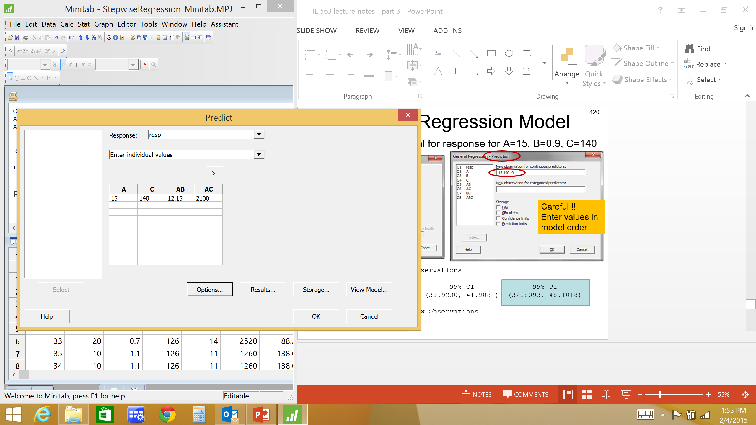
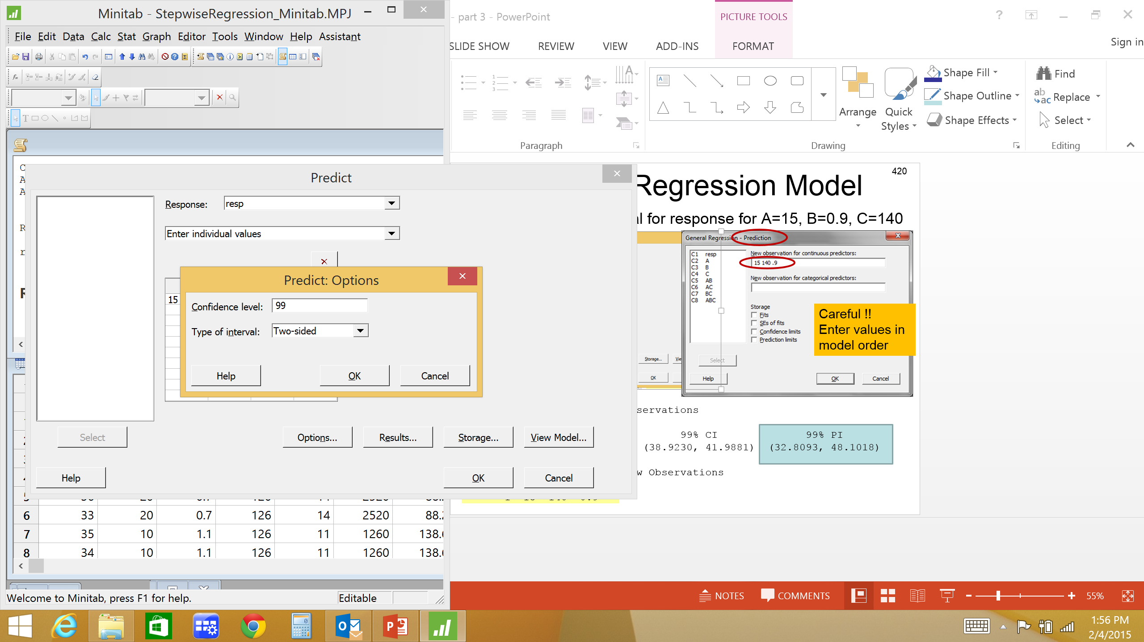
Stepwise Regression Model
99% prediction interval for response for A=15, B=0.9, C=140
Prediction for resp
Regression Equation
resp = -81.5 + 3.017 A + 0.811 C + 1.767 AB - 0.02889 AC
Variable Setting
A 15
C 140
AB 12.15
AC 2100
Fit SE Fit 99% CI 99% PI
38.0706 0.564080 (36.4568, 39.6844) (30.6358, 45.5053)

Slide 126
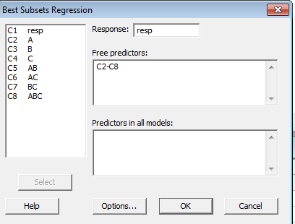
Multiple Linear Regression
Preferred method to choose subset of terms to include in regression model: ‘Best Subsets’
Best Subsets finds the n best subsets of i terms (i =1, 2, …, k)
Compare R²_{adj} values and choose subset that has good balance of high R²_{adj} and small number of terms
In Minitab
Stat
Regression
Regression
Best Subsets

Slide 127
Best Subsets in Minitab
A
R-Sq R-Sq Mallows A A B B
Vars R-Sq (adj) (pred) Cp S A B C B C C C
1 67.5 66.0 62.2 74.5 5.3343 X
1 51.6 49.4 43.7 120.6 6.5079 X
2 79.4 77.4 74.4 41.8 4.3449 X X
2 77.7 75.6 70.9 46.7 4.5180 X X
3 90.5 89.1 86.4 11.5 3.0168 X X X
3 87.9 86.1 82.7 19.2 3.4123 X X X
4 93.6 92.3 89.9 4.5 2.5367 X X X X
4 93.2 91.8 89.1 5.7 2.6223 X X X X
5 94.1 92.5 89.6 5.0 2.5019 X X X X X
5 94.0 92.4 89.2 5.4 2.5288 X X X X X
6 94.3 92.3 88.6 6.5 2.5362 X X X X X X
6 94.2 92.1 88.4 6.9 2.5668 X X X X X X
7 94.5 92.1 87.6 8.0 2.5739 X X X X X X X
Mallows Cp statistic is related to the mean square error of a fitted value. Look for models where Mallows Cp is small and close to the number of terms in the model, including the constant.

Slide 128
Best Subsets for Multiple Linear Regression
We chose a 4 term model from Best Subsets: A, C, AC, AB
Now do usual regression analysis for this model
Form regression equation
Evaluate R²_{adj} and P-values
Do residual analysis
Interpret results - Make predictions

Slide 129
Best Subsets Model
Regression Analysis: resp versus A, C, AC, AB
Analysis of Variance
Source DF Adj SS Adj MS F-Value P-Value
Regression 4 1803.07 450.767 70.05 0.000
A 1 59.75 59.749 9.28 0.007
C 1 355.27 355.267 55.21 0.000
AB 1 749.07 749.067 116.40 0.000
AC 1 112.67 112.667 17.51 0.001
Error 19 122.27 6.435
Lack-of-Fit 3 16.27 5.422 0.82 0.502
Pure Error 16 106.00 6.625
Total 23 1925.33
Model Summary
S R-sq R-sq(adj) R-sq(pred)
2.53675 93.65% 92.31% 89.86%
Coefficients
Term Coef SE Coef T-Value P-Value VIF
Constant -81.5 15.5 -5.27 0.000
A 3.017 0.990 3.05 0.007 91.39
C 0.811 0.109 7.43 0.000 10.00
AB 1.767 0.164 10.79 0.000 3.03
AC -0.02889 0.00690 -4.18 0.001 98.36
Regression Equation
resp = -81.5 + 3.017 A + 0.811 C + 1.767 AB - 0.02889 AC

Slide 130
Best Subsets Model

Slide 131
Regression Analysis
What to do when R² value not as large as you’d like?
Look at regression residual analysis
If residual plots look bad
Try transforming response variable
Try including higher order term(s) in model
If residual plots look good
Indication there are 1 or more significant factors not included in this data
Rethink experiment

Slide 132
HW#4 here
Due date =
Unless otherwise stated, you may use Minitab to do HW assignments
If submitting HW electronically, submit one (1) file only !!!
Can copy Minitab output and paste into MS Word. Use ‘Courier New’ font when pasting Minitab output in MS Word.
Indicate where the answer is located in Minitab output (circle, highlight, etc.)
Data sets can be copied from assignment document and pasted into Excel or Minitab. Some data sets may need to be rearranged before conducting an analysis in Minitab

Slide 133
Analysis of data with “infinite” factor levels
What to do if selection of factor levels cannot be easily controlled? Or data has already been collected at wide variety of factor levels?
Example: determine effect of height (in) and weight (lb) on a person’s resting heart rate (bpm)
Perform ANOVA to determine if height & weight affect resting HR?

Slide 134
Analysis of data with “infinite” factor levels
ANOVA in Minitab
General Linear Model: HR versus height, weight
Factor Type Levels Values
height fixed 17 54, 56, 59, 61, 62, 63, 64, 65, 66, 67, 69, 71, 73, 74, 75, 76, 78
weight fixed 20 178, 183, 197, 198, 202, 206, 217, 219, 222, 228, 247, 250, 252, 281, 297, 306, 316, 326, 346, 355
Analysis of Variance for HR, using Adjusted SS for Tests
Reduced
Source Model DF DF Seq SS
height 16 16 1684.300
weight 19 1+ 40.500
height*weight 304 0+ 0.000
Error -320 2 505.000
Total 19 19 2229.800
+ Rank deficiency due to empty cells, unbalanced nesting, collinearity, or an undeclared covariate. No storage of results or further analysis will be done.

Slide 135
Analysis of data with “infinite” factor levels
ANOVA in Minitab
General Linear Model: HR versus height, weight
The following terms cannot be estimated and were removed:
weight
Method
Factor coding (-1, 0, +1)
Factor Information
Factor Type Levels Values
height Fixed 17 54, 56, 59, 61, 62, 63, 64, 65, 66, 67, 69, 71, 73, 74, 75, 76, 78
Analysis of Variance
Source DF Adj SS Adj MS F-Value P-Value
height 16 1684.3 105.3 0.58 0.798
Error 3 545.5 181.8
Total 19 2229.8

Slide 136
Analysis of data with “infinite” factor levels
“Infinite” number of levels of height and weight.
No replicates - ANOVA can not estimate random error
Observations not at all combinations of factor levels (not factorial design) - ANOVA can not estimate height*weight interaction
Could use categories for factor levels (how to choose category limits?)
Height: short, tall or <60”, 60”-66”, 66”-72”, > 72”
Weight: light, heavy
OR could use multiple linear regression to analyze

Slide 137
Analysis of data with “infinite” factor levels
General Regression Analysis: HR versus height, weight
Analysis of Variance
Source DF Adj SS Adj MS F-Value P-Value
Regression 3 1261.2 420.39 6.94 0.003
height 1 864.8 864.80 14.28 0.002
weight 1 1080.8 1080.85 17.85 0.001
height*weight 1 1040.5 1040.48 17.19 0.001
Error 16 968.6 60.54
Total 19 2229.8
Model Summary
S R-sq R-sq(adj) R-sq(pred)
7.78073 56.56% 48.41% 27.93%
Coefficients
Term Coef SE Coef T-Value P-Value VIF
Constant -288.5 93.0 -3.10 0.007
height 5.23 1.38 3.78 0.002 28.08
weight 1.733 0.410 4.23 0.001 165.02
height*weight -0.02529 0.00610 -4.15 0.001 197.43
Regression Equation
HR = -288.5 + 5.23 height + 1.733 weight - 0.02529 height*weight

Slide 138
Regression Interpretation
How to interpret general effect of factors on response?
Be careful when interaction(s) in model – what is ‘total’ effect for factors?
Some regression equations easy to interpret
HR = - 288.55 + 5.23 height + 1.73 weight + 0.02529 height*weight
Effect of height?
Some regression equations difficult to interpret
HR = -288.5 + 5.23 height + 1.733 weight - 0.02529 height*weight
Effect of height? Depends on weight
If factor levels are continuous, then can be difficult to interpret
Set up model in Excel to try different values of factor levels and see effect on response
For two-way interactions, can use contour plot

Slide 139
Regression Interpretation
Contour plot or 3D surface plot to interpret significant 2-way interaction
What height and weight minimizes or maximizes resting HR?

Slide 140
Regression Interpretation
Graph
Contour Plot
Graph
3D Surface Plot

Slide 141
Qualitative/Categorical Factor Levels
How to include terms measured on a qualitative or categorical scale in a regression model?
Up until now all our regression models have been for factors measured on quantitative or continuous scale.
Factor: Tool Level: A, B, C
Factor: Day Level: M,T,W,H,F,Sa,Su
Factor: Student Level: Joe, Kate, Matt
Regression model to predict test score
Test score = 56 + 17*Student
Test score = 56 + 17*(Joe) ?????

Slide 142
Qualitative/Categorical Factor Levels
NOTE: qualitative factor levels are only a concern in regression, not ANOVA
In ANOVA we compare mean response at each factor level. The labeling or type of factor level (qualitative or quantitative) does not matter – only used to discriminate one level from another.
However, in regression we are forming a mathematical equation and therefore a numerical value must be assigned to each factor level.

Slide 143
Regression: Qualitative Factor Levels
Need to assign a numeric value to each factor level so that a mathematical regression equation can be formed
How?
Subject | Time
Andrew | 54 51
Bob | 16 12
Charles | 92 101
David | 26 33
Edward | 39 43
Fred | 87 90
Example: Develop regression equation to predict 80 yard run times for 6 subjects

Slide 144
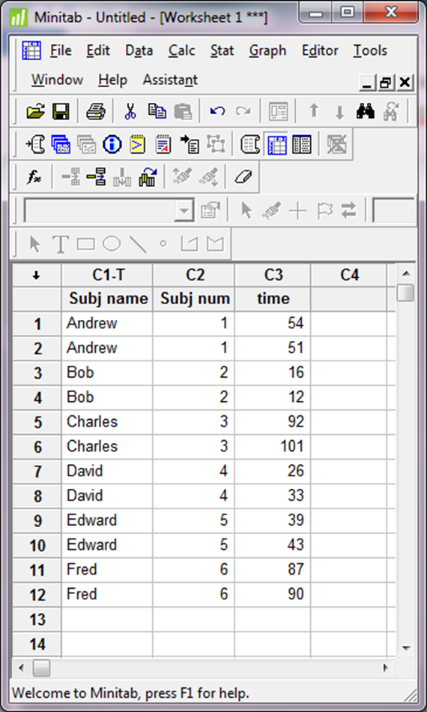
Regression: Qualitative Factor Levels
Cannot form equation with names Andrew, Bob, Charles, David, Edward, and Fred
Assign values 1-6 to the 6 subjects?

Slide 145
Regression: Qualitative Factor Levels
The regression equation is
time = 34.3 + 5.54 Subj num
Predictor Coef SE Coef T P
Constant 34.27 20.55 1.67 0.126
Subj num 5.543 5.278 1.05 0.318
S = 31.2240 R-Sq = 9.9% R-Sq(adj) = 0.9%
Residuals do not look great. Attempts to improve residuals by transforming the response or adding higher order terms fails.

Slide 146
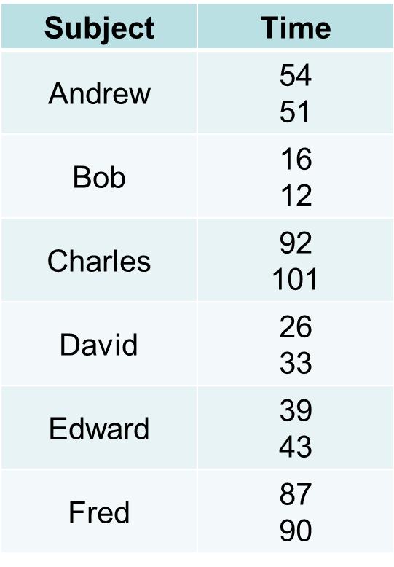
Regression: Qualitative Factor Levels
Predict 80 yard run time for David (i.e. subject 4)
Time = 34.3 + 5.54 (4) = 56.46
Good prediction? Look at original data.
What went wrong?
By numbering the subjects 1-6 we are imposing an unwanted mathematical relationship on the factor levels.
For quantitative factor (e.g. weight) a mathematical relationship is valid
200 lbs twice as heavy as 100lbs
For qualitative factor the mathematical relationship does not make sense
Subject 4 is twice as ‘subjecty’ as subject 2?

Slide 147
Regression: Qualitative Factor Levels
Use indicator variables to assign numeric values to qualitative factor levels
Indicator variables = (0,1)
Example: Form a regression equation to predict yield of a chemical process based on temperature and catalyst type (type A or B)
Catalyst has qualitative levels – use an indicator variable, X₂
X₁ = temperature
X₂ = 0 for catalyst A; X₂ = 1 for catalyst B

Slide 148
Indicator Variables
General form of multiple linear regression equation for this example
For catalyst A (X₂ =0) the regression model becomes
i.e. a straight line with intercept β₀ and slope β₁
For catalyst B (X₂ =1) the regression model becomes
i.e. a straight line with intercept (β₀ + β₂ ) and slope (β₁ + β₃ )
So, the general model with an indicator variable, X₂, actually defines 2 regression lines (one for catalyst A and one for catalyst B) with different slopes and intercepts

Slide 149
Indicator Variables
In general, a qualitative factor with a levels is represented by a-1 indicator variables
Example (cont.): 6 subjects running 80 yards
5 indicator variables needed
Subject | i1 | i2 | i3 | i4 | i5
Andrew | 0 | 0 | 0 | 0 | 0
Bob | 1 | 0 | 0 | 0 | 0
Charles | 0 | 1 | 0 | 0 | 0
David | 0 | 0 | 1 | 0 | 0
Edward | 0 | 0 | 0 | 1 | 0
Fred | 0 | 0 | 0 | 0 | 1

Slide 150
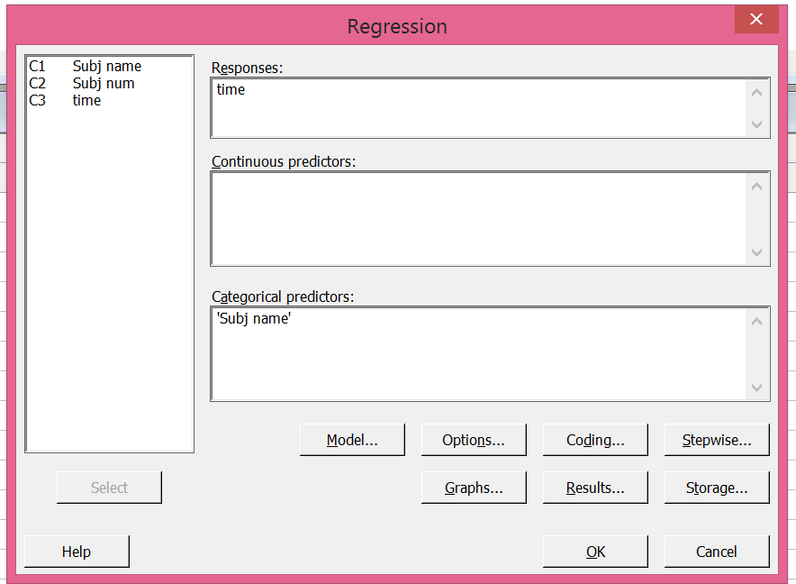
Indicator Variables
Minitab General regression can generate indicator variables

Slide 151
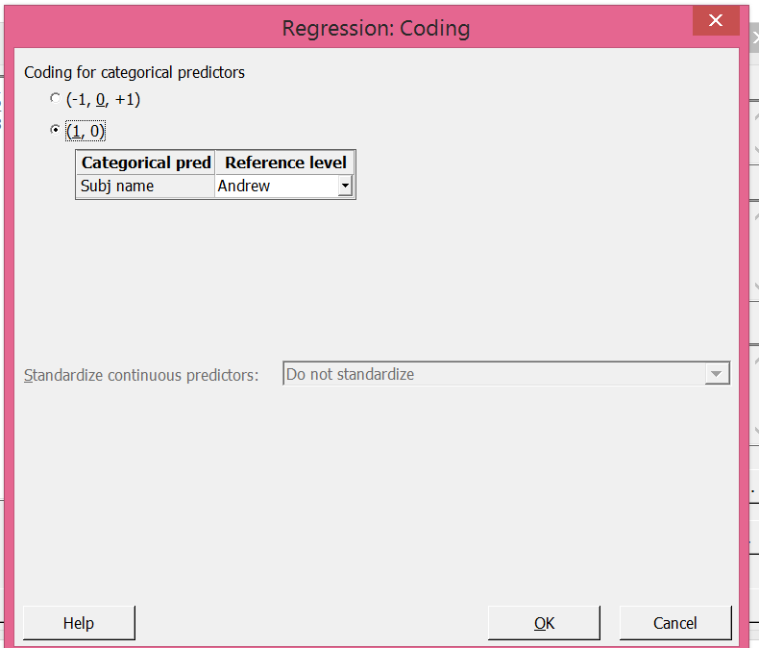
Minitab Coding for Indicator Variables
-1, 0, +1 coding for indicator variables:
For factor level not listed in Minitab General Regression analysis, use value of -1 for all indicator variables
Here use 0,1 coding for indicator variables

Slide 152
Minitab Coding for Indicator Variables
A | i1 | i2
1 | 1 | 0
2 | 0 | 1
3 | -1 | -1
A | i1 | i2
1 | 0 | 0
2 | 1 | 0
3 | 0 | 1
For (0,1) coding the regression equation coefficients represent the distance between factor levels and a baseline level (baseline is factor level not included in model)
For (-1,0,+1) coding the regression equation coefficients represent the distance between factor levels and the overall mean
Does not matter which coding type you use, but you need to know which type was used (need to know what types of values (-1,0,+1 or 0,1) to plug into equation)
-1,0,+1 coding
0,1 coding

Slide 153
Indicator Variables
General Regression Analysis: time versus Subj name
Coefficients
Term Coef SE Coef T P
Constant 52.5 2.73861 19.1703 0.000
Subj name
Bob -38.5 3.87298 -9.9407 0.000
Charles 44.0 3.87298 11.3608 0.000
David -23.0 3.87298 -5.9386 0.001
Edward -11.5 3.87298 -2.9693 0.025
Fred 36.0 3.87298 9.2952 0.000
Summary of Model
S = 3.87298 R-Sq = 99.17% R-Sq(adj) = 98.48%
PRESS = 360 R-Sq(pred) = 96.67%
Analysis of Variance
Source DF Seq SS Adj SS Adj MS F P
Regression 5 10734.7 10734.7 2146.93 143.129 0.0000037
Subj name 5 10734.7 10734.7 2146.93 143.129 0.0000037
Error 6 90.0 90.0 15.00
Total 11 10824.7

Slide 154
Indicator Variables
Regression Analysis: time versus Subj name
Method
Categorical predictor coding (1, 0)
Analysis of Variance
Source DF Adj SS Adj MS F-Value P-Value
Regression 5 10649.4 2129.88 128.44 0.000
Subj name 5 10649.4 2129.88 128.44 0.000
Error 6 99.5 16.58
Total 11 10748.9
Model Summary
S R-sq R-sq(adj) R-sq(pred)
4.07226 99.07% 98.30% 96.30%
Coefficients
Term Coef SE Coef T-Value P-Value VIF
Constant 52.50 2.88 18.23 0.000
Subj name
Bob -38.50 4.07 -9.45 0.000 1.67
Charles 43.50 4.07 10.68 0.000 1.67
David -23.00 4.07 -5.65 0.001 1.67
Edward -11.50 4.07 -2.82 0.030 1.67
Fred 36.00 4.07 8.84 0.000 1.67
Regression Equation
time = 52.50 + 0.0 Subj name_Andrew - 38.50 Subj name_Bob + 43.50 Subj name_Charles
- 23.00 Subj name_David - 11.50 Subj name_Edward + 36.00 Subj name_Fred

Slide 155
Indicator Variables

Slide 156
Indicator Variables
Predict 80 yard run time for David
Time = 52.5 – 38.5(0) +44.0(0) -23.0(1) – 11.5(0) +36.0(0) = 29.5
Good prediction? Look at original data.

Slide 157
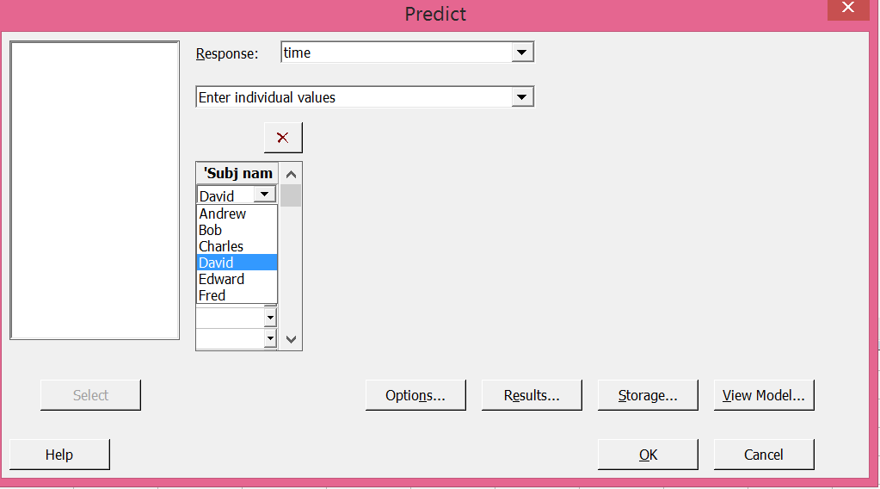
Indicator Variables
Minitab General Regression prediction for David

Slide 158
Indicator Variables
Prediction for time
Regression Equation
time = 52.50 + 0.000000 Subj name_Andrew - 38.50 Subj name_Bob + 43.50 Subj name_Charles
- 23.00 Subj name_David - 11.50 Subj name_Edward + 36.00 Subj name_Fred
Variable Setting
Subj name David
Fit SE Fit 95% CI 95% PI
29.5 2.87953 (22.4541, 36.5459) (17.2961, 41.7039)

Slide 159
Indicator Variables
Another example
How does amount of phosphor (80, 120 grams) and type of glass (glass 1, 2, 3) affect the brightness of TV tubes?
Response? Factors? # levels? # replicates?
How to decide which terms to include in regression model?
ANOVA?
Best Subsets?
 |  | Glass Type
Phosphor | 1 | 2 | 3
80 | 230 235 240 | 260 240 235 | 290 285 290
120 | 280 290 285 | 300 310 295 | 220 225 230

Slide 160
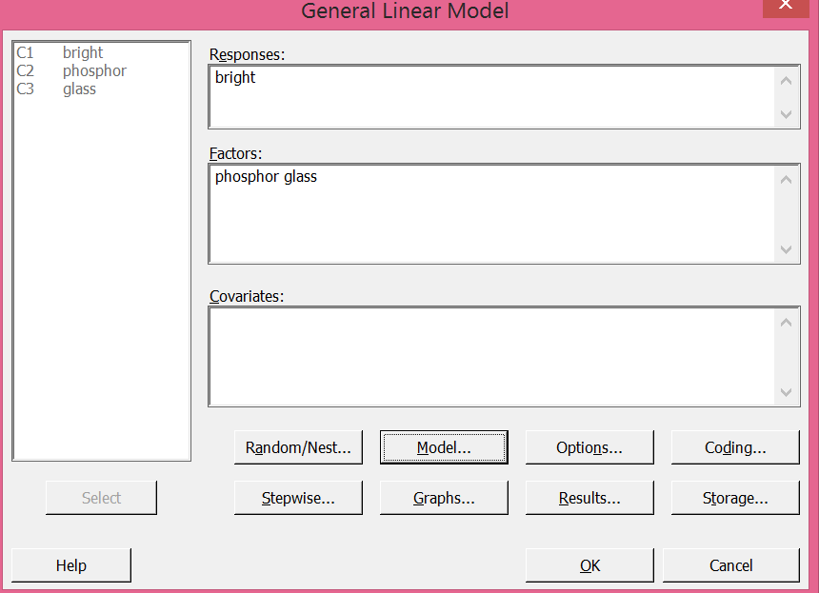
Indicator Variables
Do ANOVA to determine significant terms to include in regression equation
Don’t forget to add interactions!

Slide 161
Indicator Variables
Do ANOVA to determine significant terms to include in regression equation
General Linear Model: bright versus phosphor, glass
Method
Factor coding (-1, 0, +1)
Factor Information
Factor Type Levels Values
phosphor Fixed 2 80, 120
glass Fixed 3 1, 2, 3
Analysis of Variance
Source DF Adj SS Adj MS F-Value P-Value
phosphor 1 14450.0 14450.0 273.79 0.000
glass 2 933.3 466.7 8.84 0.004
phosphor*glass 2 133.3 66.7 1.26 0.318
Error 12 633.3 52.8
Total 17 16150.0
Model Summary
S R-sq R-sq(adj) R-sq(pred)
7.26483 96.08% 94.44% 91.18%

Slide 162
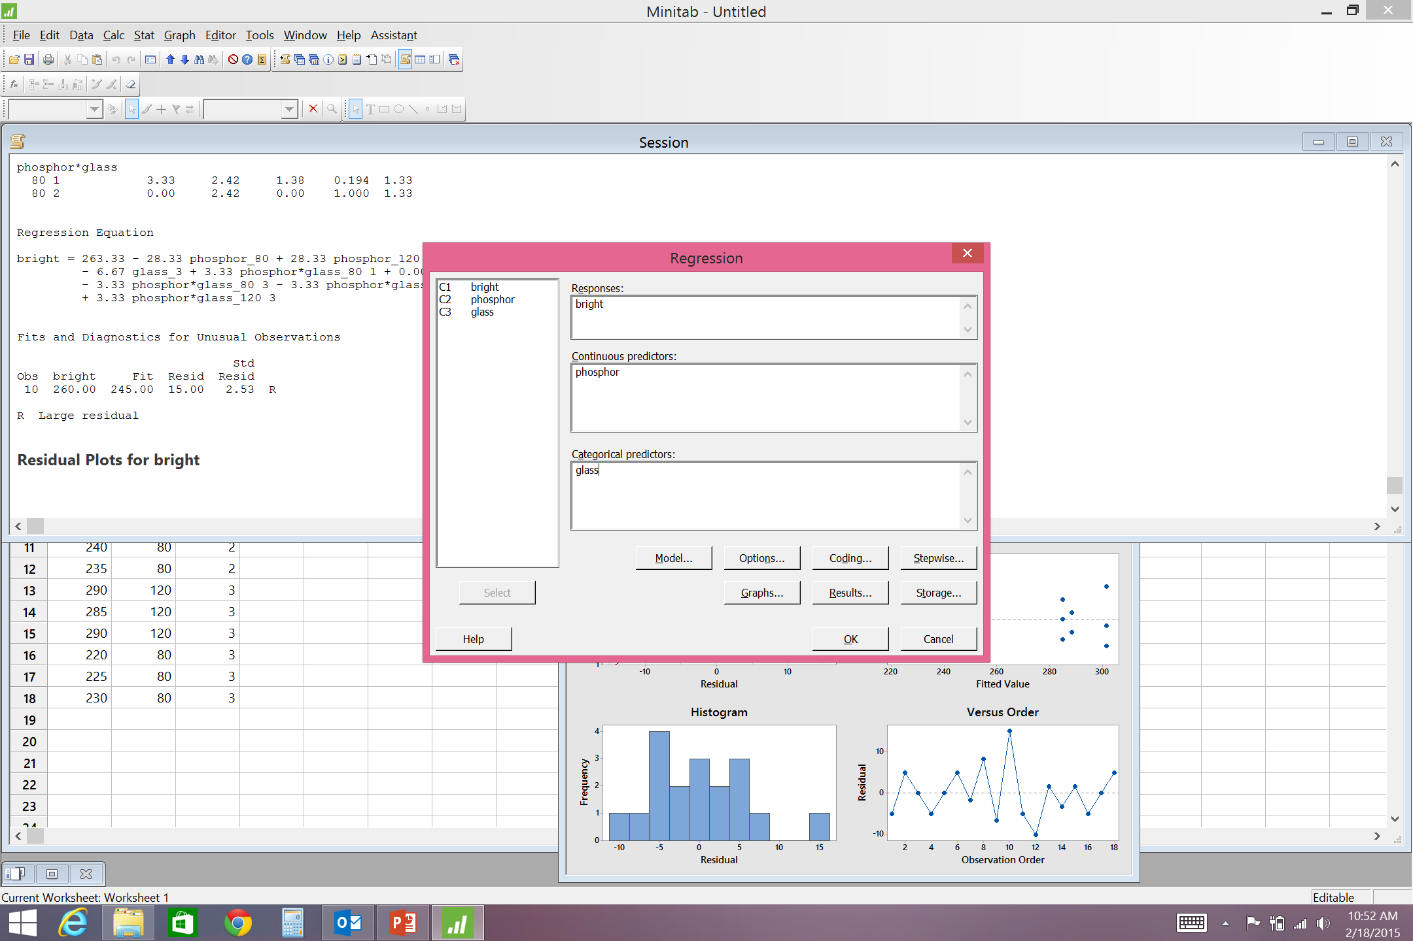
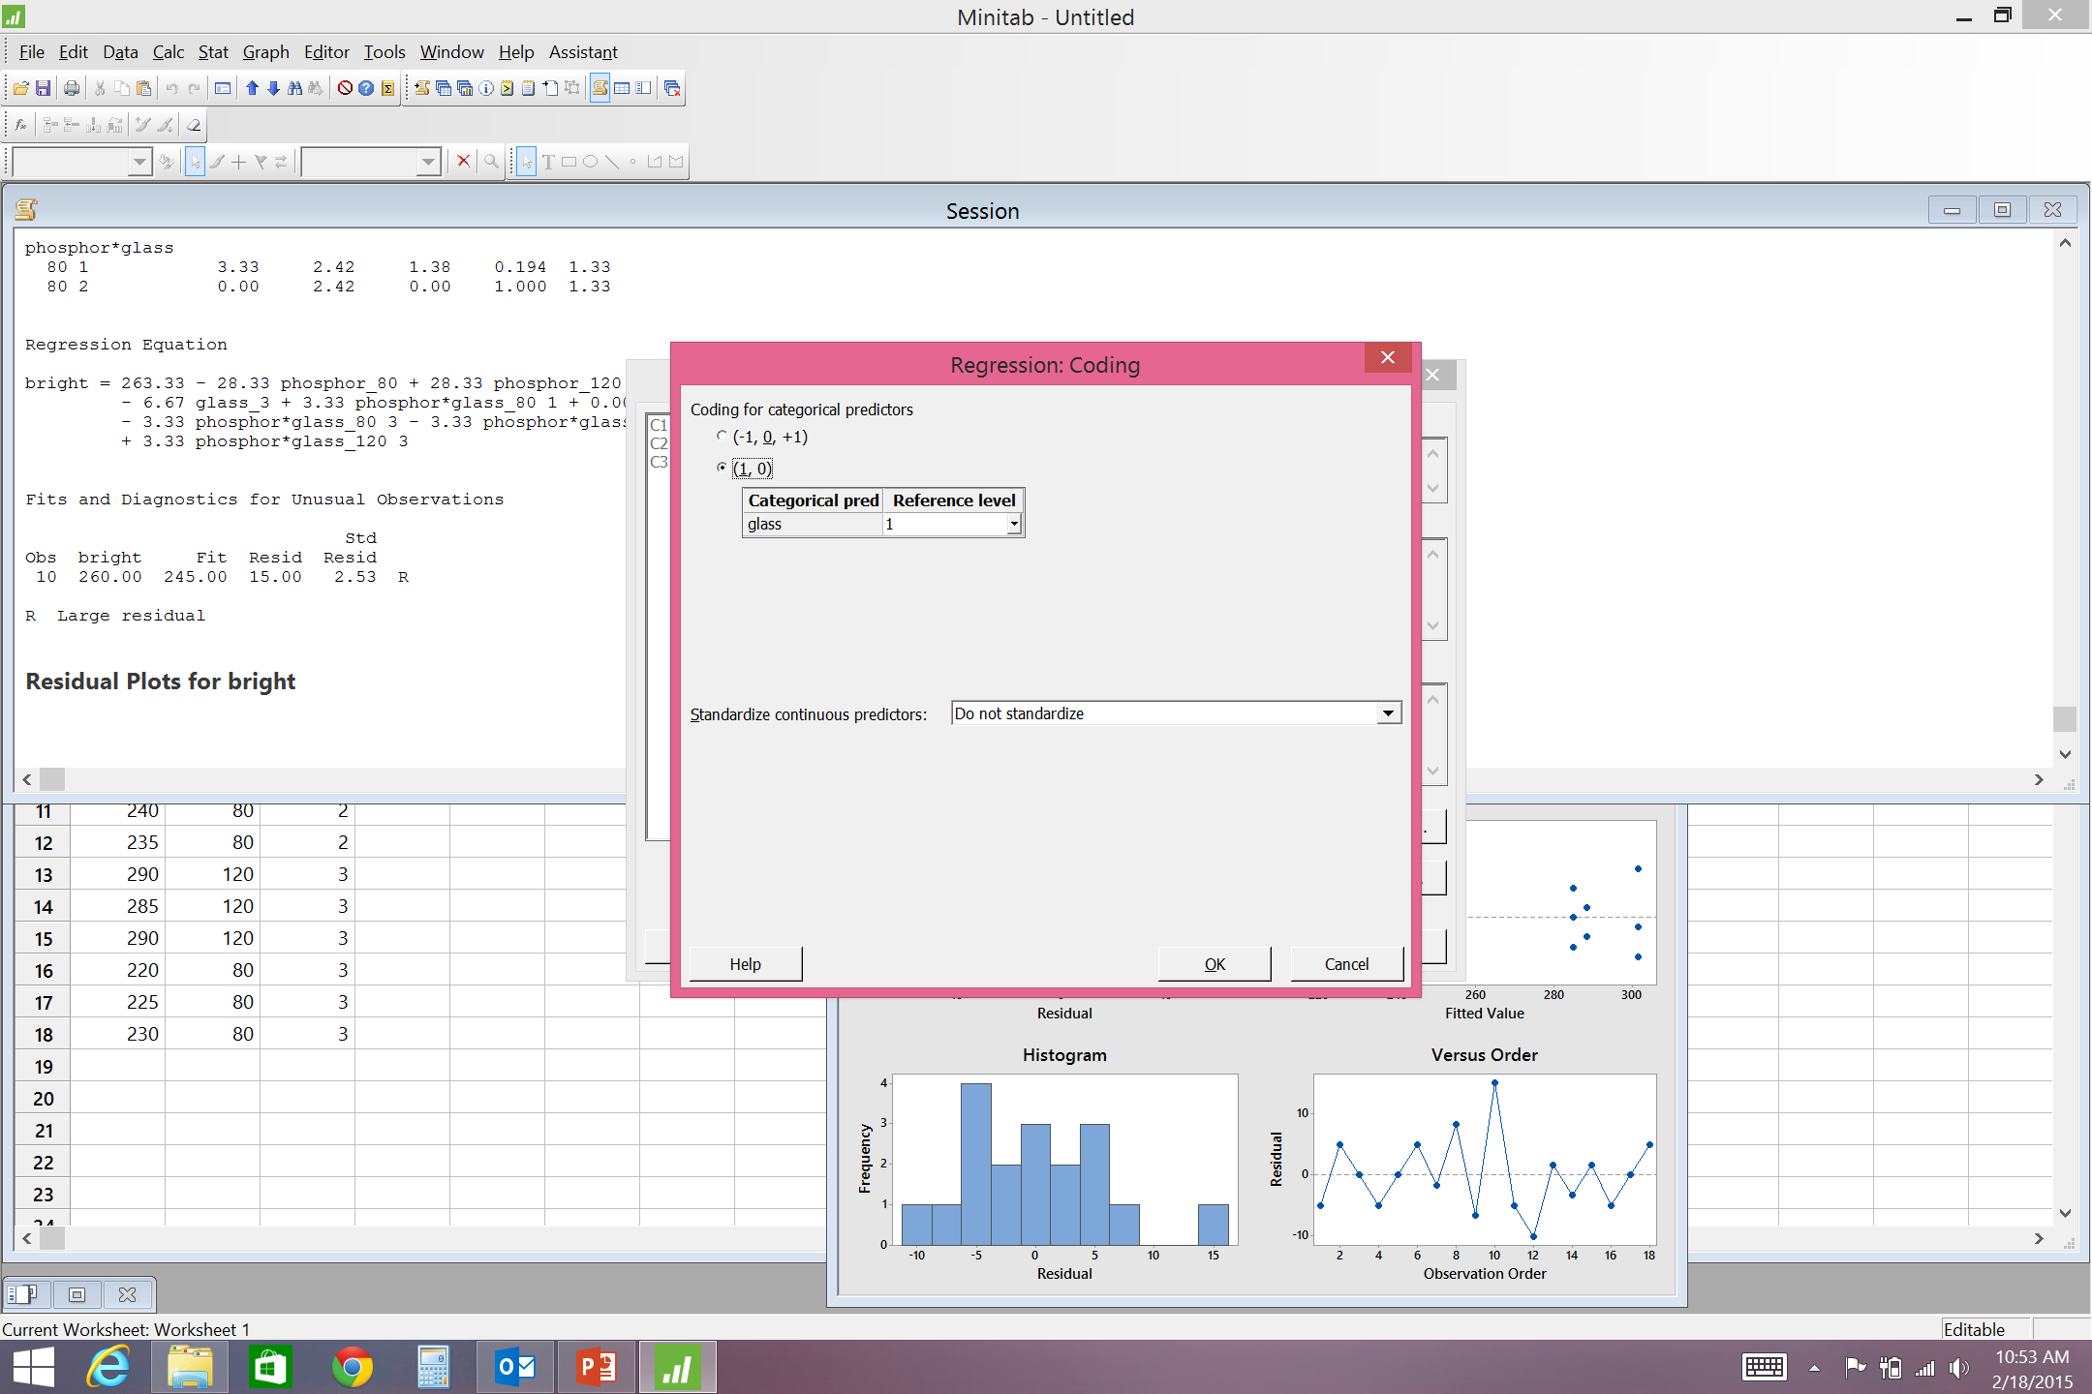
Indicator Variables
Minitab General Regression
Model: glass type and phosphor
Indicator variable: glass type
Make sure coding type is set to (1,0)

Slide 163
Regression Analysis: bright versus phosphor, glass
Method
Categorical predictor coding (1, 0)
Analysis of Variance
Source DF Adj SS Adj MS F-Value P-Value
Regression 3 15383.3 5127.8 93.64 0.000
phosphor 1 14450.0 14450.0 263.87 0.000
glass 2 933.3 466.7 8.52 0.004
Error 14 766.7 54.8
Lack-of-Fit 2 133.3 66.7 1.26 0.318
Pure Error 12 633.3 52.8
Total 17 16150.0
Model Summary
S R-sq R-sq(adj) R-sq(pred)
7.40013 95.25% 94.24% 92.15%
Coefficients
Term Coef SE Coef T-Value P-Value VIF
Constant 118.33 9.23 12.82 0.000
phosphor 1.4167 0.0872 16.24 0.000 1.00
glass
2 13.33 4.27 3.12 0.008 1.33
3 -3.33 4.27 -0.78 0.448 1.33
Regression Equation
glass
1 bright = 118.33 + 1.4167 phosphor
2 bright = 131.67 + 1.4167 phosphor
3 bright = 115.00 + 1.4167 phosphor
For Glass Type indicator variables:
Glass type 1 is baseline
Sig. dif. between 1 & 2 (p=0.008)
No sig. dif. between 1 & 3 (p=0.448)

Slide 164
Indicator Variables
Regression analysis indicates main effects of phosphor and glass type are significant, but not their interaction
Note: How could it happen that i2 is significant and not i3? They both represent the same factor (glass type).
Average brightness for each glass type
Avg brightness for glass 1 = 260.00
Avg brightness for glass 2 = 273.33
Avg brightness for glass 3 = 256.67
glass 1 ≈ glass 3, but glass 2 different
For i2, glass types 1 and 3 = 0 and glass type 2 =1
 | i2 | i3
Glass type 1 | 0 | 0
Glass type 2 | 1 | 0
Glass type 3 | 0 | 1

Slide 166
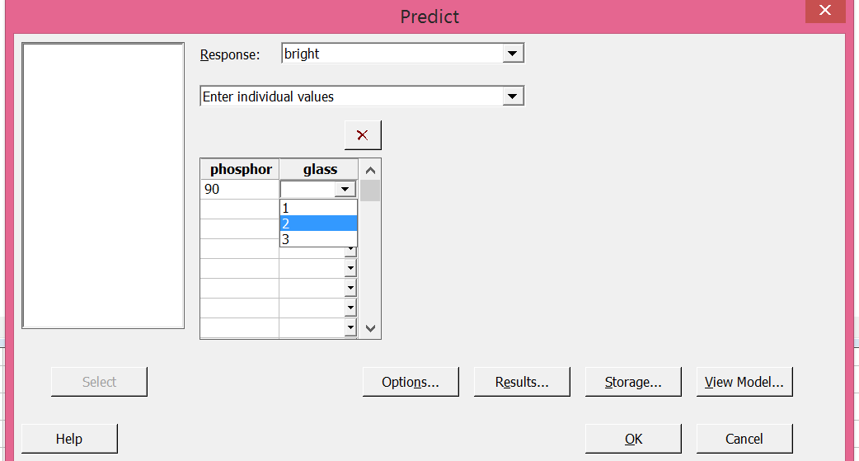
Indicator Variables
Predict brightness for phosphor=90 and glass type 2
For glass 2: brightness = 131.667 + 1.41667 phosphor = 131.667 + 1.4167(90) = 259.167
95% PI for brightness for phosphor=90 and glass type 2

Slide 167
Indicator Variables
Prediction for bright
Regression Equation
bright = 118.33 + 1.4167 phosphor + 0.000000 glass_1 + 13.33 glass_2 - 3.33 glass_3
Variable Setting
phosphor 90
glass 2
Fit SE Fit 95% CI 95% PI
259.167 3.14445 (252.422, 265.911) (241.922, 276.412)

Slide 168
Indicator Variables
Can use Best Subsets to decide which terms to include in model
Consider main effects of phosphor and glass type as well as interaction
2 indicator variables to represent glass type
 | i1 | i2
Glass type 1 | 1 | 0
Glass type 2 | 0 | 1
Glass type 3 | 0 | 0

Slide 169
Indicator Variables
To use Best Subsets must make column for each indicator variable and interactions

Slide 170
Indicator Variables
p
h p p
o h h
s o o
p s s
h * *
Mallows o i i i i
Vars R-Sq R-Sq(adj) Cp S r 1 2 1 2
1 89.5 88.8 18.2 10.308 X
1 12.9 7.5 252.5 29.650 X
2 95.0 94.4 3.2 7.3030 X X
2 94.8 94.1 3.8 7.4593 X X
3 95.3 94.2 4.5 7.4001 X X X
3 95.1 94.1 4.9 7.5053 X X X
4 95.9 94.6 4.6 7.1611 X X X X
4 95.3 93.8 6.4 7.6537 X X X X
5 96.1 94.4 6.0 7.2648 X X X X X
If 1 indicator variable associated with a factor is significant, then all the indicator variables associated with that factor should be included in the model

Slide 171
Regression Analysis: bright versus phosphor, glass
Method
Categorical predictor coding (1, 0)
Analysis of Variance
Source DF Adj SS Adj MS F-Value P-Value
Regression 3 15383.3 5127.8 93.64 0.000
phosphor 1 14450.0 14450.0 263.87 0.000
glass 2 933.3 466.7 8.52 0.004
Error 14 766.7 54.8
Lack-of-Fit 2 133.3 66.7 1.26 0.318
Pure Error 12 633.3 52.8
Total 17 16150.0
Model Summary
S R-sq R-sq(adj) R-sq(pred)
7.40013 95.25% 94.24% 92.15%
Coefficients
Term Coef SE Coef T-Value P-Value VIF
Constant 115.00 9.23 12.46 0.000
phosphor 1.4167 0.0872 16.24 0.000 1.00
glass
1 3.33 4.27 0.78 0.448 1.33
2 16.67 4.27 3.90 0.002 1.33
Regression Equation
glass
1 bright = 118.33 + 1.4167 phosphor
2 bright = 131.67 + 1.4167 phosphor
3 bright = 115.00 + 1.4167 phosphor
For Glass Type indicator variables:
Glass type 3 is baseline
No sig. dif. between 1 & 3 (p=0.448)
Sig. dif. between 2 & 3 (p=0.002)

Slide 172
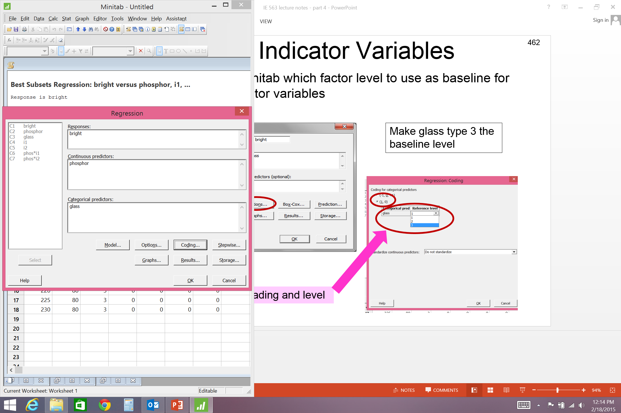
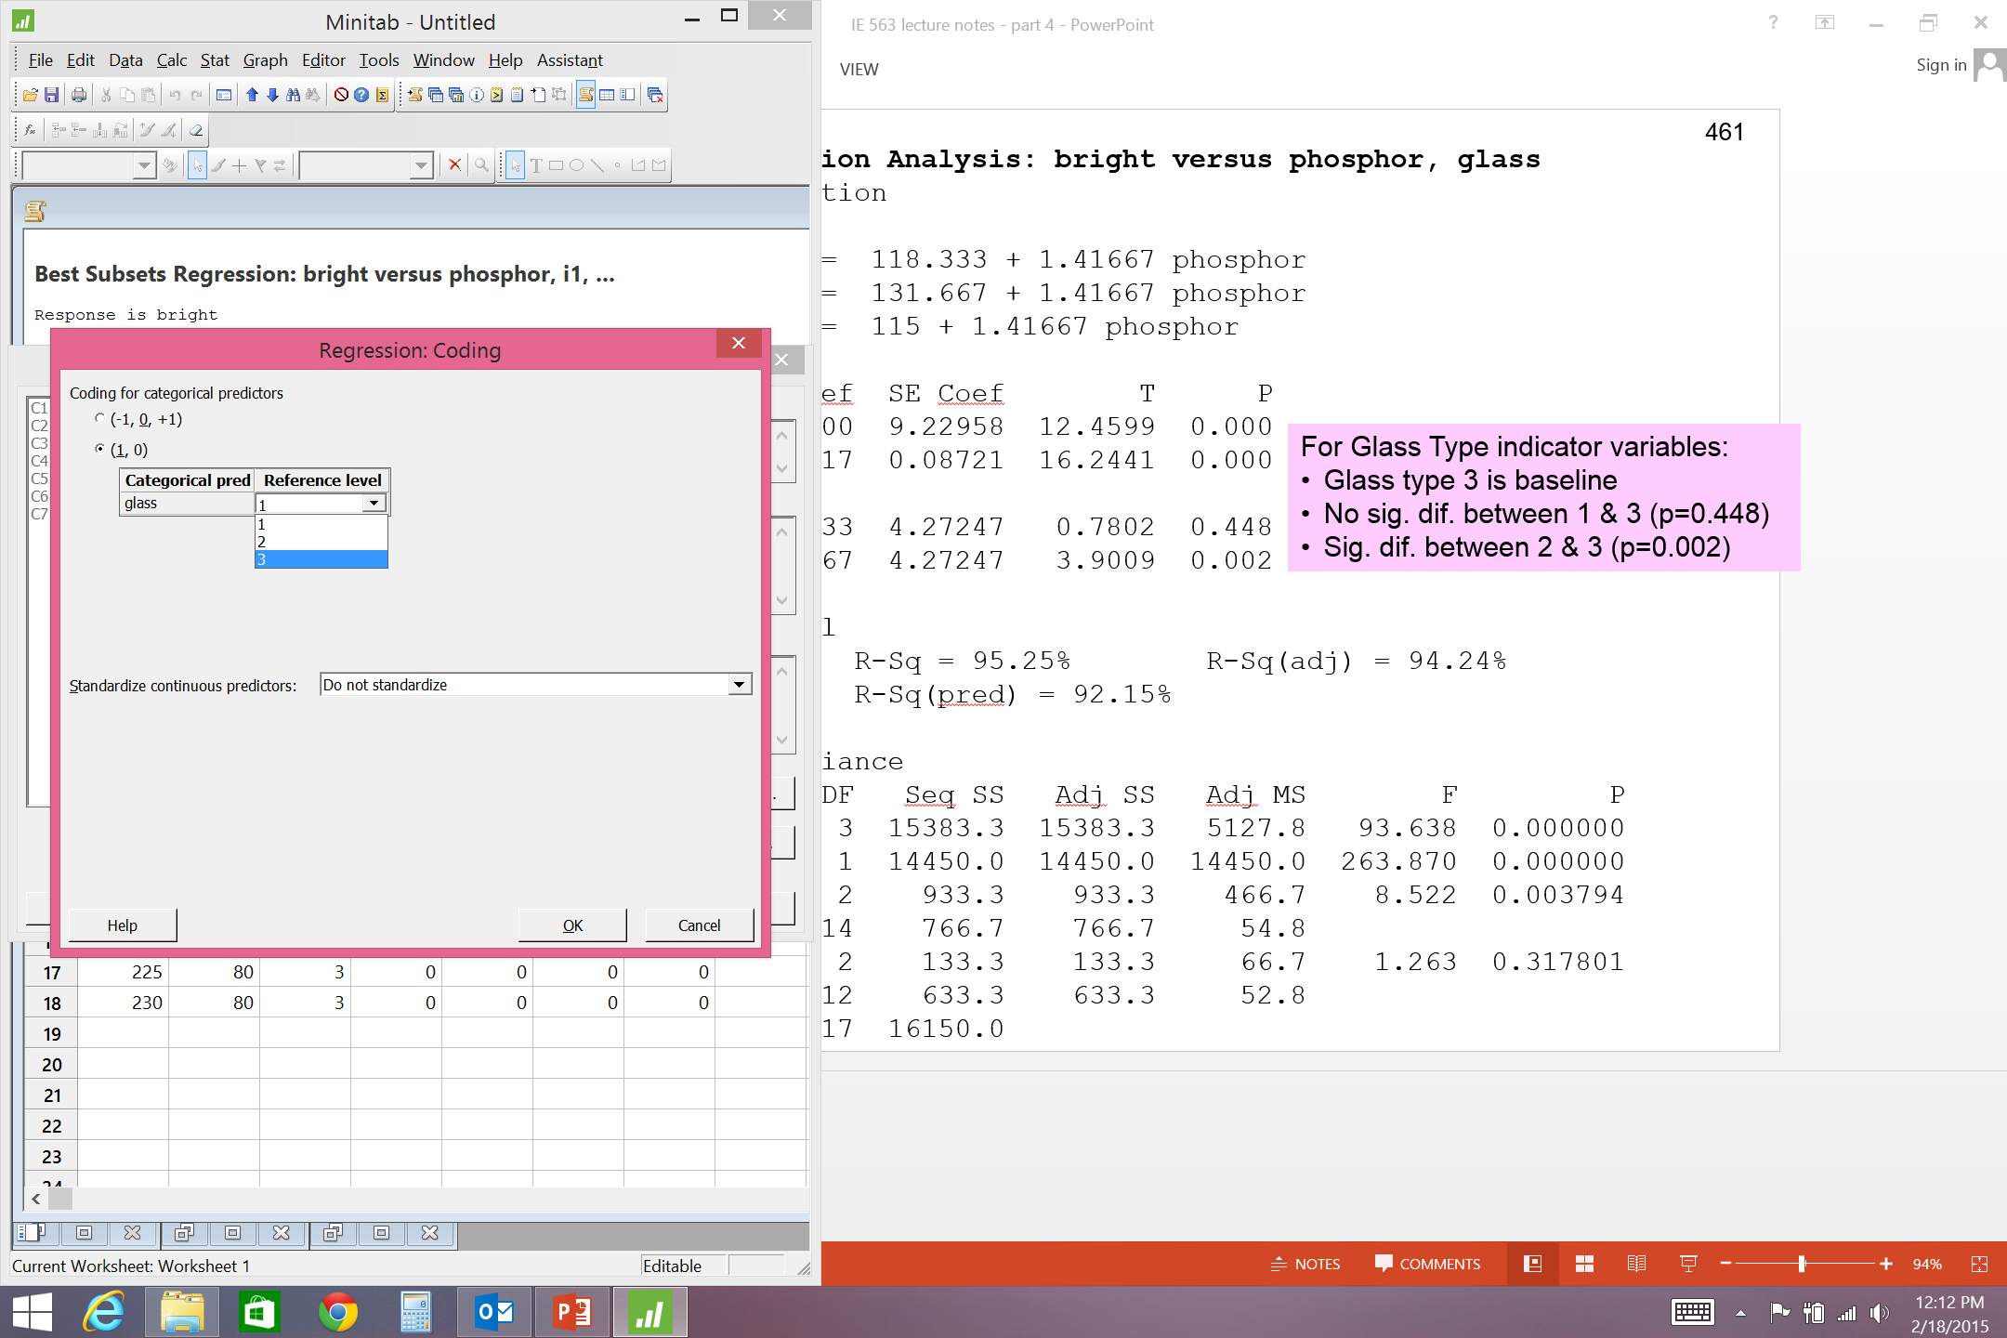
Indicator Variables
Can tell Minitab which factor level to use as baseline for (0,1) indicator variables
Make glass type 3 the baseline level
Column heading and level

Slide 173
Indicator Variables
Another example
Determine how age, weight, and gender affect time to run 1 mile.
How to decide which terms to include in regression model? ANOVA? Best Subsets?
Analyze with ANOVA first to find significant terms?

Slide 174
Analysis of data with “infinite” factor levels
What to do if it is not possible to collect observations at specific combinations of factor levels?
What if selection of factor levels cannot be easily controlled?
Example: determine effect of age, weight, gender on time to run 1 mile
Would have to find people who fit the combinations of these factor levels
i.e. would have to find a 23 year old, 189 lb man; a 23 year old, 189 lb woman; 23 year old, 201 lb man; 23 year old, 201 lb woman, etc.
Could use categories for factor levels (how to choose category limits)
Age: young, old
Weight: light, heavy
OR could simply collect data from random subjects and use multiple linear regression to analyze

Slide 175
1-mile run example
Use indicator variable for Gender
0=male; 1=female
To use Best Subsets make columns in Minitab for all interactions

Slide 176
1-mile run example
a
g
e
a *
a g w w
g e t t
e * * *
a g * g g g
Mallows g w e w e e e
Vars R-Sq R-Sq(adj) Cp S e t n t n n n
1 66.2 64.4 33.0 52.020 X
1 59.8 57.7 42.4 56.683 X
2 82.4 80.5 11.0 38.509 X X
2 82.3 80.4 11.1 38.616 X X
3 89.8 88.0 2.1 30.183 X X X
3 88.4 86.3 4.2 32.215 X X X
4 90.3 87.9 3.3 30.355 X X X X
4 90.2 87.7 3.5 30.552 X X X X
5 90.9 87.9 4.4 30.313 X X X X X
5 90.5 87.3 5.1 31.099 X X X X X
6 91.1 87.3 6.1 31.020 X X X X X X
6 91.1 87.3 6.2 31.084 X X X X X X
7 91.2 86.5 8.0 32.072 X X X X X X X
Best Subsets

Slide 177
1-mile run example
Regression Analysis: time versus age, weight, age*gen
Analysis of Variance
Source DF Adj SS Adj MS F-Value P-Value
Regression 3 136499 45499.7 49.94 0.000
age 1 62432 62432.2 68.53 0.000
weight 1 40025 40025.4 43.94 0.000
age*gen 1 30652 30652.1 33.65 0.000
Error 17 15487 911.0
Total 20 151986
Model Summary
S R-sq R-sq(adj) R-sq(pred)
30.1827 89.81% 88.01% 82.72%
Coefficients
Term Coef SE Coef T-Value P-Value VIF
Constant -3.7 47.5 -0.08 0.938
age 5.610 0.678 8.28 0.000 1.07
weight 1.828 0.276 6.63 0.000 1.57
age*gen 3.366 0.580 5.80 0.000 1.49
Regression Equation
time = -3.7 + 5.610 age + 1.828 weight + 3.366 age*gen

Slide 178
1-mile run example

Slide 179
1-mile run example
How do age, weight, and gender affect run time?
time = -3.7 + 5.610 age + 1.828 weight + 3.366 age*gen
Does age affect run time?
Yes. As age increases so does time to run 1 mile.
Does weight affect run time?
Yes. As weight increases so does time to run 1 mile.
Does gender affect run time?
Yes. As age*gender increases so does time to run
For men:
time = - 3.7 + 5.61 age + 1.83 wt + 3.37 age*(0)
time = - 3.7 + 5.61 age + 1.83 wt
For women:
time = - 3.7 + 5.61 age + 1.83 wt + 3.37 age*(1)
time = - 3.7 + 8.98 age + 1.83 wt
As women get older their times slow down faster than men
time
F
M
age

Slide 180
Regression Interpretation
How to interpret general effect of factors on response?
Be careful when interaction(s) in model – what is ‘total’ effect for factors?
Some regression equations easy to interpret
time = -3.73445 + 5.60962 age + 1.82848 wt + 3.36581 age*gen
Effect of age?
Some regression equations difficult to interpret
resp = -81.5333 + 3.01667 A + 0.811111 C - 0.0288889 A*C
Effect of factor A? Depends on C
If C is indicator variable, then not too difficult to interpret
If C is continuous, then can be difficult to interpret
Set up model in Excel to try different values of factor levels and see effect on response
For two-way interactions, can use contour plot

Slide 181
Indicator Variables
Using indicator variables does not change what we previously learned about linear regression
Can include squared terms
Does not make sense to square indicator variables
Can square quantitative factors and consider interactions between squared terms and indicator variables
Remember do not add too many ‘complicated’ terms – difficult to interpret
age
weight
gender
Age*wt
Age*gender
Wt*gender
Age*wt*gender
age²
weight²
Age²*gender
Wt²*gender
Age²*wt²
Cannot add unlimited terms – must have more observations than terms in model

Slide 182
Indicator Variables
Can also consider interactions between qualitative variables
Factor A (3 qualitative levels); i1, i2
Factor B (4 qualitative levels); i3, i4, i5
Consider including the following in model
Main Effects: i1, i2, i3, i4, i5
2-way interaction: i1*i3, i1*i4, i1*i5, i2*i3, i2*i4, i2*i5
Include i1*i2? Or i3*i5?

Slide 183
Minitab ANOVA output
R² value shown on Minitab ANOVA output is for regression model with all indicator variables
General Linear Model: yield versus temp, press
Factor Type Levels Values
temp fixed 3 100, 150, 250
press fixed 3 40, 60, 150
Analysis of Variance for yield, using Adjusted SS for Tests
Source DF Seq SS Adj SS Adj MS F P
temp 2 1965 1965 983 1.61 0.253
press 2 15272 15272 7636 12.50 0.003
temp*press 4 80337 80337 20084 32.87 0.000
Error 9 5498 5498 611
Total 17 103073
S = 24.7173 R-Sq = 94.67% R-Sq(adj) = 89.92%
Accurate if all factors have qualitative levels
If some factor levels are quantitative, then do not want regression model with all indicator variables
In other words DO NOT change quantitative factors into qualitative levels. Quantitative data is always better in the long run.

Slide 184
IE 563 project
Work in groups of 1 or 2
Design, conduct, and analyze an experiment.
Your experiment must consider at least 3 factors (can include blocks)
Your report should contain (template posted to Bb):
a complete description of the experiment, to include:
identity of the response variable, factors, and factor levels
discussion of your experimental design
discussion of how the experiment was conducted (including drawings or pictures)
table(s) of the experimental data
a description of your analysis
results and conclusions
appropriate references
Project grade based on: readability of the report, technical accuracy with regard to the design and analysis of your experiment, experiment selection, success of your experiment (i.e. ability to identify significant factors and good models), and your ability to draw practical conclusions from your analysis.
See project assignment document for more details.

Slide 185
Experimental Designs
We have discussed the following designs:
Completely randomized single factor
Single factor with completely randomized block
Full factorial design
Other common multiple factor designs:
Factorial with completely randomized block
Nested Factor
Split-plot
2^{k} factorial design
Fractional factorial design

Slide 186
Factorial Designs with Blocking
General Two-Factor Factorial Design with Blocking
Two Factors: A and B
Factor A has a levels
Factor B has b levels
n blocks (Note: a single replicate of a complete factorial experiment is run within each block)
total number of observations = abn

Slide 187
General Two-Factor Factorial Design with Blocking
Linear Statistical Model
Y_{ijk} = observation from i^{th} level of Factor A, j^{th} level of Factor B, k^{th} block

Slide 188
General Two-Factor Factorial Design with Blocking
Partition total variability in components

Slide 189
General Two-Factor Factorial Design with Blocking
ANOVA Table
Blocks are not involved in interactions

Slide 190
General Two-Factor Factorial Design with Blocking
How does temperature and pressure affect the yield of a chemical process?
Three levels of temperature (low, medium, high) and three levels of pressure (250 psi, 260 psi, 270 psi) are selected.
2 replicates for each combination of temperature and pressure
However, only 9 runs can be made in one day, so the experimenter runs a complete replicate of the design on each of two days.

Slide 191
General Two-Factor Factorial Design with Blocking
Response: yield
Factors: temperature (3), pressure (3)
Block: day(2)

Slide 192
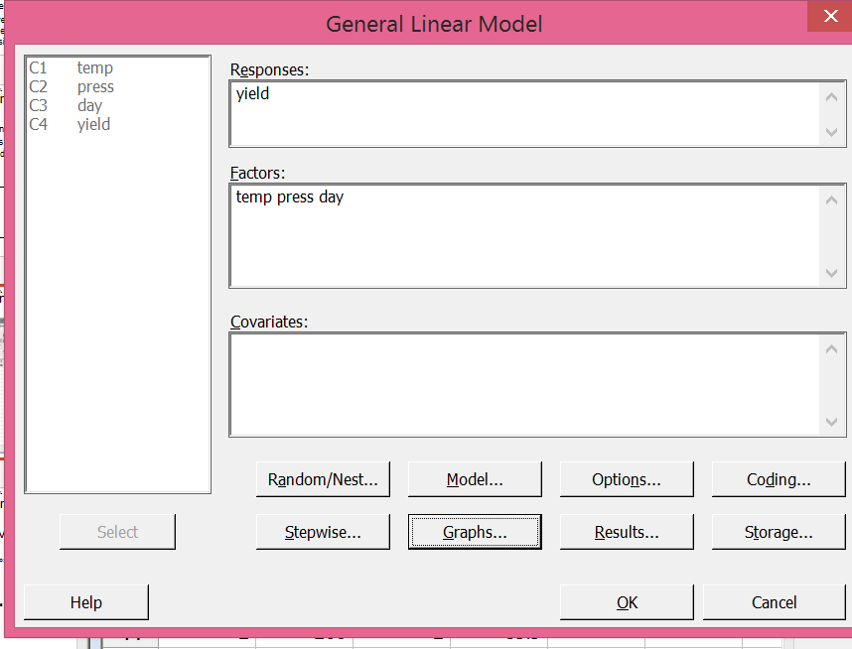
General Two-Factor Factorial Design with Blocking
Why not use indicator variables for temperature?
Don’t forget to add interaction for Temp* Press

Slide 193
General Two-Factor Factorial Design with Blocking
ANOVA model: temp|press day
General Linear Model: yield versus temp, press, day
Method
Factor coding (-1, 0, +1)
Factor Information
Factor Type Levels Values
temp Fixed 3 1, 2, 3
press Fixed 3 250, 260, 270
day Fixed 2 1, 2
Analysis of Variance
Source DF Adj SS Adj MS F-Value P-Value
temp 2 89.498 44.7489 76.33 0.000
press 2 2.148 1.0739 1.83 0.221
day 1 10.580 10.5800 18.05 0.003
temp*press 4 4.549 1.1372 1.94 0.197
Error 8 4.690 0.5863
Total 17 111.464
Model Summary
S R-sq R-sq(adj) R-sq(pred)
0.765670 95.79% 91.06% 78.70%

Slide 194
General Two-Factor Factorial Design with Blocking

Slide 195
General Two-Factor Factorial Design with Blocking
Interpret results
Choose temperature preference using main effects plot and Tukey test.
Suppose goal is to minimize yield

Slide 196
General Two-Factor Factorial Design with Blocking
Grouping Information Using Tukey Method and 95.0% Confidence
temp N Mean Grouping
3 6 91.2 A
2 6 89.0 B
1 6 85.8 C
Means that do not share a letter are significantly different.
All pairs significantly different at α = 0.05.
Choose temperature 1 (low temp) to minimize yield.

Slide 197
General Two-Factor Factorial Design with Blocking
Interpret results
Choose pressure preference using residual vs pressure plot.
Blocking was necessary
Residual variances look similar for all levels of pressure – maybe pressure of 270 has smaller residual variance

Slide 198
HW#5 here
Due date =
Unless otherwise stated, you may use Minitab to do HW assignments
If submitting HW electronically, submit one (1) file only !!!
Can copy Minitab output and paste into MS Word. Use ‘Courier New’ font when pasting Minitab output in MS Word.
Indicate where the answer is located in Minitab output (circle, highlight, etc.)
Data sets can be copied from assignment document and pasted into Excel or Minitab. Some data sets may need to be rearranged before conducting an analysis in Minitab

Slide 199
Experimental Designs
We have discussed the following designs:
Completely randomized single factor
Single factor with completely randomized block
Full factorial design
Factorial design with completely randomized block
Other common multiple factor designs:
Nested Factor
Split-plot
2^{k} factorial design
Fractional factorial design

Slide 200
Chapter 13
Nested and Split-Plot Designs

Slide 201
Two-Stage Nested Design
Use Two-Stage Nested Design for a 2 factor experiment where the levels of one factor are similar but not identical for different levels of another factor
Gets the name “Nested” because factors of one level are nested under another level
Example: Factor A is vendor; Factor B is sample
Nested design typically dictated by system/process, not experimenter’s choice
Factor A
1
2
• • • • • • •
a
Not same level 1 of factor B
1
• • •
b
1’
• • •
b’
1*
Factor B
• • •
b*
y₁₁₁
y₁₁₂
• • •
y_{11n}
y_{1b1}
y_{1b2}
• • •
y_{1bn}
y_{21’1}
y_{21’2}
• • •
y_{21’n}
y_{2b’1}
y_{2b’2}
• • •
y_{2b’n}
y_{a1*1}
y_{a1*2}
• • •
y_{a1*n}
y_{ab*1}
y_{ab*2}
• • •
y_{ab*n}
Observations
“Factor B nested under/within Factor A” or “B within A” or B(A)

Slide 202
Nested vs. Factorial Designs
Use nested design when levels of one factor are not crossed with levels of another factor
Crossed = factorial = all combinations of factor levels
Not same level 1 of factor B
Two-Stage Nested Design
Factor A
1
2
• • • • • • •
a
1
• • •
b
1’
• • •
b’
1*
Factor B
• • •
b*
Two Factor Factorial Design
Factor A
1
2
• • • • • • •
a
1
• • •
b
1
• • •
b
1
Factor B
• • •
b

Slide 203
Two-Stage Nested Design Example
Effect of restaurant and waiter on customer service levels.
Want to know if different restaurants have significantly different service levels and if different waiters have significantly different service levels.
4 restaurants are selected and 3 waiters at each restaurant are observed. 5 measurements of time to bring first drinks to table for 2 when restaurant is busy.
Factorial Design?
2 Factors: Restaurant & Waiter
No! Why?
This is a balanced nested design because there are an equal number of levels of ‘Waiter’ within each level of ‘Restaurant’
 | Restaurant 1 |  |  | Restaurant 2 |  |  | Restaurant 3 |  |  | Restaurant 4
Waiter | 1 | 2 | 3 | 1 | 2 | 3 | 1 | 2 | 3 | 1 | 2 | 3
Service Time (in min) | 4.3 | 4.7 | 3.8 | 7.2 | 10.3 | 9.5 | 16.3 | 14.3 | 10.3 | 7.3 | 9.5 | 6.4
 | 4.5 | 5.2 | 7.0 | 9.0 | 9.6 | 8.0 | 14.2 | 12.0 | 11.9 | 9.0 | 10.3 | 9.3
 | 3.1 | 7.1 | 6.2 | 11.3 | 12.2 | 7.2 | 15.9 | 10.3 | 13.8 | 8.8 | 8.4 | 11.3
 | 6.8 | 6.0 | 4.5 | 6.3 | 11.0 | 9.4 | 10.3 | 9.9 | 9.3 | 6.9 | 7.0 | 7.4
 | 3.9 | 4.8 | 3.9 | 9.9 | 8.4 | 10.2 | 11.5 | 13.9 | 12.1 | 7.5 | 6.3 | 8.9

Slide 204
Two-Stage Nested Design Example
Not a factorial design - waiter 1 from restaurant 1 has no connection to waiter 1 from restaurant 3
Waiters have the same number (#1) but that numbering is arbitrary
2 Factors: Restaurant and Waiter – interested in effects of both
4 levels of Restaurant
3 levels of Waiter nested under each level of Restaurant
Restaurant 1
Restaurant 2
Restaurant 3
Restaurant 4
Waiter
1
2
3
1
2
3
1
2
3
1
2
3
4.3 | 4.7 | 3.8
4.5 | 5.2 | 7.0
3.1 | 7.1 | 6.2
6.8 | 6.0 | 4.5
3.9 | 4.8 | 3.9
7.2 | 10.3 | 9.5
9.0 | 9.6 | 8.0
11.3 | 12.2 | 7.2
6.3 | 11.0 | 9.4
9.9 | 8.4 | 10.2
16.3 | 14.3 | 10.3
14.2 | 12.0 | 11.9
15.9 | 10.3 | 13.8
10.3 | 9.9 | 9.3
11.5 | 13.9 | 12.1
7.3 | 9.5 | 6.4
9.0 | 10.3 | 9.3
8.8 | 8.4 | 11.3
6.9 | 7.0 | 7.4
7.5 | 6.3 | 8.9
Service Time

Slide 205
Two-Stage Nested Design
If the levels of a factor can be renumbered/renamed arbitrarily then the factor is nested
Alternate waiter labeling for example
Restaurant 1
Restaurant 2
Restaurant 3
Restaurant 4
Waiter
a
b
c
d
e
f
g
h
i
j
k
l
Nested design typically dictated by system/process, not experimenter’s choice

Slide 206
Two-Stage Nested Design
Linear statistical model for two-stage nested design
No interaction between A and B because every level of B does not appear with every level of A (i.e. A and B not factorial factors). Can only consider interaction for factorial factors.
Partitioning total variability into components:
SS_{T} = SS_{A} + SS_{B(A)} + SS_{E}
j^{th} level of factor B nested under the i^{th} level of factor A
replicates nested within the combination of levels A and B

Slide 207
Two-Stage Nested Design
ANOVA table for balanced two-stage nested design
† If B is fixed then F_{A}= MS_{A}/MS_{E}
if B is random then F_{A}= MS_{A}/MS_{B(A)}
Source of Variability | SS | df | MS | F
A |  | a-1 | MS _{A} | TBD†
B within A, B(A) |  | a(b-1) | MS _{B(A)} | MS _{B(A)} / MS _{E}
Error |  | ab(n-1) | MS _{E}
Total |  | abn-1

Slide 208
Two-Stage Nested Design Example
2 Factors: Restaurant and Waiter – interested in effects of both
4 levels of Restaurant
3 levels of Waiter nested under each level of Restaurant
Waiters were selected by experimenter (i.e. fixed)
 | Restaurant 1 |  |  | Restaurant 2 |  |  | Restaurant 3 |  |  | Restaurant 4
Waiter | 1 | 2 | 3 | 1 | 2 | 3 | 1 | 2 | 3 | 1 | 2 | 3
Service Time (in min) | 4.3 | 4.7 | 3.8 | 7.2 | 10.3 | 9.5 | 16.3 | 14.3 | 10.3 | 7.3 | 9.5 | 6.4
 | 4.5 | 5.2 | 7.0 | 9.0 | 9.6 | 8.0 | 14.2 | 12.0 | 11.9 | 9.0 | 10.3 | 9.3
 | 3.1 | 7.1 | 6.2 | 11.3 | 12.2 | 7.2 | 15.9 | 10.3 | 13.8 | 8.8 | 8.4 | 11.3
 | 6.8 | 6.0 | 4.5 | 6.3 | 11.0 | 9.4 | 10.3 | 9.9 | 9.3 | 6.9 | 7.0 | 7.4
 | 3.9 | 4.8 | 3.9 | 9.9 | 8.4 | 10.2 | 11.5 | 13.9 | 12.1 | 7.5 | 6.3 | 8.9

Slide 209
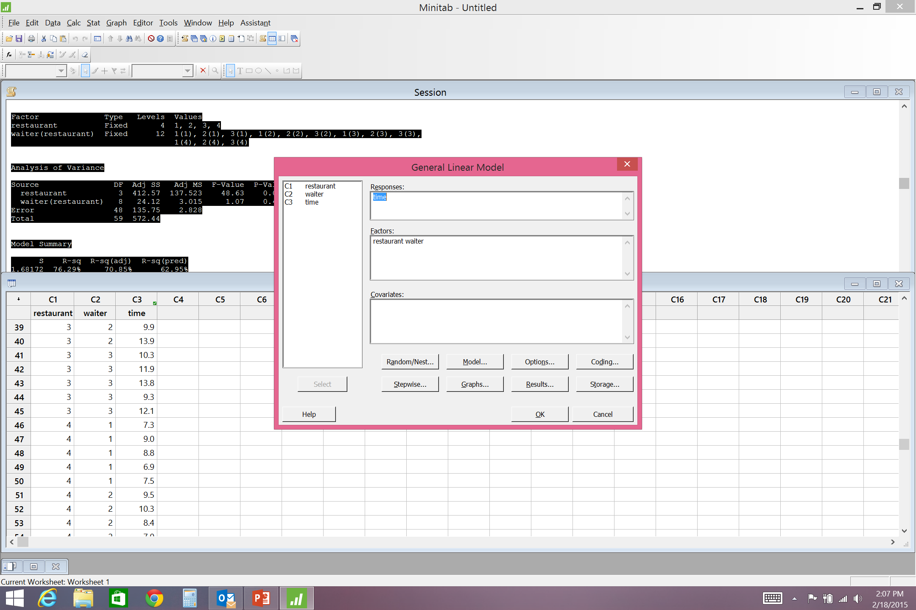
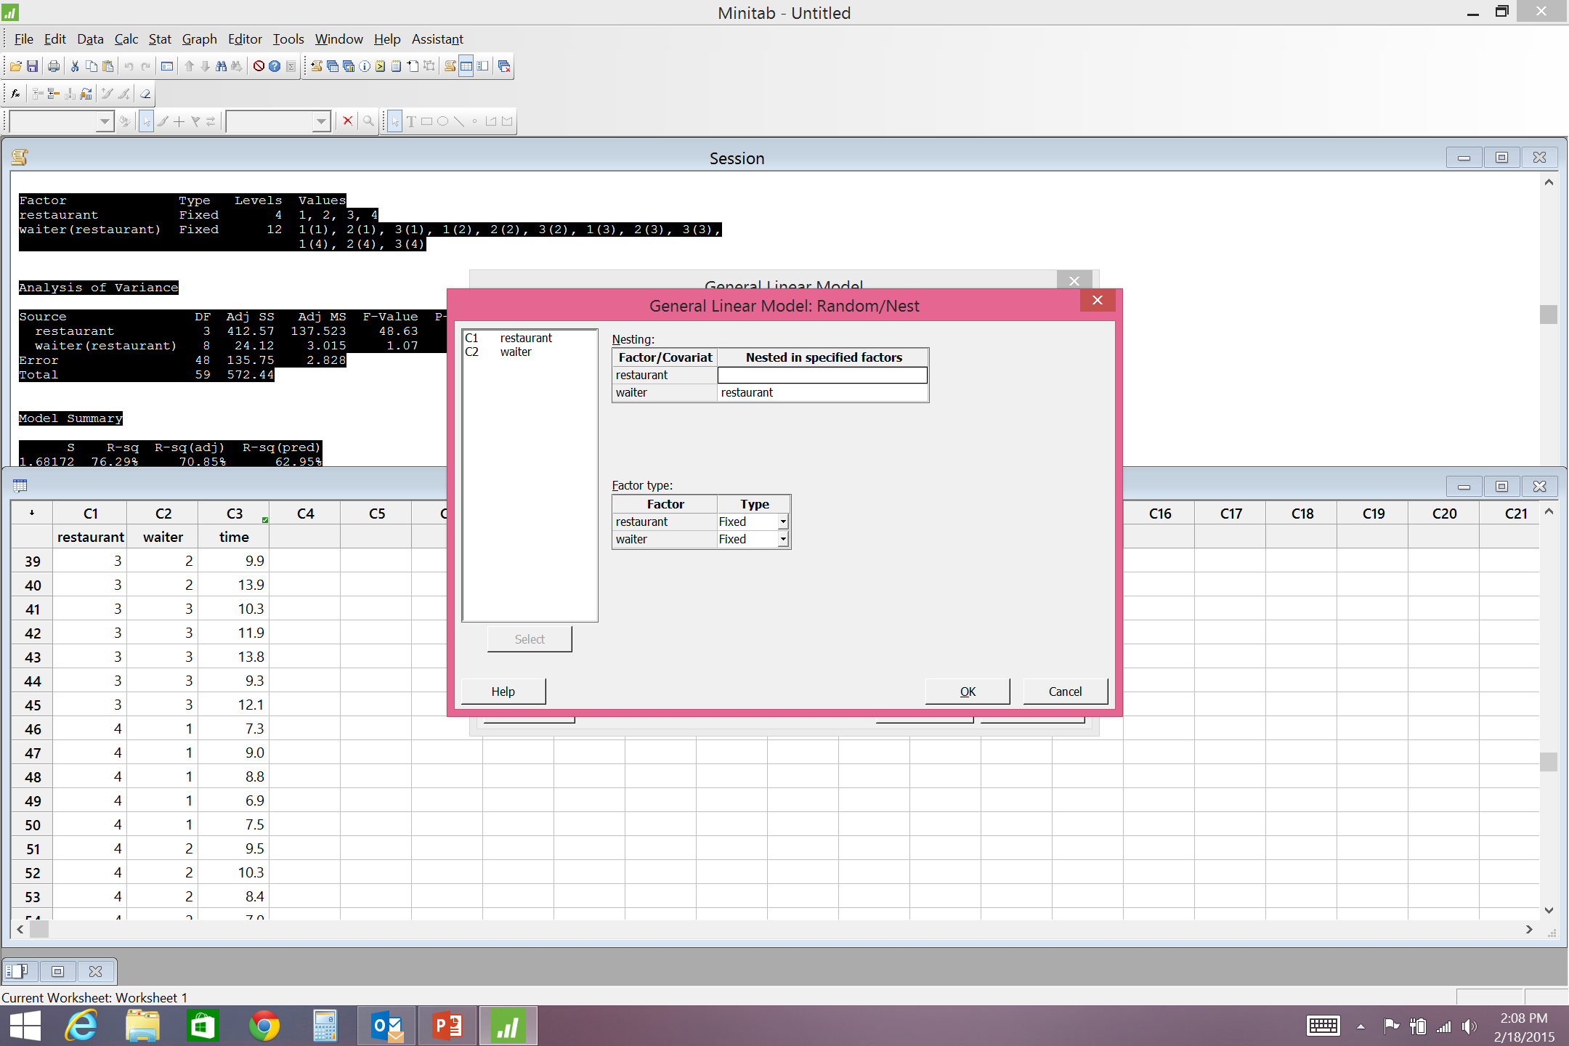
Two-Stage Nested Design Example
In Minitab
STAT
ANOVA
GLM
ORDER MATTERS!!!!
B(A) ≠ A(B)
If B is nested within A then: B(A)

Slide 210
Two-Stage Nested Design Example
General Linear Model: time versus restaurant, waiter
Method
Factor coding (-1, 0, +1)
Factor Information
Factor Type Levels Values
restaurant Fixed 4 1, 2, 3, 4
waiter(restaurant) Fixed 12 1(1), 2(1), 3(1), 1(2), 2(2), 3(2), 1(3), 2(3), 3(3),
1(4), 2(4), 3(4)
Analysis of Variance
Source DF Adj SS Adj MS F-Value P-Value
restaurant 3 412.57 137.523 48.63 0.000
waiter(restaurant) 8 24.12 3.015 1.07 0.402
Error 48 135.75 2.828
Total 59 572.44
Model Summary
S R-sq R-sq(adj) R-sq(pred)
1.68172 76.29% 70.85% 62.95%
Restaurant is significant, but Waiter is not significant
Significant differences in service time between restaurants
It matters which restaurant you visit
No significant differences between waiters at the same restaurant
Good waiter training at each restaurant ?

Slide 211
Two-Stage Nested Design Example
Study the effect of 3 production processes and batch on burn rate of rocket propellant
Want to know if different production processes lead to different burn rates and if there are burn rate differences between batches
4 batches are randomly selected from each production process and 3 burn rate determinations are made on each batch
 | Process 1 |  |  |  | Process 2 |  |  |  | Process 3
Batch | 1 | 2 | 3 | 4 | 1 | 2 | 3 | 4 | 1 | 2 | 3 | 4
Burn Rate | 25 | 19 | 15 | 15 | 19 | 23 | 18 | 35 | 14 | 35 | 38 | 25
 | 30 | 28 | 17 | 16 | 17 | 24 | 21 | 27 | 15 | 21 | 54 | 29
 | 26 | 20 | 14 | 13 | 14 | 21 | 17 | 25 | 20 | 24 | 50 | 33
Batch 1 from process 1 the same as batch 1 from process 2?
No. Batch is nested within process .

Slide 212
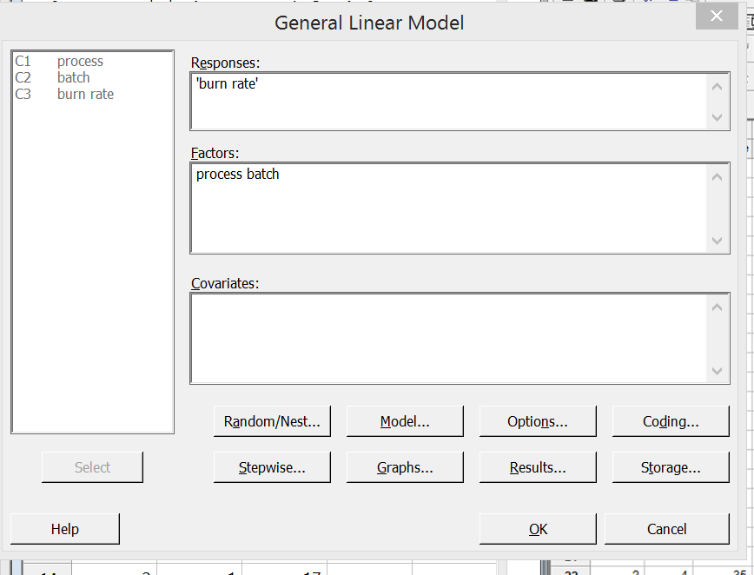
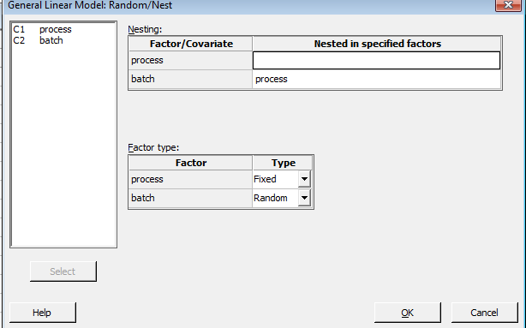
Two-Stage Nested Design Example
In Minitab
STAT
ANOVA
GLM
ORDER MATTERS!!!!
B(A) ≠ A(B)
If B is nested within A then: B(A)

Slide 213
Two-Stage Nested Design Example Minitab
General Linear Model: burn rate versus process, batch
Method
Factor coding (-1, 0, +1)
Factor Information
Factor Type Levels Values
process Fixed 3 1, 2, 3
batch(process) Random 12 1(1), 2(1), 3(1), 4(1), 1(2), 2(2), 3(2), 4(2), 1(3), 2(3),
3(3), 4(3)
Analysis of Variance
Source DF Adj SS Adj MS F-Value P-Value
process 2 676.1 338.03 1.46 0.281
batch(process) 9 2077.6 230.84 12.20 0.000
Error 24 454.0 18.92
Total 35 3207.6
Model Summary
S R-sq R-sq(adj) R-sq(pred)
4.34933 85.85% 79.36% 68.15%

Slide 214
Two-Stage Nested Design Example Minitab
Production Process is not significant, but Batch is significant
The 3 production processes make propellants with the same mean burn rates
It does not matter which supplier you use
Batch was significant.
This means that there is a significant difference between the batches within each production process
Work with suppliers to reduce variability between batches

Slide 215
Two-Stage Nested Design Example Residuals
Remember:
For two-stage nested design:

Slide 216
Two-Stage Nested Design Example Residuals

Slide 217
Two-Stage Nested Design
Pairwise comparisons (Tukey test) for Nested designs
If a factor is random (not fixed) or nested with a random factor, then pairwise comparisons do not make sense
No need to evaluate randomly chosen levels – they may not be randomly chosen ever again
Pairwise comparisons tell you which specific levels of a factor maximize/minimize the response
If you choose the factor levels randomly you do not care about a specific level(s) so no need to do pairwise comparison
If you are interested in specific factor levels, then they are fixed levels and a pairwise comparison can be performed

Slide 218
Two-Stage Nested Design Example
For restaurant example: since the levels of Waiter were fixed, can do pairwise comparisons (i.e. Tukey test) for this example
Grouping Information Using Tukey Method and 95.0% Confidence
restaurant N Mean Grouping
3 15 12.400 A
2 15 9.300 B
4 15 8.287 B
1 15 5.053 C
Means that do not share a letter are significantly different.

Slide 219
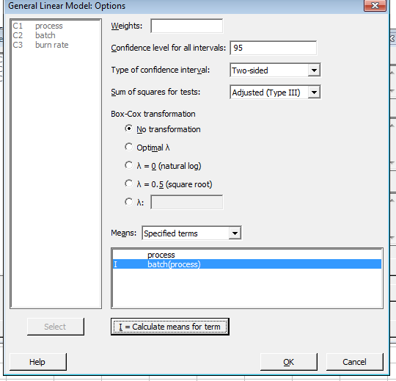
Two-Stage Nested Design Example
For rocket propellant example: since the levels of Batch were chosen randomly, no pairwise comparisons for this example
Cannot do Tukey’s test for Batch since it is random factor, but can compare average burn rate for each batch

Slide 220
Two-Stage Nested Design Example
Cannot do Tukey’s test for Batch since it is random factor, but can compare average burn rate for each batch
Means
Term Fitted Mean
batch(process)
1(1) 27.0000
2(1) 22.3333
3(1) 15.3333
4(1) 14.6667
1(2) 16.6667
2(2) 22.6667
3(2) 18.6667
4(2) 29.0000
1(3) 16.3333
2(3) 26.6667
3(3) 47.3333
4(3) 29.0000
Much variation between batches from process 3

Slide 221
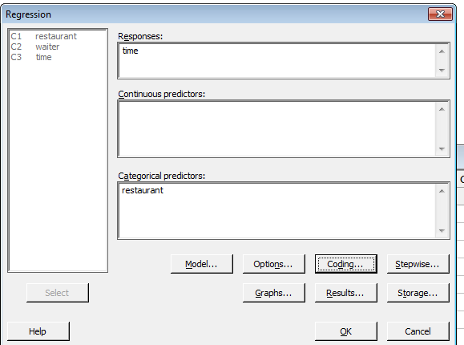
Two-Stage Nested Design Example
Regression Analysis for Nested Designs
Can perform regression for nested designs using categorical levels (indicator variables) for combinations of nested factor levels
For restaurant example:
ANOVA told us significant differences in service time between Restaurants, but not Waiters
Form regression model with Restaurant
Use indicator variables for Restaurant
4 restaurants; therefore 3 indicator variables
Switch to (0,1) coding for indicator variables

Slide 222
Two-Stage Nested Design Example
Regression Analysis for Restaurant example
Regression Analysis: time versus restaurant
Method
Categorical predictor coding (1, 0)
Analysis of Variance
Source DF Adj SS Adj MS F-Value P-Value
Regression 3 412.6 137.523 48.17 0.000
restaurant 3 412.6 137.523 48.17 0.000
Error 56 159.9 2.855
Total 59 572.4
Model Summary
S R-sq R-sq(adj) R-sq(pred)
1.68965 72.07% 70.58% 67.94%
Coefficients
Term Coef SE Coef T-Value P-Value VIF
Constant 5.053 0.436 11.58 0.000
restaurant
2 4.247 0.617 6.88 0.000 1.50
3 7.347 0.617 11.91 0.000 1.50
4 3.233 0.617 5.24 0.000 1.50
Regression Equation
time = 5.053 + 0.0 restaurant_1 + 4.247 restaurant_2 + 7.347 restaurant_3
+ 3.233 restaurant_4

Slide 223
Two-Stage Nested Design
Regression Analysis for Nested Designs
Can perform regression for nested designs using categorical levels (indicator variables) for combinations of nested factor levels
For rocket propellant example:
ANOVA told us no significant differences in burn rate between Processes, but significant differences between Batches
Form regression model with Batches (remember Batch is nested in Process)
Use indicator variables for all combinations of process and batch
4 batches from each of 3 processes = 4*3 = 12 combinations; therefore 11 indicator variables
Usefulness of regression for this example??? Predict burn rate of these 12 randomly selected batches ☹

Slide 224
m-Stage Nested Design
Can extend two-stage nested design to m-stage nested design
Factor
Design
A
1
• • • • • • •
a
2-Stage Nested
B
1
• • •
b
1*
• • •
b*
C
3-Stage Nested
1
• • •
c
1’
c’
1”
c”
1*
c*
• • •
• • •
• • •
D
4-Stage Nested
1
• •
d
1’
• •
d’
1”
• •
d”
1*
• •
d*

Slide 225
3-Stage Nested Design Example
Investigate the effect of brand, manufacturing location, and production line on the amount of iron in baby formula
Select 3 brands of formula
Select 2 manufacturing locations for each brand (from m_{b} possible locations for a brand)
Select 3 production lines for each manufacturing location (from l_{m} possible lines at manufacturing location m)
Measure amount of iron in 4 containers of formula
 | Brand 1 |  |  |  |  |  | Brand 2 |  |  |  |  |  | Brand 3
Location | 1 |  |  | 2 |  |  | 1 |  |  | 2 |  |  | 1 |  |  | 2
Line | 1 | 2 | 3 | 1 | 2 | 3 | 1 | 2 | 3 | 1 | 2 | 3 | 1 | 2 | 3 | 1 | 2 | 3
Iron (mg/fl oz) | 5.3 | 5.9 | 5.6 | 6.2 | 4.9 | 6.3 | 2.6 | 3.9 | 3.6 | 3.7 | 3.4 | 3.7 | 6.9 | 8.6 | 7.6 | 7.6 | 8.2 | 8.0
 | 4.9 | 5.4 | 4.7 | 5.4 | 4.6 | 5.9 | 3.4 | 4.1 | 3.8 | 3.8 | 3.9 | 2.9 | 7.8 | 8.1 | 7.0 | 8.0 | 7.6 | 7.6
 | 5.0 | 4.8 | 4.8 | 5.8 | 5.9 | 5.1 | 2.9 | 4.5 | 4.6 | 4.6 | 3.6 | 3.5 | 7.6 | 8.4 | 7.4 | 7.1 | 7.7 | 7.9
 | 5.7 | 5.1 | 6.0 | 5.5 | 5.7 | 5.4 | 3.7 | 3.7 | 4.4 | 4.1 | 3.0 | 3.0 | 6.7 | 8.6 | 7.3 | 7.6 | 8.7 | 7.1

Slide 226
3-Stage Nested Design
Partitioning total variability into components:
SS_{T} = SS_{A} + SS_{B(A)} + SS_{C(B)} + SS_{E}
ANOVA table for balanced 3-stage nested design
Source of Var. | SS | df | MS | F
A |  | a-1 | MS _{A} | TBD†
B within A, B(A) |  | a(b-1) | MS _{B(A)} | TBD††
C within B, C(B) |  | ab(c-1) | MS _{C(B)} | MS _{C(B)} / MS _{E}
Error |  | abc(n-1) | MS _{E}
Total |  | abcn-1
† If B is fixed and C is fixed then F_{A}= MS_{A}/MS_{E}
If B is fixed and C is random then F_{A}= MS_{A}/MS_{C(B)}
If B is random then F_{A}= MS_{A}/MS_{B(A)}
†† If C is fixed then F_{B}= MS_{B}/MS_{E}
if C is random then F_{B}= MS_{B}/MS_{C(B)}

Slide 227
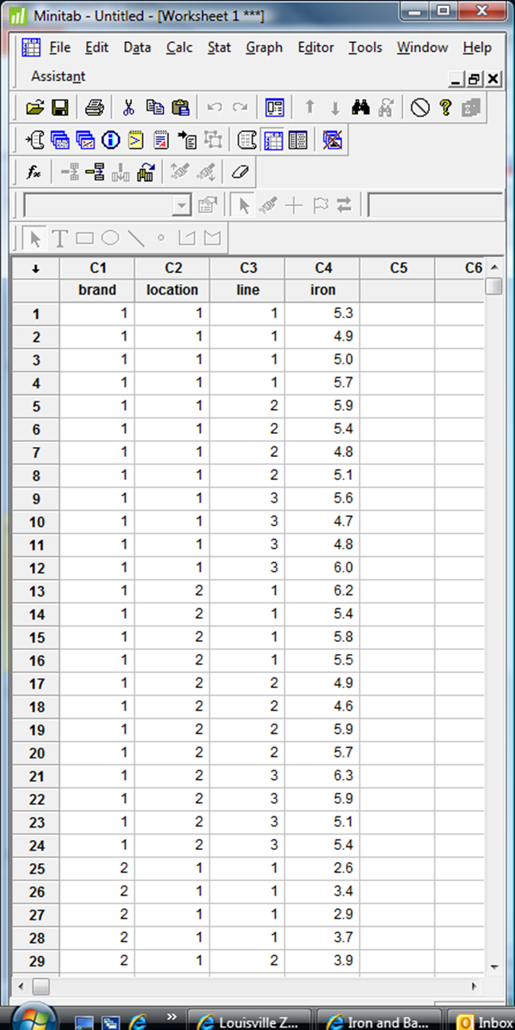
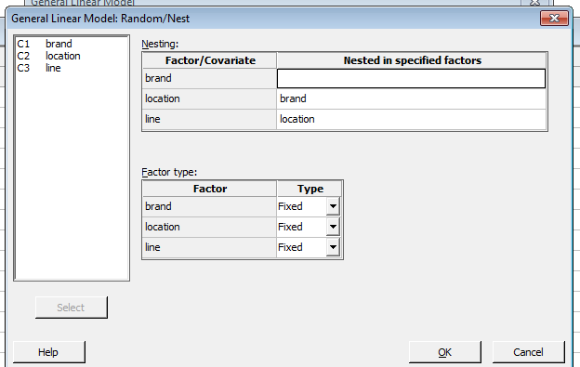
3-Stage Nested Design Example

Slide 228
3-Stage Nested Design Example
General Linear Model: iron versus brand, location, line
Method
Factor coding (-1, 0, +1)
Factor Information
Factor Type Levels Values
brand Fixed 3 1, 2, 3
location(brand) Fixed 6 1(1), 2(1), 1(2), 2(2), 1(3), 2(3)
line(brand, location) Fixed 18 1(1, 1), 2(1, 1), 3(1, 1), 1(1, 2), 2(1, 2), 3(1, 2),
1(2, 1), 2(2, 1), 3(2, 1), 1(2, 2), 2(2, 2), 3(2, 2),
1(3, 1), 2(3, 1), 3(3, 1), 1(3, 2), 2(3, 2), 3(3, 2)
Analysis of Variance
Source DF Adj SS Adj MS F-Value P-Value
brand 2 196.114 98.0568 497.89 0.000
location(brand) 3 0.727 0.2425 1.23 0.307
line(brand, location) 12 8.063 0.6719 3.41 0.001
Error 54 10.635 0.1969
Total 71 215.539
Model Summary
S R-sq R-sq(adj) R-sq(pred)
0.443784 95.07% 93.51% 91.23%

Slide 229
3-Stage Nested Design Example
Brand and Line are significant, but not Location
Significant differences in iron content between brands of baby formula and between production lines at each location of each brand
It matters which brand you use
Manufacturers’ QC need to reduce variance between lines at each manufacturing location
Location was not significant.
This means there are not significant differences between the manufacturing locations within each brand

Slide 230
3-Stage Nested Design Example

Slide 231
3-Stage Nested Design Example
Pairwise Comparisons (Tukey Test) for Brand
Tukey Pairwise Comparisons: Response = iron, Term = brand
Grouping Information Using the Tukey Method and 95% Confidence
brand N Mean Grouping
3 24 7.71250 A
1 24 5.41250 B
24 3.68333 C
Means that do not share a letter are significantly different.
Tukey Simultaneous Tests for Differences of Means
Difference
of brand Difference SE of Simultaneous Adjusted
Levels of Means Difference 95% CI T-Value P-Value
2 - 1 -1.729 0.128 (-2.038, -1.420) -13.50 0.000
3 - 1 2.300 0.128 ( 1.991, 2.609) 17.95 0.000
3 - 2 4.029 0.128 ( 3.720, 4.338) 31.45 0.000
Individual confidence level = 98.07%

Slide 232
3-Stage Nested Design Example
Pairwise Comparisons (Tukey Test) for Line
Grouping Information Using the Tukey Method and 95% Confidence
line(brand, location) N Mean Grouping
2(3, 1) 4 8.425 A
2(3, 2) 4 8.050 A B
3(3, 2) 4 7.650 A B
1(3, 2) 4 7.575 A B
3(3, 1) 4 7.325 A B
1(3, 1) 4 7.250 B
1(1, 2) 4 5.725 C
3(1, 2) 4 5.675 C
2(1, 1) 4 5.300 C
2(1, 2) 4 5.275 C
3(1, 1) 4 5.275 C
1(1, 1) 4 5.225 C D
3(2, 1) 4 4.100 D E
1(2, 2) 4 4.050 E
2(2, 1) 4 4.050 E
2(2, 2) 4 3.475 E
3(2, 2) 4 3.275 E
1(2, 1) 4 3.150 E
For brand 3, only significant difference in iron content between lines 1 and 2 at location 1
No significant differences in iron content between the 6 lines making brand 1 (Group C)
No significant differences in iron content between the 6 lines making brand 2
(Group E)

Slide 233
3-Stage Nested Design
Regression Analysis for Nested Designs
Can perform regression for nested designs using categorical levels (indicator variables) for combinations of nested factor levels
For baby formula example:
ANOVA told us significant differences in iron content between Brand and Line, but no significant differences between Locations
Form regression model with Brand and Line.
Since Line nested in Location (which is nested in Brand), use indicator variables for all combinations of Brand, Location, and Line
3 brands, 2 locations for each brand, 3 lines at each location = 3*2*3 = 18 combinations; therefore 17 indicator variables
18 different Lines

Slide 234
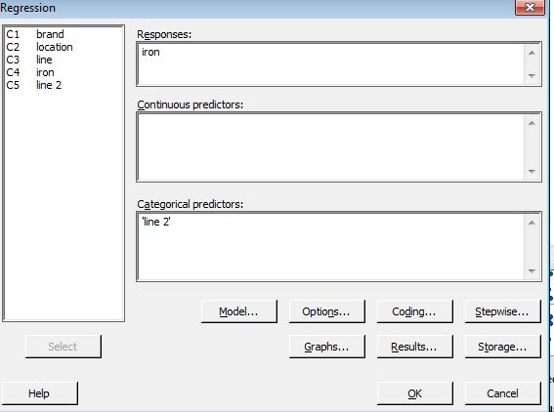
3-Stage Nested Design Example
Regression Analysis for Baby Formula example
Add column to Minitab Worksheet: sequentially number all 18 combinations of brand, location, and line
In General Regression, form regression equation with indicator variables for added column
Switch to (0,1) coding for indicator variables

Slide 235
3-Stage Nested Design Example
General Regression Analysis: iron versus line2
Coefficients
Term Coef SE Coef T-Value P-Value VIF
Constant 5.225 0.222 23.55 0.000
line 2
2 0.075 0.314 0.24 0.812 1.89
3 0.050 0.314 0.16 0.874 1.89
4 0.500 0.314 1.59 0.117 1.89
5 0.050 0.314 0.16 0.874 1.89
6 0.450 0.314 1.43 0.157 1.89
7 -2.075 0.314 -6.61 0.000 1.89
8 -1.175 0.314 -3.74 0.000 1.89
9 -1.125 0.314 -3.59 0.001 1.89
10 -1.175 0.314 -3.74 0.000 1.89
11 -1.750 0.314 -5.58 0.000 1.89
12 -1.950 0.314 -6.21 0.000 1.89
13 2.025 0.314 6.45 0.000 1.89
14 3.200 0.314 10.20 0.000 1.89
15 2.100 0.314 6.69 0.000 1.89
16 2.350 0.314 7.49 0.000 1.89
17 2.825 0.314 9.00 0.000 1.89
18 2.425 0.314 7.73 0.000 1.89

Slide 236
3-Stage Nested Design Example
General Regression Analysis: iron versus line2
Analysis of Variance
Source DF Adj SS Adj MS F-Value P-Value
Regression 17 204.90 12.0532 61.20 0.000
line 2 17 204.90 12.0532 61.20 0.000
Error 54 10.63 0.1969
Total 71 215.54
Model Summary
S R-sq R-sq(adj) R-sq(pred)
0.443784 95.07% 93.51% 91.23%

Slide 237
Designs with both Nested and Factorial Factors
Nested Factors: the levels of one factor are similar but not identical for different levels of another factor
Factorial Factors: all combinations of the factor levels are investigated. Same factor levels for each level of another factor.

Slide 238
Nested & Factorial Design Example
Investigate how the age of consumer affects their rating of soda taste
Select 2 types of soda (Coke Zero & Diet Coke)
Select 2 age groups (young & old)
Randomly select 3 taste testers in each age group
Each taste tester gets 2 samples of each soda type
Interested in effect of soda type, age, and tester on rating (1-100)
Factorial Factors: Soda Type and Age
Nested Factor: Taste Tester
 | Coke Zero |  |  |  |  |  | Diet Coke
Age | young |  |  | old |  |  | young |  |  | old
Tester | Kim | Bill | Jim | Bev | Ed | Tom | Kim | Bill | Jim | Bev | Ed | Tom
Taste Rating | 75 | 70 | 58 | 85 | 77 | 45 | 68 | 86 | 77 | 67 | 60 | 34
 | 67 | 73 | 62 | 79 | 82 | 52 | 72 | 80 | 86 | 64 | 55 | 29
What if we are not interested in differences between testers?
2 factor factorial
Block on tester? Single replicate of complete factorial design in each block?

Slide 239
Nested & Factorial Design Example
 | Coke Zero |  |  |  |  |  | Diet Coke
Age | young |  |  | old |  |  | young |  |  | old
Tester | Kim | Bill | Jim | Bev | Ed | Tom | Kim | Bill | Jim | Bev | Ed | Tom
Taste Rating | 75 | 70 | 58 | 85 | 77 | 45 | 68 | 86 | 77 | 67 | 60 | 34
 | 67 | 73 | 62 | 79 | 82 | 52 | 72 | 80 | 86 | 64 | 55 | 29
Factorial Factors: Soda Type and Age
Nested Factor: Taste Tester
Partitioning total variability into components:
SS_{T} = SS_{Soda} + SS_{Age} + SS_{Tester(Age)} + SS_{Soda*Age}
+ SS_{Soda*Tester(Age)} + SS_{E}
Cannot include Age*Tester or Soda*Age*Tester interactions because all testers are not in all age groups (Testers are nested in Age)

Slide 240
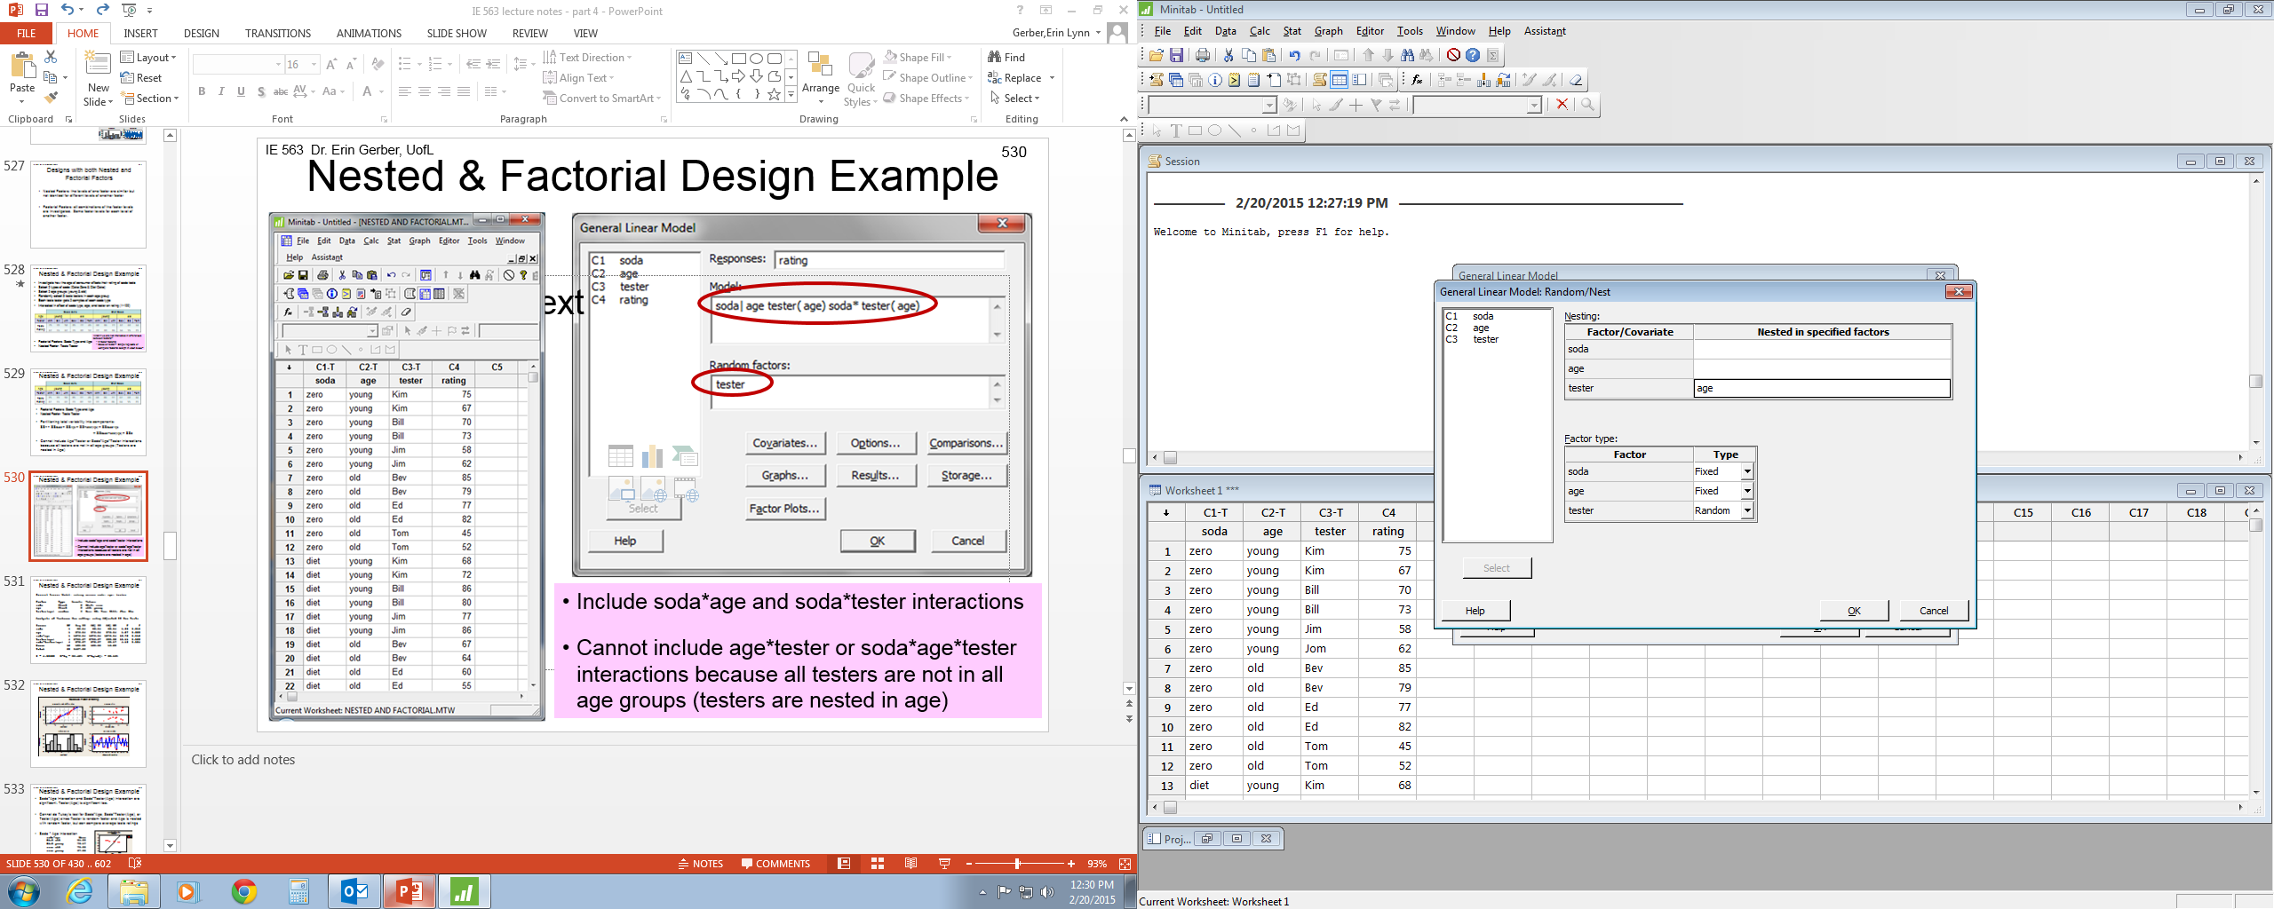
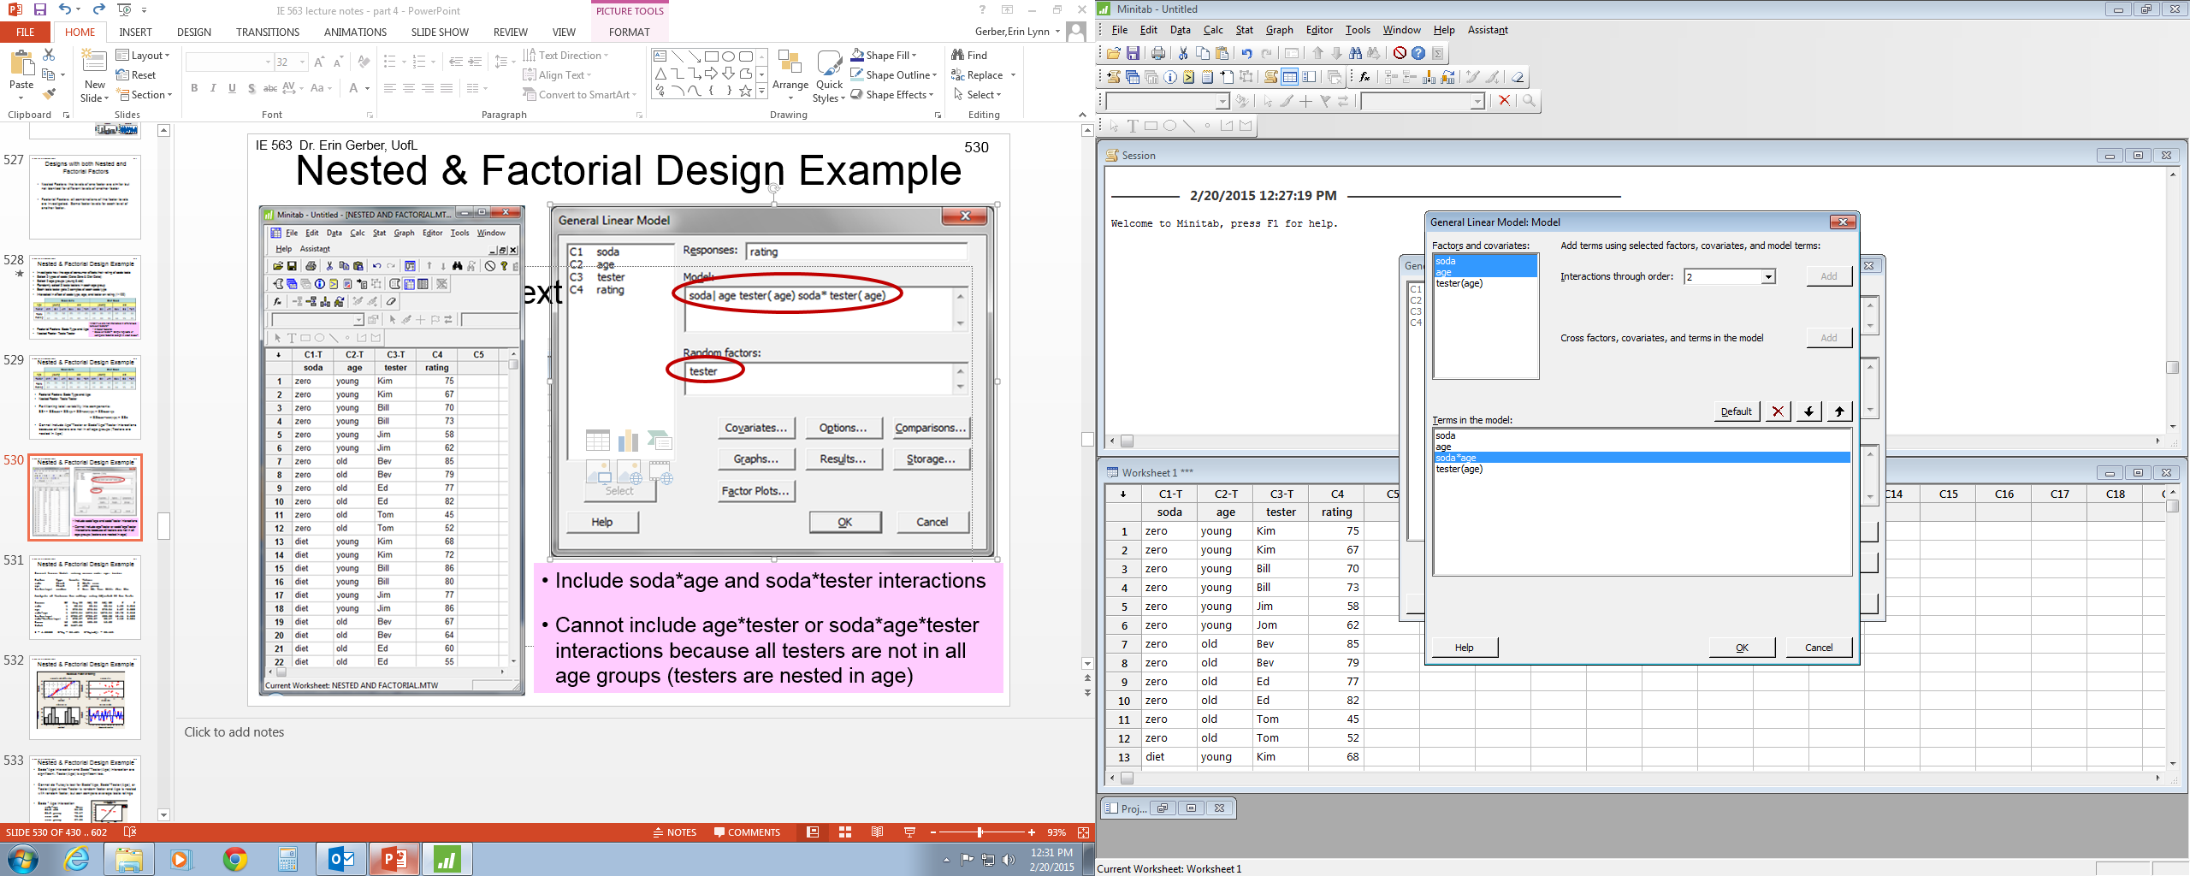
Nested & Factorial Design Example
Include soda*age and soda*tester interactions
Cannot include age*tester or soda*age*tester interactions because all testers are not in all age groups (testers are nested in age)

Slide 241
Nested & Factorial Design Example
General Linear Model: rating versus soda, age, tester
Method
Factor coding (-1, 0, +1)
Factor Information
Factor Type Levels Values
soda Fixed 2 diet, zero
age Fixed 2 old, young
tester(age) Random 6 Bev(old), Ed(old), Tom(old), Bill(young), Jim(young), Kim(young)
Analysis of Variance
Source DF Adj SS Adj MS F-Value P-Value
soda 1 92.04 92.04 1.35 0.310
age 1 876.04 876.04 1.27 0.323
soda*age 1 1276.04 1276.04 18.72 0.012
tester(age) 4 2755.67 688.92 10.11 0.023
soda*tester(age) 4 272.67 68.17 4.18 0.024
Error 12 195.50 16.29
Total 23 5467.96
Model Summary
S R-sq R-sq(adj) R-sq(pred)
4.03629 96.42% 93.15% 85.70%

Slide 242
Nested & Factorial Design Example

Slide 243
Nested & Factorial Design Example
Soda*Age interaction and Soda*Tester(Age) interaction are significant. Tester(Age) is significant too.
Cannot do Tukey’s test for Soda*Age, Soda*Tester(Age), or Tester(Age) since Tester is random factor and Age is nested with random factor, but can compare average taste ratings
Soda * Age interaction
Means
Term Fitted Mean
age*soda
old diet 51.5000
old zero 70.0000
young diet 78.1667
young zero 67.5000
Different age groups prefer different sodas
Old people prefer Coke Zero, young people prefer Diet Coke

Slide 244
Nested & Factorial Design Example
Cannot do Tukey’s test for Soda*Age, Soda*Tester(Age), or Tester(Age) since Tester is random factor and Age is nested with random factor, but can compare average taste ratings
Soda*Tester(Age) interaction
Different testers (within an age group) prefer different sodas
Tester Kim preferred Coke Zero while other young testers preferred Diet Coke
Significant Soda*Tester(Age) interaction could also indicate differences in strength of preference by tester
Ed really prefers Coke Zero while Kim somewhat prefers Coke Zero
soda*tester(age)
diet Bev(old) 65.5000
diet Ed(old) 57.5000
diet Tom(old) 31.5000
zero Bev(old) 82.0000
zero Ed(old) 79.5000
zero Tom(old) 48.5000
diet Bill(young) 83.0000
diet Jim(young) 81.5000
diet Kim(young) 70.0000
zero Bill(young) 71.5000
zero Jim(young) 60.0000
zero Kim(young) 71.0000

Slide 245
Nested & Factorial Design Example
Cannot do Tukey’s test for Soda*Age, Soda*Tester(Age), or Tester(Age) since Tester is random factor and Age is nested with random factor, but can compare average taste ratings
Tester(Age) main effect
Different testers give significantly different average ratings
Tom had lower average ratings than other testers
tester(age)
Bev(old) 73.7500
Ed(old) 68.5000
Tom(old) 40.0000
Bill(young) 77.2500
Jim(young) 70.7500
Kim(young) 70.5000

Slide 246
Split-Plot Designs
Often not practical to conduct factorial design as CRD (completely randomized design)
Limitations can make it inefficient or impossible to conduct CRD
Limitations of time, material, cost, equipment, etc.
Fix level of hard-to-change factor and run all combinations of easy-to-change factor(s). This is a split-plot design.
Cake baking example:
Hard-to-change factor: oven temperature
Easy-to-change factors: # eggs, oil

Slide 247
Split-Plot Designs
Cake baking example:
Response: cake height (mm)
Factors:
oven temp (350ºF, 400ºF)
# eggs (1, 2, 3, 4)
Type of oil (vegetable, canola)
# combinations of factor levels = (2)(4)(2) = 16 = # obs in 1 replicate
To conduct as CRD, would need to change oven temp for each cake
OR could choose an oven temp, then bake several cakes with different combinations of # eggs, oil at the same time.
NOT CRD! This is a split-plot design.
Restriction on randomization

Slide 248
CRD vs Split-Plot
350
350
400
350
400
400
350
350
400
350
350
400
400
350
400
400
1 replicate of completely randomized design (CRD)

Slide 249
CRD vs Split-Plot
350
400
1 replicate of split-plot design
Split-plot design is a restriction on randomization
Hard-to-change factor not completely randomized

Slide 250
Split-Plot Designs
Split-Plot designs started in agricultural industry
Hard-to-change factor: irrigation method or broadcast fertilizer
Applied to large section of land called whole plot
Easy-to-change factor: seed variety
Applied to smaller sections of land obtained by splitting larger section (whole plot) into subplots or split plots
For cake baking example:
Oven temperature is whole plot (hard-to-change factor)
# eggs and oil type are subplots (easy-to-change factors)

Slide 251
Split-Plot Designs
Split-plot designs have one or more of the following characteristics:
The levels of all the factors are not randomly determined and reset for each experimental run. A factor is held at a particular setting/level and then all the combinations of the other factors were run
The size of the experimental unit is not the same for all experimental factors. One factor is applied to a larger unit or group of units made up of combinations of the other factors
Agriculture example: irrigation applied to large sections of land while different seed varieties planted on smaller sections of land
Restriction on random assignment of factor level combinations (i.e. treatments) to the experimental units. Something prohibits assigning the treatments to the units completely randomly

Slide 252
Split-Plot Designs
How the experiment is conducted will influence the statistical analysis
The analysis of the designed experiment directly follows from the way the runs were carried out
Split-plot design is a restriction on randomization
Hard-to-change factor (whole plots) not completely randomized
The restriction on randomization of whole plots will change ANOVA from CRD; error term calculated differently
For split-plot design there are two different error terms: one for the whole plot (hard-to-change) factor and another for the subplot (easy-to-change) factors

Slide 253
Split-Plot Designs
Split-plot design 2 different estimates of error
Two error terms a result of two randomizations that occur when experiment is conducted; one randomization for whole plot factor and another for subplot factors
Need multiple replicates of whole plot factor.
e.g. Each oven temperature needs to be run more than once.
2 different error terms in Split-Plot design
Whole plot error is typically larger than subplot error
Whole plot factor will have fewer replicates and therefore estimated less precisely than subplot factors
If given a choice, experimenter should put the most important factors at the subplot level (not always possible)

Slide 254
Split-Plot Designs
Many different variations of split-plot design
Number of hard-to-change (WP) factors: 1 or multiple
Number of easy-to-change (SP) factors: 1 or multiple
Randomization of hard-to-change (WP) factor levels: completely randomized or blocked
For split-plot designs Minitab cannot automatically calculate WP terms
We have to tell Minitab what to use for WP error
WP error term depends on design

Slide 255
Split-Plot Design 1 WP factor, multiple SP factors, CRD at WP level
General Split-Plot model for 1 WP factor, multiple SP factors, CRD at WP level
Y = WP factor + WP error + SP factors + WP*SP interactions
+ SP*SP interactions + SP error
WP error used to evaluate significance of WP factor
WP error term is WP(WP factor). i.e. WP nested in WP factor
SP error used to evaluate significance of SP factors and WP*SP interactions and SP*SP interactions
To estimate WP error need multiple replicates of whole plot factor

Slide 256
Split-Plot Design
ANOVA table for Split-Plot model for 1 WP factor (A), 2 SP factors (B,C), CRD at WP level
n is # replicates of WP
WP(WP factor) is WP error term. WP nested in WP factor
Source of Variation | df | SS | MS | F
A | a-1 | SS_{A} | MS_{A} | MS_{A} / MS_{WP(A)}
WP(A) | a(n-1) | SS_{WP(A)} | MS_{WP(A)}
B | b-1 | SS_{B} | MS_{B} | MS_{B} / MS_{E}
C | c-1 | SS_{C} | MS_{C} | MS_{C} / MS_{E}
AB | (a-1)(b-1) | SS_{AB} | MS_{AB} | MS_{AB} / MS_{E}
AC | (a-1)(c-1) | SS_{AC} | MS_{AC} | MS_{AC} / MS_{E}
BC | (b-1)(c-1) | SS_{BC} | MS_{BC} | MS_{BC} / MS_{E}
ABC | (a-1)(b-1)(c-1) | SS_{ABC} | MS_{ABC} | MS_{ABC} / MS_{E}
Error | a(n-1)(bc-1) | SS_{E} | MS_{E}
Total | abcn-1 | SS_{T}

Slide 257
Split-Plot Design 1 WP factor, multiple SP factors, CRD at WP level
Cake baking example:
Response: cake height (mm)
3 Factors:
oven temp (350ºF, 400ºF)
# eggs (1, 2, 3, 4)
Type of oil (vegetable, canola)
Set oven to a temp and bake 8 cakes at a time – one cake at each combination of # eggs and oil type.
Repeat for other oven temperatures in random order
Cakes randomly positioned in oven
Use two replicates of the oven temperature factor
32 total cakes; 2 replicates of temp, 4 replicates of # eggs and oil type

Slide 258
Split-Plot Design 1 WP factor, multiple SP factors, CRD at WP level
400
350
350
400
2 replicates of split-plot design, CRD at WP level

Slide 259
Split-Plot Design 1 WP factor, multiple SP factors, CRD at WP level
Characteristic of split-plot design:
Limited randomization
Above data in actual run order
Temp (i.e. WP) levels randomized
Eggs & oil (i.e. SP) levels randomized within each temp (i.e. WP)

Slide 260
Split-Plot Design 1 WP factor, multiple SP factors, CRD at WP level
How to do ANOVA in Minitab for 1WP, CRD at WP level
Need to get Minitab to calculate WP error term
Create new variable, WP, that indicates which whole plot each observation belongs to
Number whole plots sequentially (each WP level & replicate)
In Minitab: >Stat >ANOVA >General Linear Model
Include nested term WP(whole plot factor) in model and designate WP as a Random Factor
WP(whole plot factor) is WP error term
For cake baking example: include WP(temp) in model and WP in GLM Random Factors window
Minitab will recognize the appropriate error term, i.e. WP(whole plot factor), for the WP factor

Slide 261
Split-Plot Design 1 WP factor, multiple SP factors, CRD at WP level
Create new variable, WP, that indicates which whole plot each observation belongs to
Number whole plots sequentially (each WP level & replicate)
Number of WP = (# WP levels)*(# WP replicates)

Slide 262
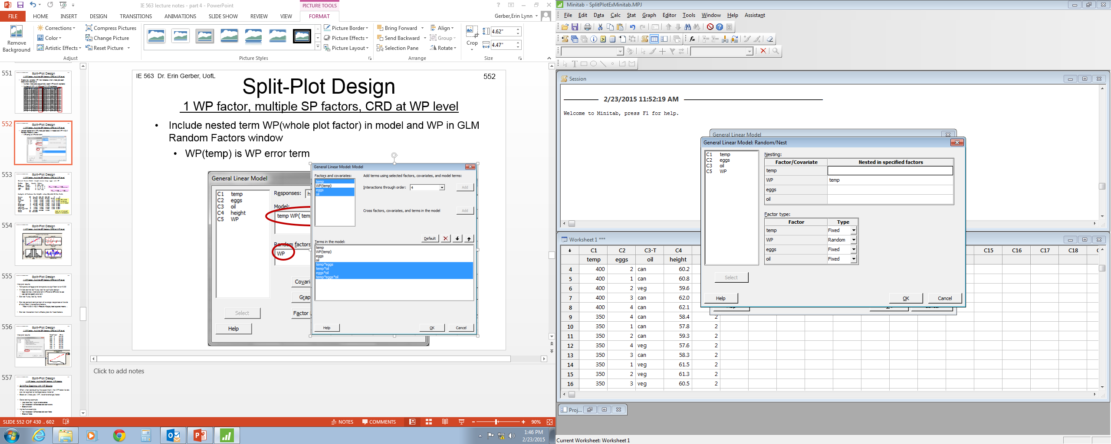
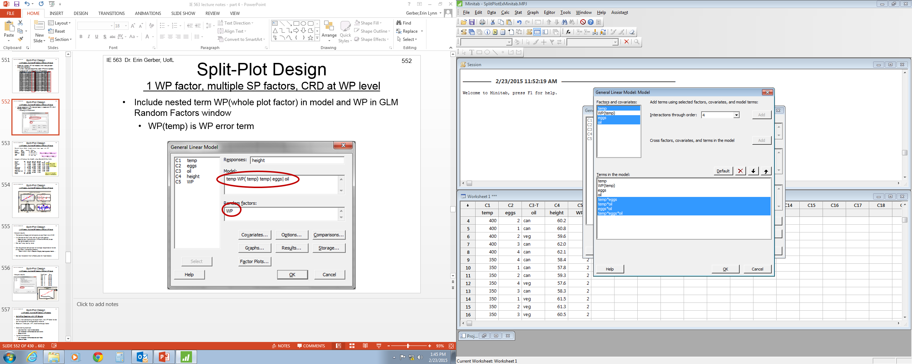
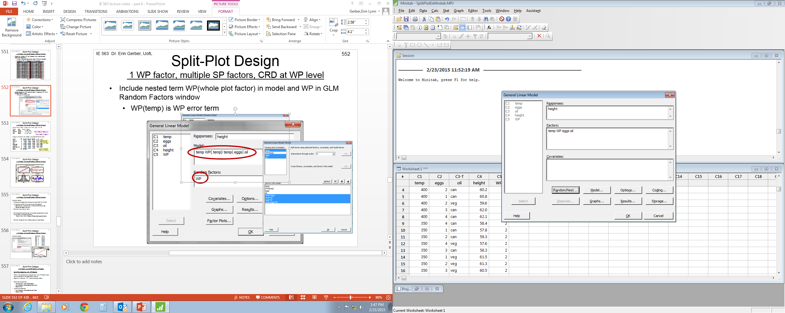
Split-Plot Design 1 WP factor, multiple SP factors, CRD at WP level
Include nested term WP(whole plot factor) in model and WP in GLM Random Factors window
WP(temp) is WP error term

Slide 263
Split-Plot Design 1 WP factor, multiple SP factors, CRD at WP level
General Linear Model: height versus temp, WP, eggs, oil
Method
Factor coding (-1, 0, +1)
Factor Information
Factor Type Levels Values
temp Fixed 2 350, 400
WP(temp) Random 4 2(350), 3(350), 1(400), 4(400)
eggs Fixed 4 1, 2, 3, 4
oil Fixed 2 can, veg
Analysis of Variance
Source DF Adj SS Adj MS F-Value P-Value
temp 1 51.511 51.5113 50.25 0.019
eggs 3 9.001 3.0004 2.14 0.141
oil 1 2.420 2.4200 1.73 0.210
WP(temp) 2 2.050 1.0250 0.73 0.499
temp*eggs 3 23.451 7.8171 5.58 0.010
temp*oil 1 0.405 0.4050 0.29 0.599
eggs*oil 3 1.247 0.4158 0.30 0.827
temp*eggs*oil 3 5.553 1.8508 1.32 0.307
Error 14 19.620 1.4014
Total 31 115.259
F_{temp} = MS _{temp} / MS _{WP(temp)}
F_{other} = MS _{other} / MS _{error}
Only used to test sig. of WP factor
Note: all WP and SP factors in interactions

Slide 264
Split-Plot Design 1 WP factor, multiple SP factors, CRD at WP level

Slide 265
Split-Plot Design 1 WP factor, multiple SP factors, CRD at WP level
Interpret results
Temperature*eggs and temperature significant at α=0.05
Minitab cannot do Tukey test for split-plot design
Does not know which error term (WP error or SP error) to use
User cannot specify error term
Can do Tukey test by hand
Can do general comparison of average responses at levels of significant interactions/factors
>Stat >ANOVA >GLM
> Options > Means > “selection”
> Results >Display least squares means …
Can do interaction/main effects plots for fixed factors

Slide 266
Split-Plot Design 1 WP factor, multiple SP factors, CRD at WP level
temp*eggs Mean
350 1 59.43
350 2 58.93
350 3 59.38
350 4 58.23
400 1 59.82
400 2 60.75
400 3 62.20
400 4 63.33
Interpret results

Slide 267
Split-Plot Design 1 WP factor, multiple SP factors, WP blocks
Split-Plot Designs with WP Blocks
Often when conducting the experiment, the WP factor levels are not applied to homogeneous material
Block on whole plot, WP, (hard-to-change) factor
Cake baking example:
Use more than 1 oven to bake cakes
Not interested in differences between ovens
Block on oven
Agriculture example
Not interested in differences between fields
Block on fields

Slide 268
Split-Plot Design 1 WP factor, multiple SP factors, WP blocks
General Split-Plot model for 1 WP factor, multiple SP factors, WP blocks
Y = WP factor + WP block + WP error + SP factors
+ WP*SP interactions + SP*SP interactions + SP error
WP error used to evaluate significance of WP factor and WP block
WP error term is WP block*WP factor
SP error used to evaluate significance of SP factors and WP*SP interactions and SP*SP interactions
All levels of WP factor appears once per block
Each block has 1 complete replicate (i.e. all combinations) of SP factors at each level of WP factor
Each block has 1 replicate of WP factor, multiple (# WP factor levels) replicates of SP factors

Slide 269
Split-Plot Design
ANOVA table for Split-Plot model for 1 WP factor (A), 2 SP factors (B,C), WP blocks
n blocks. Each block has 1 replicate of WP factor, a replicates of SP factors
WP block*WP factor is WP error term
Variation | df | SS | MS | F
A | a-1 | SS_{A} | MS_{A} | MS_{A} / MS_{block*A}
WP block | n-1 | SS_{block} | MS_{block} | MS_{block} / MS_{block*A}
WP block*A | (a-1)(n-1) | SS_{block*A} | MS_{block*A}
B | b-1 | SS_{B} | MS_{B} | MS_{B} / MS_{E}
C | c-1 | SS_{C} | MS_{C} | MS_{C} / MS_{E}
AB | (a-1)(b-1) | SS_{AB} | MS_{AB} | MS_{AB} / MS_{E}
AC | (a-1)(c-1) | SS_{AC} | MS_{AC} | MS_{AC} / MS_{E}
BC | (b-1)(c-1) | SS_{BC} | MS_{BC} | MS_{BC} / MS_{E}
ABC | (a-1)(b-1)(c-1) | SS_{ABC} | MS_{ABC} | MS_{ABC} / MS_{E}
Error | a(n-1)(bc-1) | SS_{E} | MS_{E}
Total | abcn-1 | SS_{T}

Slide 270
Split-Plot Design 1 WP factor, multiple SP factors, WP blocks
Split-Plot Designs with WP Blocks
Cake baking example:
Response: cake height
3 Factors: oven temp (350ºF, 400ºF), # eggs (1,2,3,4), type of oil (vegetable, canola)
Use 2 ovens. Each oven set to a temp and bake 8 cakes at a time – one cake at each combination of # eggs and oil.
Repeat on each oven for the other temperature
Block on oven
Not interested in differences between ovens
32 total cakes. 2 blocks. Each block includes 1 replicate of temp, 2 replicates of # eggs and oil type

Slide 271
Split-Plot Design 1 WP factor, multiple SP factors, WP blocks
400
350
Oven 1
350
400
Oven 2
2 replicates of split-plot design, WP blocks

Slide 272
Split-Plot Design 1 WP factor, multiple SP factors, WP blocks
Above data in actual run order
Temp (i.e. WP) levels randomized in each oven (i.e. block)
Eggs & oil (i.e. SP) levels randomized within each temp (i.e. WP)

Slide 273
Split-Plot Design 1 WP factor, multiple SP factors, WP blocks
How to do ANOVA in Minitab for 1WP, WP blocks
Need to get Minitab to calculate WP error term
WP error used to test significance of WP factor and WP block
For split-plot design with WP block, WP error is WP block* WP factor term
In Minitab: >Stat >ANOVA >General Linear Model
Include term WP block * WP factor in model and designate WP block as a Random Factor
For cake baking example: include oven*temp in model and oven as a Random Factor
Minitab will recognize the appropriate error term, i.e. WP block*WP factor for the WP factor and WP block

Slide 274
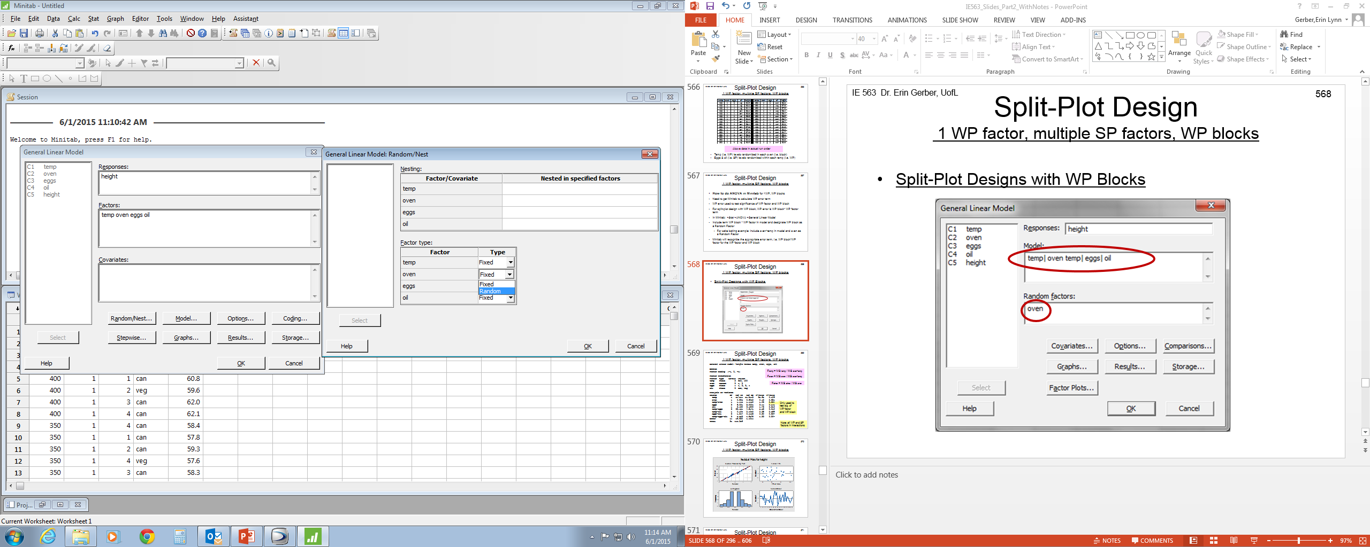
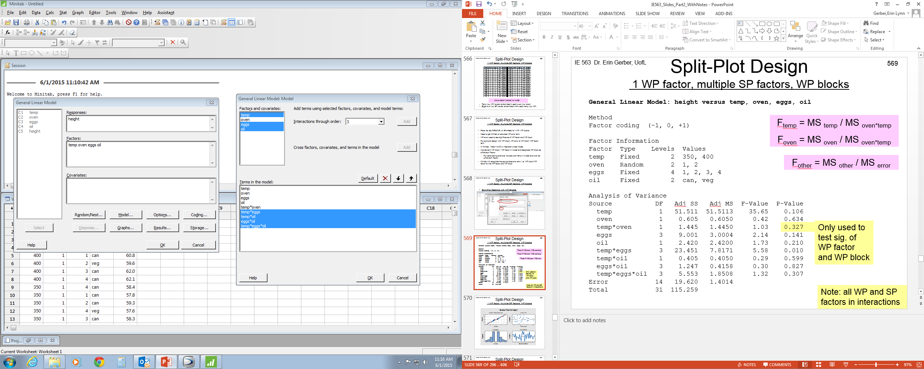
Split-Plot Design 1 WP factor, multiple SP factors, WP blocks
Split-Plot Designs with WP Blocks

Slide 275
Split-Plot Design 1 WP factor, multiple SP factors, WP blocks
General Linear Model: height versus temp, oven, eggs, oil
Method
Factor coding (-1, 0, +1)
Factor Information
Factor Type Levels Values
temp Fixed 2 350, 400
oven Random 2 1, 2
eggs Fixed 4 1, 2, 3, 4
oil Fixed 2 can, veg
Analysis of Variance
Source DF Adj SS Adj MS F-Value P-Value
temp 1 51.511 51.5113 35.65 0.106
oven 1 0.605 0.6050 0.42 0.634
temp*oven 1 1.445 1.4450 1.03 0.327
eggs 3 9.001 3.0004 2.14 0.141
oil 1 2.420 2.4200 1.73 0.210
temp*eggs 3 23.451 7.8171 5.58 0.010
temp*oil 1 0.405 0.4050 0.29 0.599
eggs*oil 3 1.247 0.4158 0.30 0.827
temp*eggs*oil 3 5.553 1.8508 1.32 0.307
Error 14 19.620 1.4014
Total 31 115.259
F_{temp} = MS _{temp} / MS _{oven*temp}
F_{oven} = MS _{oven} / MS _{oven*temp}
F_{other} = MS _{other} / MS _{error}
Only used to test sig. of WP factor and WP block
Note: all WP and SP factors in interactions

Slide 276
Split-Plot Design 1 WP factor, multiple SP factors, WP blocks

Slide 277
Split-Plot Design 1 WP factor, multiple SP factors, WP blocks
Interpret results
Temperature*eggs significant at α=0.05
No significant differences between ovens
Minitab cannot do Tukey test for split-plot design
Can do general comparison of average responses at levels of significant interactions/factors
Can do interaction plot for fixed factors
temp*eggs
350 1 59.4250
350 2 58.9250
350 3 59.3750
350 4 58.2250
400 1 59.8250
400 2 60.7500
400 3 62.2000
400 4 63.3250

Slide 278
Split-Plot Design multiple WP factors, multiple SP factors, CRD at WP level
Split-Plot Designs with Multiple WP
Consider case with more than one hard-to-change factor
Multiple whole plots (WP)
Cake baking example:
Hard-to-change factors: oven temperature and heat type (conventional, convection)
Easy-to-change factors: # eggs and type of oil
Agriculture example
Hard-to-change factors: irrigation method and broadcast fertilizer
Easy-to-change factors: seed variety and time to harvest

Slide 279
Split-Plot Design multiple WP factors, multiple SP factors, CRD at WP level
General Split-Plot model for multiple WP factor, multiple SP factors, CRD at WP level
Y = WP factors + WP*WP interactions + WP error + SP factors
+ WP*SP interactions + SP*SP interactions + SP error
WP error used to evaluate significance of WP factor and WP*WP interactions
WP error term is WP(WP factors). WP nested in all WP factors
SP error used to evaluate significance of SP factors and WP*SP interactions and SP*SP interactions
To estimate WP error need multiple replicates of whole plot factor combinations

Slide 280
ANOVA table for Split-Plot model for 2 WP factor (A,B), 2 SP factors (C,D), CRD at WP level
Variation | df | SS | MS | F
A | a-1 | SS_{A} | MS_{A} | MS_{A} / MS_{WP(AB)}
B | b-1 | SS_{B} | MS_{B} | MS_{B} / MS_{WP(AB)}
AB | (a-1)(b-1) | SS_{AB} | MS_{AB} | MS_{AB} / MS_{WP(AB)}
WP(A B) | ab(n-1) | SS_{WP(AB)} | MS_{WP(AB)}
C | c-1 | SS_{C} | MS_{C} | MS_{C} / MS_{E}
D | d-1 | SS_{D} | MS_{D} | MS_{D} / MS_{E}
AC | (a-1)(c-1) | SS_{AC} | MS_{AC} | MS_{AC} / MS_{E}
AD | (a-1)(d-1) | SS_{AD} | MS_{AD} | MS_{AD} / MS_{E}
BC | (b-1)(c-1) | SS_{BC} | MS_{BC} | MS_{BC} / MS_{E}
BD | (b-1)(d-1) | SS_{BD} | MS_{BD} | MS_{BD} / MS_{E}
CD | (c-1)(d-1) | SS_{CD} | MS_{CD} | MS_{CD} / MS_{E}
ABC | (a-1)(b-1)(c-1) | SS_{ABC} | MS_{ABC} | MS_{ABC} / MS_{E}
ABD | (a-1)(b-1)(d-1) | SS_{ABD} | MS_{ABD} | MS_{ABD} / MS_{E}
BCD | (b-1)(c-1)(d-1) | SS_{BCD} | MS_{BCD} | MS_{BCD} / MS_{E}
ABCD | (a-1)(b-1)(c-1)(d-1) | SS_{ABCD} | MS_{ABCD} | MS_{ABCD} / MS_{E}
Error | ab(n-1)(cd-1) | SS_{E} | MS_{E}
Total | abcdn-1 | SS_{T}
n is # replicates of WP*WP interaction
WP(WP factors) is WP error term. WP nested in all WP factors
WP(A B) is WP error term. WP nested in A and B

Slide 281
Split-Plot Design multiple WP factors, multiple SP factors, CRD at WP level
Cake baking example:
Response: cake height
4 Factors: oven temp (350ºF, 400ºF), heat type (conventional, convection), # eggs (1,2,3,4), type of oil (vegetable, canola)
Each oven set to a temp and heat type. Bake 8 cakes at a time – one cake at each combination of # eggs and oil type
Repeat for other oven temperature/heat type combination in random order
Cakes randomly positioned in oven
Use two replicates for each oven temperature & heat type interaction
64 total cakes; 2 replicates of each temp & heat type combination, 8 replicates of # eggs and oil type

Slide 282
Split-Plot Design multiple WP factors, multiple SP factors, CRD at WP level
350
400
400
400
350
400
350
350
2 replicates of split-plot design, CRD at WP level

Slide 283
Split-Plot Design multiple WP factors, multiple SP factors, CRD at WP level
data in actual run order
Temp and heat type interaction (i.e. WP*WP) levels randomized
Eggs & oil (i.e. SP) levels randomized within each temp and heat type interaction (i.e. WP*WP)

Slide 284
Split-Plot Design multiple WP factors, multiple SP factors, CRD at WP level
How to do ANOVA in Minitab for multiple WP, CRD at WP level
Need to get Minitab to calculate WP error term
Create new variable, WP, that indicates which whole plot each observation belongs to
Number whole plots sequentially (each WP*WP interaction level & replicate)
In Minitab: >Stat >ANOVA >General Linear Model
Include nested term WP(all whole plot factors) in model and WP as GLM Random Factor
WP(all WP factors) is WP error term; Nest all WP factors in WP
For cake baking example: include WP(temp heat) in model and WP as GLM Random Factor

Slide 285
Split-Plot Design multiple WP factors, multiple SP factors, CRD at WP level
Create new variable, WP, that indicates which whole plot each observation belongs to
Number whole plots sequentially (each WP*WP interaction level & replicate)

Slide 286
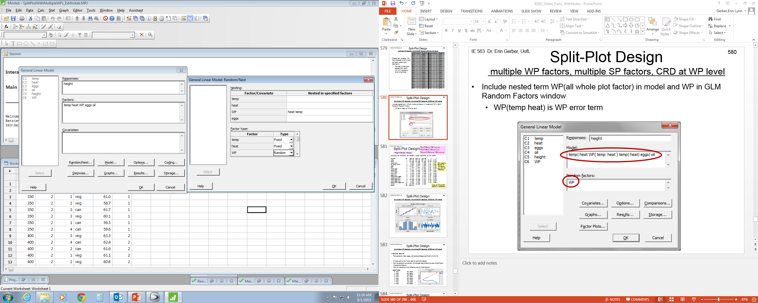
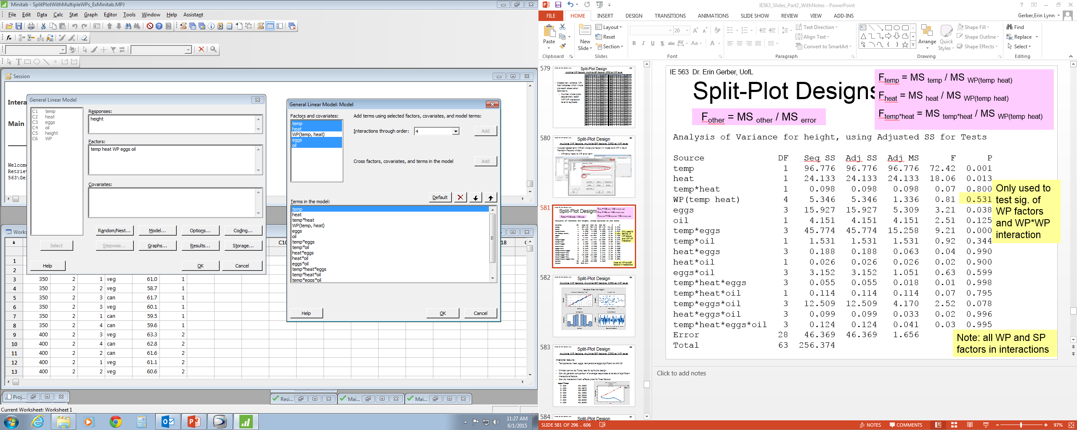
Split-Plot Design multiple WP factors, multiple SP factors, CRD at WP level
Include nested term WP(all whole plot factor) in model and WP in GLM Random Factors window
WP(temp heat) is WP error term

Slide 287
Split-Plot Designs
F_{temp} = MS _{temp} / MS _{WP(temp} _{heat)}
F_{heat} = MS _{heat} / MS _{WP(temp} _{heat)}
F_{temp*heat} = MS _{temp*heat} / MS _{WP(temp} _{heat)}
F_{other} = MS _{other} / MS _{error}
Analysis of Variance for height, using Adjusted SS for Tests
Source DF Seq SS Adj SS Adj MS F P
temp 1 96.776 96.776 96.776 72.42 0.001
heat 1 24.133 24.133 24.133 18.06 0.013
temp*heat 1 0.098 0.098 0.098 0.07 0.800
WP(temp heat) 4 5.346 5.346 1.336 0.81 0.531
eggs 3 15.927 15.927 5.309 3.21 0.038
oil 1 4.151 4.151 4.151 2.51 0.125
temp*eggs 3 45.774 45.774 15.258 9.21 0.000
temp*oil 1 1.531 1.531 1.531 0.92 0.344
heat*eggs 3 0.188 0.188 0.063 0.04 0.990
heat*oil 1 0.026 0.026 0.026 0.02 0.900
eggs*oil 3 3.152 3.152 1.051 0.63 0.599
temp*heat*eggs 3 0.055 0.055 0.018 0.01 0.998
temp*heat*oil 1 0.114 0.114 0.114 0.07 0.795
temp*eggs*oil 3 12.509 12.509 4.170 2.52 0.078
heat*eggs*oil 3 0.099 0.099 0.033 0.02 0.996
temp*heat*eggs*oil 3 0.124 0.124 0.041 0.03 0.995
Error 28 46.369 46.369 1.656
Total 63 256.374
Only used to test sig. of WP factors and WP*WP interaction
Note: all WP and SP factors in interactions

Slide 288
Split-Plot Design multiple WP factors, multiple SP factors, CRD at WP level

Slide 289
Split-Plot Design multiple WP factors, multiple SP factors, CRD at WP level
Interpret results
Temperature, heat, eggs, temperature*eggs significant at α=0.05
Minitab cannot do Tukey test for split-plot design
Can do general comparison of average responses at levels of significant interactions/factors
Can do interaction/main effects plots for fixed factors
eggs*temp
1 350 60.0625
1 400 60.3875
2 350 59.6250
2 400 61.4625
3 350 60.0250
3 400 62.7000
4 350 58.8500
4 400 63.8500

Slide 290
Split-Plot Design multiple WP factors, multiple SP factors, CRD at WP level
Interpret results
Temperature, heat, eggs, temperature*eggs significant at α=0.05
heat
1 60.2562
2 61.4844

Slide 291
Easy Split-Plot Design in Minitab
Minitab can easily do split-plot analysis for special case of factorial design; when all factors have 2 levels
Cake baking example:
Response: cake height
4 Factors: oven temp (350ºF, 400ºF), heat type (conventional, convection), # eggs (1,4), type of oil (vegetable, canola)
Each oven set to a temp and heat type. Bake 4 cakes at a time – one cake at each combination of # eggs and oil type
Repeat for other oven temperature/heat type combination in random order
Use two replicates for each oven temperature & heat type interaction
32 total cakes; 2 replicates of each temp & heat type combination, 8 replicates of # eggs and oil type
multiple WP factors, multiple SP factors, CRD at WP level
Y = WP factors + WP*WP interactions + WP error + SP factors
+ WP*SP interactions + SP*SP interactions + SP error

Slide 292
Easy Split-Plot Design in Minitab multiple WP factors, multiple SP factors, CRD at WP level
Minitab can do split-plot analysis for special case of factorial design; when all factors have 2 levels
Stat
DOE
Factorial
Create Factorial Design
2-level split-plot
In >Stat >DOE
First ‘Create Factorial Design’
Enter responses
Then ‘Analyze Factorial Design’

Slide 293
Easy Split-Plot Design in Minitab multiple WP factors, multiple SP factors, CRD at WP level
Factor levels are coded (-1, 1)
Can use ‘Factors’ to enter actual levels (350, 400, conventional, convection, etc.)
Factors A and B are WP (HTC)
Factors C and D are SP (ETC)
Enter response in column C10
A | Temp
B | Heat
C | # Eggs
D | Oil

Slide 294
Easy Split-Plot Design in Minitab multiple WP factors, multiple SP factors, CRD at WP level
Stat
DOE
Factorial
Analyze Factorial Design

Slide 295
Easy Split-Plot Design in Minitab multiple WP factors, multiple SP factors, CRD at WP level
Analysis of Variance for height (coded units)
Source DF Seq SS Adj SS Adj MS F P
A[HTC] 1 56.711 56.7112 56.7112 165.28 0.000
B[HTC] 1 11.045 11.0450 11.0450 32.19 0.005
A[HTC]*B[HTC] 1 0.061 0.0612 0.0612 0.18 0.694
WP Error 4 1.373 1.3725 0.3431 0.38 0.821
C 1 10.125 10.1250 10.1250 11.13 0.006
D 1 5.281 5.2813 5.2813 5.80 0.033
A[HTC]*C 1 43.711 43.7112 43.7112 48.05 0.000
A[HTC]*D 1 0.720 0.7200 0.7200 0.79 0.391
B[HTC]*C 1 0.005 0.0050 0.0050 0.01 0.942
B[HTC]*D 1 0.011 0.0113 0.0113 0.01 0.913
C*D 1 0.361 0.3612 0.3612 0.40 0.540
A[HTC]*B[HTC]*C 1 0.001 0.0012 0.0012 0.00 0.971
A[HTC]*B[HTC]*D 1 0.125 0.1250 0.1250 0.14 0.717
A[HTC]*C*D 1 12.500 12.5000 12.5000 13.74 0.003
B[HTC]*C*D 1 0.001 0.0012 0.0012 0.00 0.971
A[HTC]*B[HTC]*C*D 1 0.045 0.0450 0.0450 0.05 0.828
SP Error 12 10.918 10.9175 0.9098
Total 31 152.995

Slide 296
Easy Split-Plot Design in Minitab 1 WP factor, multiple SP factors, WP blocks
When all factors have 2 levels, easy analysis in Minitab
Cake baking example:
Response: cake height
4 Factors: oven temp (350ºF, 400ºF), # eggs (2, 3), Type of flour (bleached, unbleached), Type of oil (vegetable, canola)
Use 2 ovens. Each oven set to a temp and bake 8 cakes at a time – one cake at each combination of # eggs, flour type, and oil type.
Repeat on each oven for the other temperature
Block on oven
Not interested in differences between ovens
32 total cakes. 2 blocks. Each block includes 1 replicate of temp, 2 replicates of # eggs, flour type and oil type

Slide 297
Easy Split-Plot Design in Minitab 1 WP factor, multiple SP factors, WP blocks
Stat
DOE
Factorial
Create design
# SP replicates in each WP

Slide 298
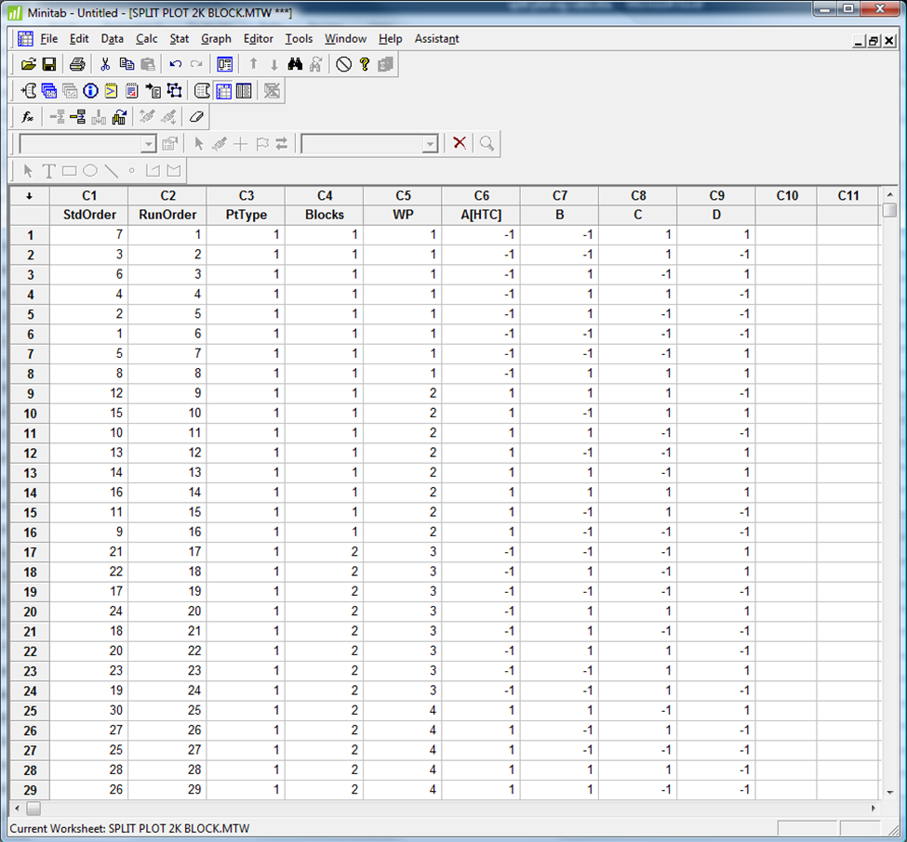
Easy Split-Plot Design in Minitab 1 WP factor, multiple SP factors, WP blocks
Randomized order

Slide 299
Easy Split-Plot Design in Minitab 1 WP factor, multiple SP factors, WP blocks
In same randomized order as Minitab worksheet

Slide 300
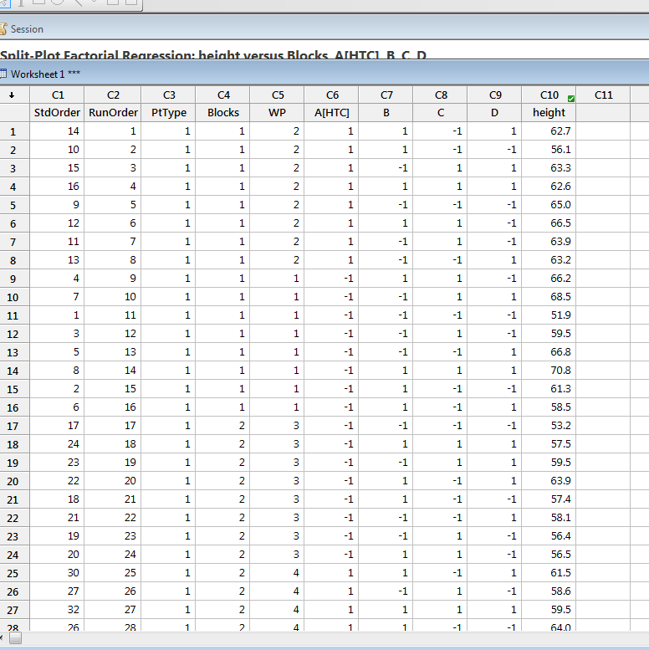
Easy Split-Plot Design in Minitab 1 WP factor, multiple SP factors, WP blocks
Randomized order

Slide 301
Easy Split-Plot Design in Minitab 1 WP factor, multiple SP factors, WP blocks
Stat
DOE
Factorial
Analyze factorial design
Select ‘Four in one residual plot’

Slide 302
Easy Split-Plot Design in Minitab 1 WP factor, multiple SP factors, WP blocks
Analysis of Variance for height (coded units)
Source DF Seq SS Adj SS Adj MS F P
Block 1 27.380 27.380 27.3800 0.32 0.671
A[HTC] 1 85.805 85.805 85.8050 1.02 0.498
WP Error 1 84.500 84.500 84.5000 6.78 0.021
B 1 45.601 45.601 45.6013 3.66 0.077
C 1 41.405 41.405 41.4050 3.32 0.090
D 1 76.261 76.261 76.2613 6.11 0.027
A[HTC]*B 1 1.051 1.051 1.0512 0.08 0.776
A[HTC]*C 1 78.125 78.125 78.1250 6.26 0.025
A[HTC]*D 1 62.161 62.161 62.1613 4.98 0.042
B*C 1 27.751 27.751 27.7512 2.23 0.158
B*D 1 2.880 2.880 2.8800 0.23 0.638
C*D 1 43.711 43.711 43.7113 3.50 0.082
A[HTC]*B*C 1 0.151 0.151 0.1513 0.01 0.914
A[HTC]*B*D 1 0.720 0.720 0.7200 0.06 0.814
A[HTC]*C*D 1 2.761 2.761 2.7612 0.22 0.645
B*C*D 1 7.220 7.220 7.2200 0.58 0.459
A[HTC]*B*C*D 1 0.005 0.005 0.0050 0.00 0.984
SP Error 14 174.610 174.610 12.4721
Total 31 762.100
Remember WP error is block*A

Slide 303
Easy Split-Plot Design in Minitab 1 WP factor, multiple SP factors, WP blocks

Slide 304
Easy Split-Plot Design in Minitab 1 WP factor, multiple SP factors, WP blocks
No 3-way or 4-way interactions significant
Display model with only main effects & 2-way interactions
Stat
DOE
Factorial
Analyze factorial design
Terms

Slide 305
Easy Split-Plot Design in Minitab 1 WP factor, multiple SP factors, WP blocks
A | Temp
B | Eggs
C | Flour
D | Oil
Analysis of Variance for height (coded units)
Source DF Seq SS Adj SS Adj MS F P
Block 1 27.380 27.380 27.380 0.32 0.671
A[HTC] 1 85.805 85.805 85.805 1.02 0.498
WP Error 1 84.500 84.500 84.500 8.66 0.008
B 1 45.601 45.601 45.601 4.67 0.044
C 1 41.405 41.405 41.405 4.24 0.053
D 1 76.261 76.261 76.261 7.81 0.012
A[HTC]*B 1 1.051 1.051 1.051 0.11 0.746
A[HTC]*C 1 78.125 78.125 78.125 8.00 0.011
A[HTC]*D 1 62.161 62.161 62.161 6.37 0.021
B*C 1 27.751 27.751 27.751 2.84 0.108
B*D 1 2.880 2.880 2.880 0.30 0.593
C*D 1 43.711 43.711 43.711 4.48 0.048
SP Error 19 185.468 185.468 9.761
Total 31 762.100
Remember WP error is block*A

Slide 306
Easy Split-Plot Design in Minitab 1 WP factor, multiple SP factors, WP blocks

Slide 307
Easy Split-Plot Design in Minitab 1 WP factor, multiple SP factors, WP blocks
A | Temp
B | Eggs
C | Flour
D | Oil
Interpret results
CD, AD, AC, B, D significant at α=0.05 (C barely not sig)
Minitab cannot do Tukey test for split-plot design
Does not know which error term (WP error or SP error) to use
User cannot specify error term
Can do Tukey test by hand
Can do general comparison of average responses at levels of significant interactions/factors
>Stat >DOE >Factorial >Analyze Factorial Design
> Options > Means > “selection”

Slide 308
Easy Split-Plot Design in Minitab 1 WP factor, multiple SP factors, WP blocks
Mean SE Mean
B
-1 60.81 1.716
1 63.19 1.716
A[HTC]*C
-1 -1 60.79 2.427
1 -1 60.94 2.427
-1 1 59.94 2.427
1 1 66.34 2.427
A[HTC]*D
-1 -1 60.21 2.427
1 -1 60.70 2.427
-1 1 60.51 2.427
1 1 66.57 2.427
C*D
-1 -1 60.49 1.886
1 -1 60.42 1.886
-1 1 61.24 1.886
1 1 65.85 1.886
Interpret results
A | Temp
B | Eggs
C | Flour
D | Oil

Slide 309
HW#6 here
Due date =
Unless otherwise stated, you may use Minitab to do HW assignments
If submitting HW electronically, submit one (1) file only !!!
Can copy Minitab output and paste into MS Word. Use ‘Courier New’ font when pasting Minitab output in MS Word.
Indicate where the answer is located in Minitab output (circle, highlight, etc.)
Data sets can be copied from assignment document and pasted into Excel or Minitab. Some data sets may need to be rearranged before conducting an analysis in Minitab

Slide 310
Test #2
Test #2 date:
Closed Book
1 page (8.5”x11”) notes. You may write on both sides of the page
Bring a calculator
All relevant statistical tables will be provided
Z, t, F, χ², q (tukey test)
No sharing of materials during test
No laptops
No statistical software

Slide 311
Topics on Test #2
Covers Chpt.s 4,5,10,13; HWs #4, 5, & 6
Randomized Block Designs
Factorial Designs
Two-Factor ANOVA
3+ Factor ANOVA
Multiple comparisons
Main Effects and Interaction plots
Tukey Test
Factorial Designs with Blocking
Nested Design
Split-Plot Designs
Multiple Linear Regression
Best Subsets
Indicator Variables
Residual Analysis
ANOVA
Regression
p-value

Slide 312
Experimental Designs
We have discussed the following designs:
Completely randomized single factor
Single factor with completely randomized block
Full factorial design
Factorial design with completely randomized block
Nested Factor Design
Split-plot Design
Other common multiple factor designs:
2^{k} factorial design
Fractional factorial design

